Slide 1
Analysis of the Gene Expression Profiles of Oxidative Stress Tolerant Genes in Newly Developed Rubber (Hevea brasiliensis) Genotypes
REH Lenora¹, SP Withanage² and PWM Tharindi¹
¹ Department of Export Agriculture, Faculty of Agricultural Sciences, Sabaragamuwa University of Sri Lanka.
² Department of Genetics and Plant Breeding, Rubber Research Institute of Sri Lanka, Substation Niwithigala Kale, Mathugama, Sri Lanka.

Slide 2
Content for the presentation
Introduction
Problem statement
Objectives
Methodology
Results and Discussion
Conclusions and Recommendations
References
Acknowledgement

Slide 3
Introduction
Scientific name: Hevea brasiliensis
Family: Euphorbiaceae
Perennial crop
Important export agricultural plantation crop
To obtain natural latex
Laticifers:
Cells of phloem which produce latex
Tendency of being exposed to oxidative stress

Slide 4
Problem statement
ROS scavenging enzymes/ antioxidants (APX,GPX,CAT,SOD,GR)
Oxidative/ abiotic stress
Annual yield loss
(15% -20%)
Production of Reactive Oxygen Species (ROS)
Expression of the responsible genes for antioxidants
Tapping Panel Dryness (TPD)
Over accumulation of ROS
Early screening of vigorous plants

Slide 5
Objectives
To evaluate the expression levels of CAT (Catalase) and GPX (Glutathione Peroxidase) genes of selected Hevea genotypes under low soil moisture status
To quantify the expression of selected genes to utilize as a marker in early selection of drought-tolerant genotypes

Slide 6
Methodology
Selection of planting material
RNA extraction
Agarose gel electrophoresis to visualize RNA
Preliminary trials to determine annealing temperatures
cDNA synthesis
Quantitative PCR for gene expression analysis

Slide 7
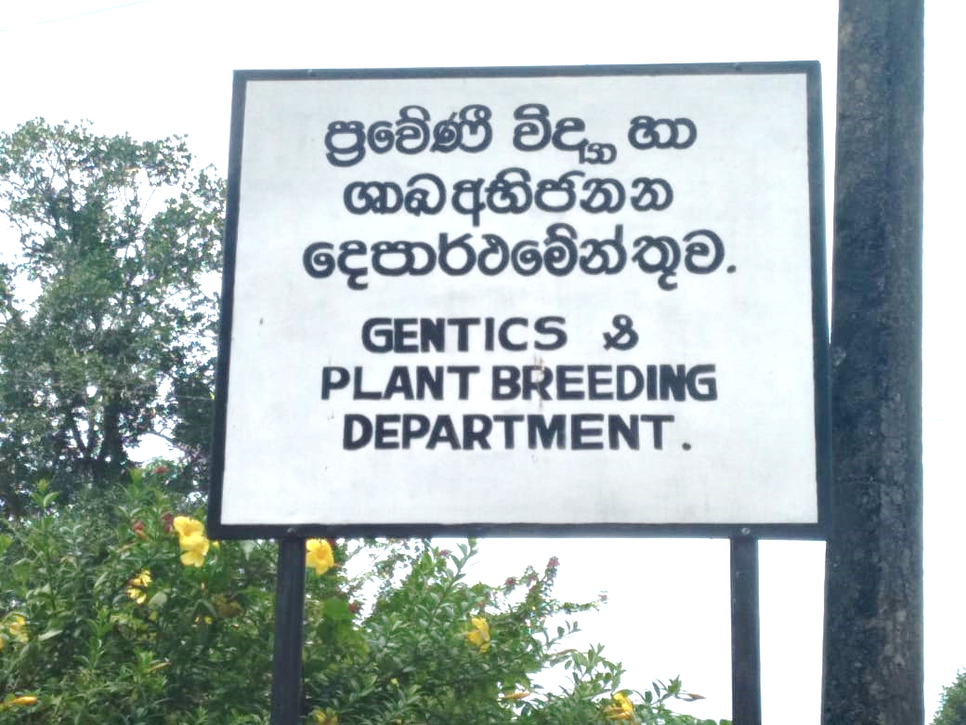
Experimental location
Department of Genetics and Plant Breeding (DGPB)
Rubber Research Institute of Sri Lanka (RRISL)
Substation Niwithigala Kale
Mathugama

Slide 8
Selection of planting material
Materials:
2011 HP 42
2011 HP 202
2011 HP 297
2011 HP 300
RRISL 2006 (control clone)
From 2011 Hand Pollination (HP) program, planted in 2018 at Eladuwa estate as an Estate Collaborative Trial (ECT)

Slide 9
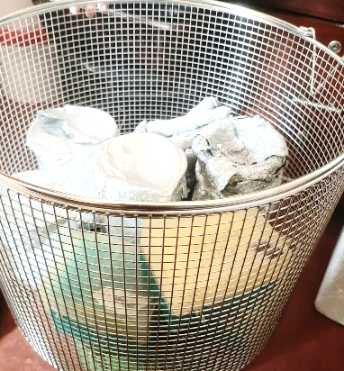
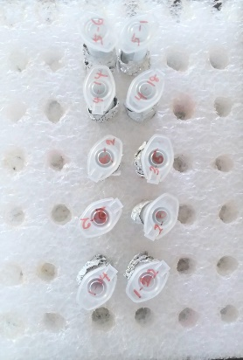
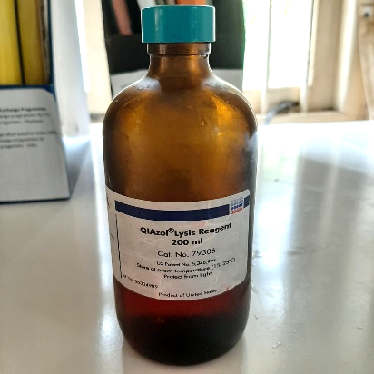
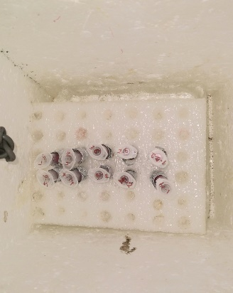
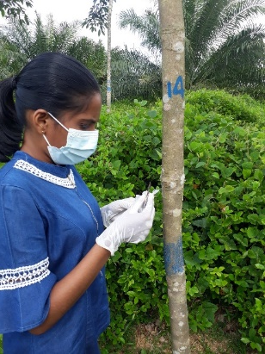
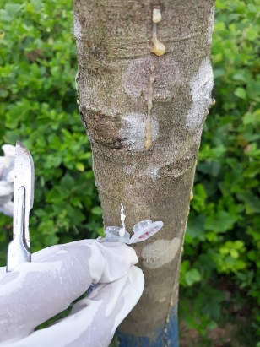
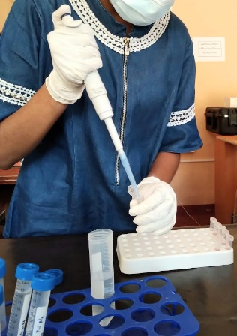
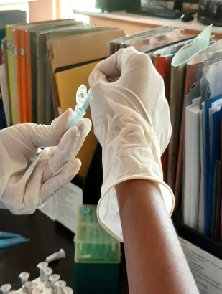
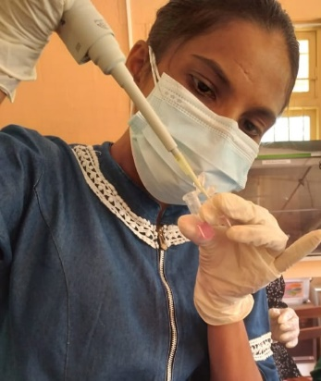
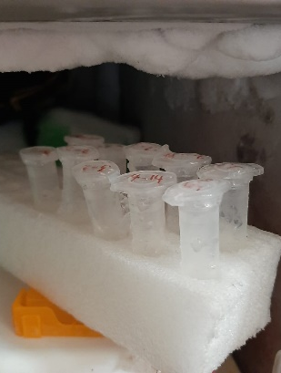
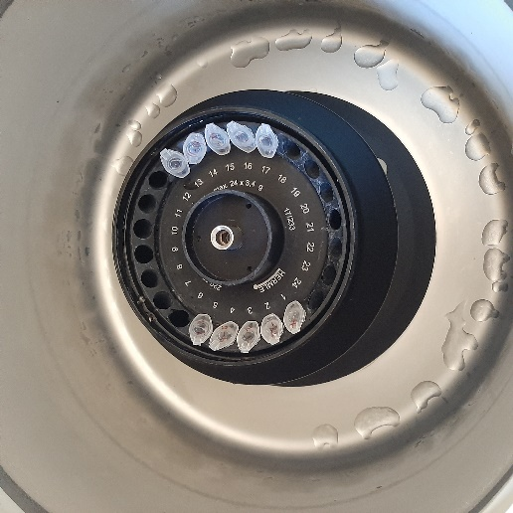
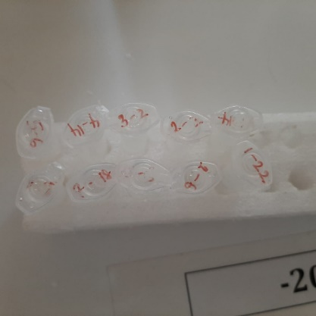
RNA extraction - TRizolTM Method
(Gunasekara et al., 2020)
Autoclave the tools
Cover with Al foil land label
Fill with TRizolTM
Carry in ice bucket
Applying a cut on bark
Obtain latex
Add chloroform
Incubate at room temperature
Separate supernatant
Centrifuge
Incubate at -20 ℃
Crushing

Slide 10
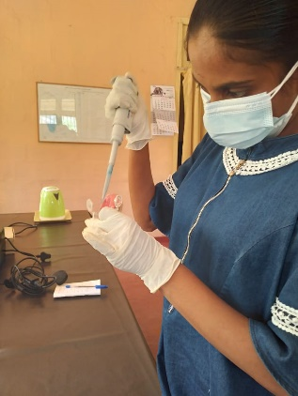
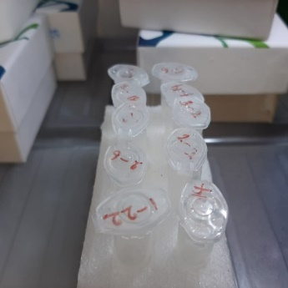
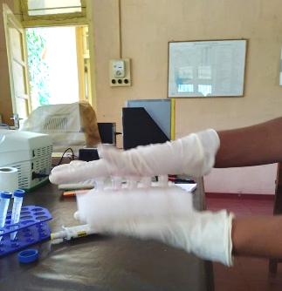
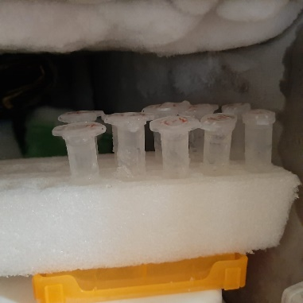
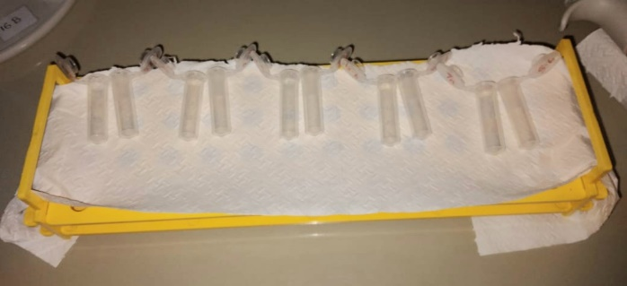
RNA extraction cont.
Shake upside down
Incubate at room temperature and centrifuge
Separate supernatant, add isopropanol
Incubate at 4 ℃ and centrifuge
Add nuclease free water to air dried pellet and store at
-20 ℃
Remove supernatant and air dry the pellet
Remove supernatant, add 75% ethanol and centrifuge
Remove supernatant, add 95% ethanol and centrifuge

Slide 11
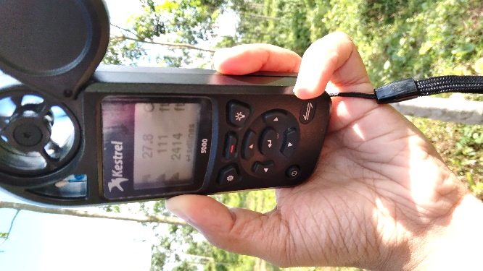
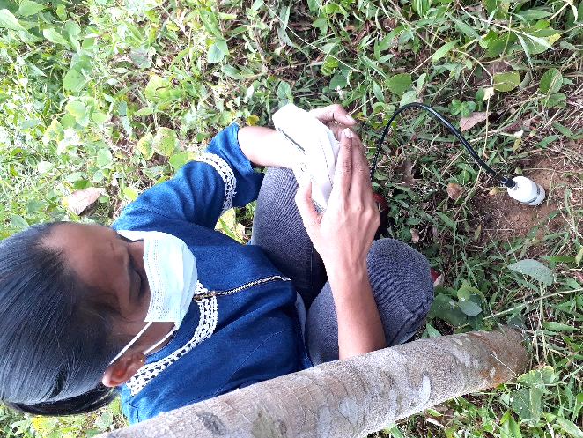
Measuring of soil moisture, weather parameters at the moment of latex collection
Measuring weather parameters with
Kestrel™ portable weather meter
Measuring soil moisture with
ΔT HH2™ moisture meter

Slide 12
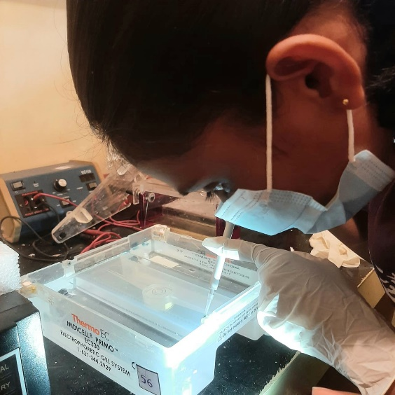
Agarose gel electrophoresis to visualize RNA
1.2 g of Agarose
100 ml of 1x TBE buffer
Stained with Ethidium bromide
67 V for 45 minutes
3 µl of sample with 1 µl of loading dye

Slide 13
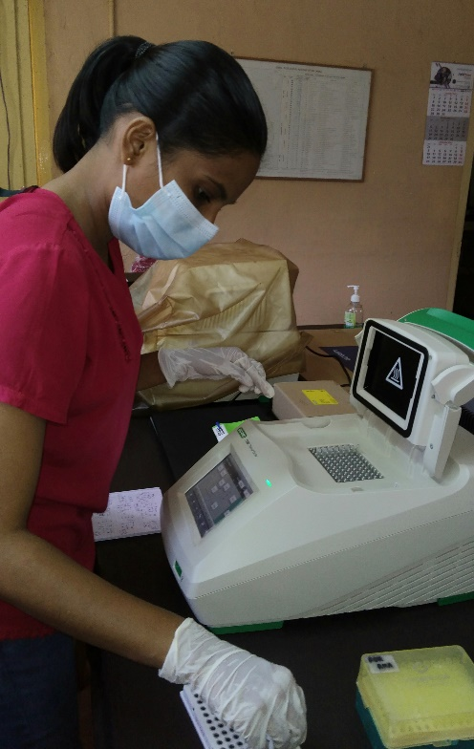
Preliminary trials to determine annealing temperatures of target genes
PCR master mix
DreamTaqTM Green buffer 2.5 µl
dNTPs 0.3 µl
Forward primer 1.0 µl
Reverse primer 1.0 µl
DreamTaqTM DNA polymerase 0.1 µl
DNA template 2.0 µl
Nuclease free water 13.1 µl

Slide 14
Protocol for gradient PCR
Pre denaturation 94 ℃ 04 minutes
Denaturation 94 ℃ 30 seconds
Annealing (Temperature gradient) 45 seconds
Extension 72 ℃ 01 minute
Incubation 72 ℃ 04 minutes
Infinite step 4 ℃
Temperature gradient for CAT gene
50 ℃, 50.5 ℃, 51.3 ℃, 52.7 ℃, 54.3 ℃, 55.6 ℃, 56.5 ℃, 57 ℃
Temperature gradient for GPX gene
58 ℃, 58.7 ℃, 59.6 ℃, 60.8 ℃, 62.4 ℃, 63.7 ℃, 64.5 ℃, 65 ℃

Slide 15
cDNA synthesis
cDNA master mix
10x RT buffer 2 µl
25x dNTP mix (100 mM) 0.8 µl
10x RT random primers 2 µl
MultiScribeTM reverse transcriptase 1 µl
RNA 10 µl
Nuclease free water 4.2 µl

Slide 16
cDNA synthesis cont.
Protocol for cDNA synthesis
First incubation at 25 ℃ for 10 minutes
Second incubation at 37 ℃ for 120 minutes
Annealing at 85 ℃ for 5 minutes
Infinity hold step at 4 ℃

Slide 17
Primers used in the PCR experiments
Commercially available (macrogen™) CATALASE, HbGPX2016 and GAPDH primers were used.
Gene | Base sequence
CAT GPX GAPDH | Forward 5’ TCT CCT TTT CAA TGA CGC ACT TC 3’ Reverse 5’ GCT GAG AGA ACC CCA CTT CCT 3’ Forward 5’ GAT AAG ATC GAG GTA AAT GGG 3’ Reverse 5’ ATC GCT CCA CAA CCT TTC 3’ Forward 5’ GCC TGT GAT AGT CTT CGG TGT TAG 3’ Reverse 5’ GCC TTA TCC TTG TCA GTG AAC 3’

Slide 18
Quantitative PCR (qPCR) for gene expression analysis
Master mix
EvaGreenTM qPCR Mix Plus buffer 2 µl
10nM forward primer 0.3 µl
10nM reverse primer 0.3 µl
First-strand cDNA 2 µl
Nuclease-free water 5.4 µl

Slide 19
Results and Discussion
23+4% moisture content is the optimum condition
(Matan and Kyokong, 2003)

Slide 20
Weather parameters
Parameter | Reading
Wind speed | 3.6 km/h
Temperature | 31.4 ℃
Relative Humidity | 77.6 %
Altitude | 33.83 m
Optimum conditions
Temperature - 23 ℃ - 28 ℃
Relative Humidity - 80%
Altitude - < 200 m above sea level
(Kudaligama et al., 2010)

Slide 21
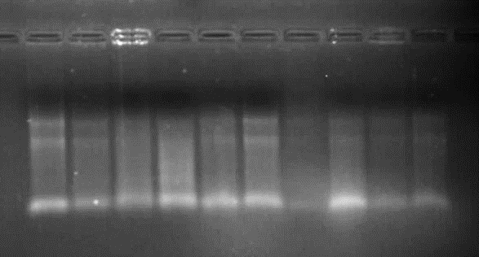
RNA visualization
2011 2011 2011 2011 2011 2011 2011 2011 RRISL RRISL
HP 42 HP 42 HP 202 HP 202 HP 297 HP 297 HP 300 HP 300 2006 2006

Slide 22
Gradient PCR test for CAT gene
200 bp
100 bp

Slide 23
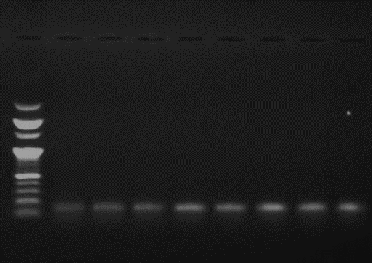
Gradient PCR test for GPX gene
100 bp 65 ℃ 64.5 ℃ 63.7 ℃ 62.4 ℃ 60.8 ℃ 59.6 ℃ 58.7 ℃ 58 ℃
ladder
200 bp
100 bp

Slide 24
PCR test for confirmation of annealing temperatures
100 bp ladder
PCR product of CAT gene at 52.7 ℃
PCR product of GPX gene at 60.8 ℃
PCR product of GAPDH gene at 52.7 ℃
PCR product of GAPDH gene at 60.8 ℃
300 bp
200 bp
100 bp

Slide 25
Data analysis of qPCR experiment
2^{-ΔΔC}_{T} method (Livak and Schmittgen, 2001)
ΔC_{T} _{Treatment} = C_{T} _{Treatment} _{Target gene} – C_{T} _{Treatment} _{Housekeeping gene}
ΔC_{T} _{Control} = C_{T} _{Control Target gene} – C_{T} _{Control Housekeeping gene}
ΔΔC_{T} = ΔC_{T} _{Treatment} – ΔC_{T} _{Control}
Fold difference = 2^{-ΔΔC}_{T}
Where;
C_{T} – Cycle Threshold value
If;
Fold difference > 0 up regulated
Fold difference < 0 down regulated

Slide 26
Fold difference of CAT gene expression according to
quantification data

Slide 27
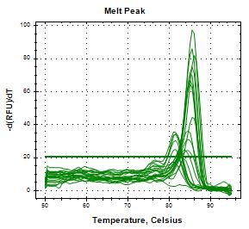
Melt peak obtained from qPCR test for CAT gene with GAPDH gene
Peak of CAT gene
Peak of GAPDH gene

Slide 28
Fold difference of GPX gene expression according
to quantification data

Slide 29
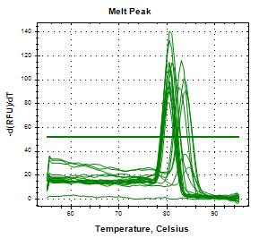
Melt peak obtained from qPCR test for GPX gene
with GAPDH gene
Peak of GPX gene
Peak of GAPDH gene

Slide 30
Conclusions and Recommendations
Both CAT and GPX genes were upregulated in selected four genotypes
According to the obtained results the four genotypes can be considered as less susceptible for TPD incidence and having self-recovering ability related to tapping panel dryness disorder in molecular basis
Analyzing same genotypes for other genes (APX, SOD, GR) responsible for detoxification of ROS will strengthen obtained results
Analyzing the genes under different TPD levels can be done as further studies

Slide 31
References
Amarasekara, I.N., Withanage, S.P. and Palihakkara, I.R., 2020. Quantitative gene expression analysis of selected genes to screen drought tolerance of selected Hevea Clones. International Journal for Research in Applied Sciences and Biotechnology, 7(6), pp.46-53.
Bandara, P.K.G.S.S., Perera, L.H., Kumara, J.B.D.A. and Dissanayake, P.K., 2017. Superoxide Dismutase Gene Might Play a Major Role in Tapping Panel Dryness of Rubber (Hevea brasiliensis Muell. Arg.).
Edwards, K.J., 2004. Performing real-time PCR. real-time PCR an essential guide. Horizon bioscience, Norfolk.
Gunasekara, S.D.T.S., Palihakkara, I.R. and Withanage, S.P., 2020. Study toward the development of relationship between Ref gene expression and yield potential of Hevea clones. International Journal for Research in Applied Sciences and Biotechnology (IJRASB), 7(5), pp.98-105.
Kudaligama, K.K., Rodrigo, V.H.L., Fernando, K.M.E.P. and Yapa, P.A.J., 2010. Response of low frequency harvesting systems of rubber under drier climatic conditions in Sri Lanka. In Proceedings of International Forestry and Environment Symposium (Vol. 15).
Livak, K.J. and Schmittgen, T.D., 2001. Analysis of relative gene expression data using real-time quantitative PCR and the 2^{− ΔΔC}T method. Methods, 25(4), pp.402-408.
Matan, N. and Kyokong, B., 2003. Effect of moisture content on some physical and mechanical properties of juvenile rubberwood (Hevea brasiliensis Muell. Arg.). Songklanakarin Journal of Science and Technology, 25(3), pp.327-340.
Zhang, Y., 2018. Identification of genes involved in the production and scavenging of reactive oxygen species in Hevea brasiliensis and their characterizations in latex.
Zhang, Y., Leclercq, J. and Montoro, P., 2016. Reactive oxygen species in Hevea brasiliensis latex and relevance to Tapping Panel Dryness. Tree physiology, 37(2), pp.261-269.

Slide 32
Acknowledgment
Organizers of AgSURS 2023
Dr. S. P. Withanage, Head of the Department, Department of Genetics and Plant Breeding, Rubber Research Institute of Sri Lanka, Substation Niwithigala Kale, Mathugama.
Ms. P. W. M. Tharindi, Lecturer (Probationary), Department of Export Agriculture, Faculty of Agricultural Sciences, Sabaragamuwa University of Sri Lanka, Belihuloya, Sri Lanka.
Research officers, Experimental officers, Technical officers, Research assistants and other staff members from Department of Genetics and Plant Breeding, Rubber Research Institute of Sri Lanka, Substation Niwithigala Kale, Mathugama.
Parents and friends

