Slide 1
Study of the variation of Piperine and Essential oil composition in Ceylon black pepper (Piper nigrum) with different geographical conditions in Sri Lanka.
MM Dikmadugoda¹, WMAUKM Wijesekara ¹, UALP Kumara²
¹ Department of Export Agriculture, Faculty of Agricultural Sciences, Sabaragamuwa University of
Sri Lanka, Belihuloya.
² Samagi Organics (Pvt) Ltd, Akuressa, Sri Lanka

Slide 2
Content for the presentation
Introduction
Objectives
Material and Methods
Results and Discussion
Conclusion and Recommendations
References

Slide 3
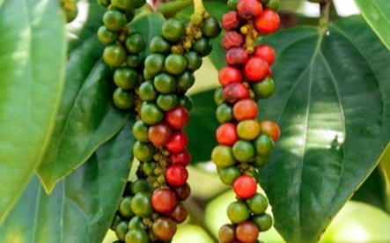
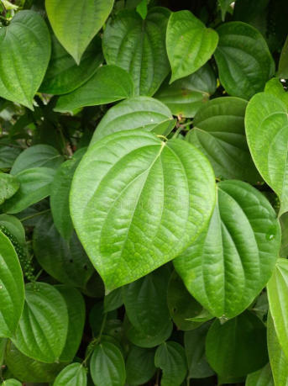
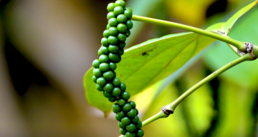
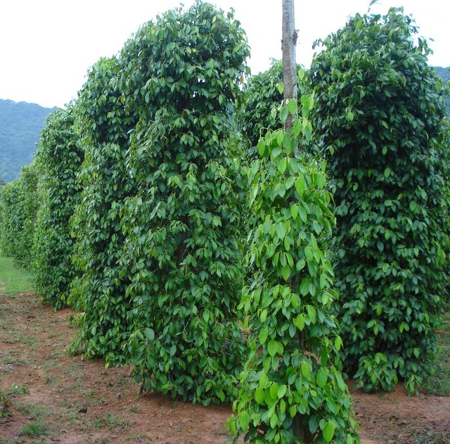
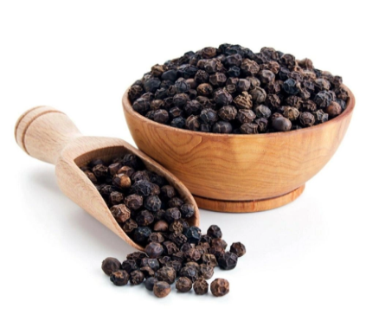
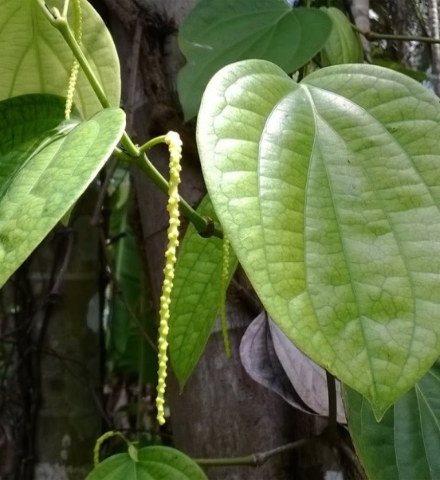
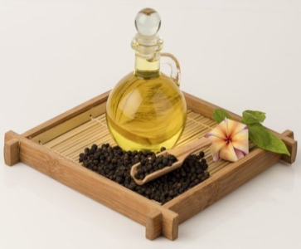
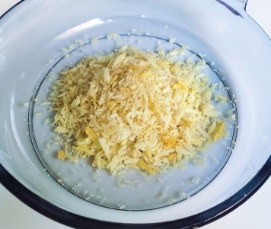
Introduction
Essential oil
Piperine

Slide 4
Objectives
Main objective
To analyze the piperine and essential oil content of black pepper in central, uwa and southern provinces and to study the variation of piperine and essential oil composition in Ceylon black pepper (Piper nigrum) with different geographical conditions in Sri Lanka.

Slide 5
Specific objectives
To study the effect of temperature, relative humidity and rainfall on the piperine and essential oil content of the black pepper.
To study the effect of soil pH, bulk density and cation exchange capacity on the piperine and essential oil content of the black pepper.
To study the effect of different management practices on the piperine and essential oil content of the black pepper.

Slide 6
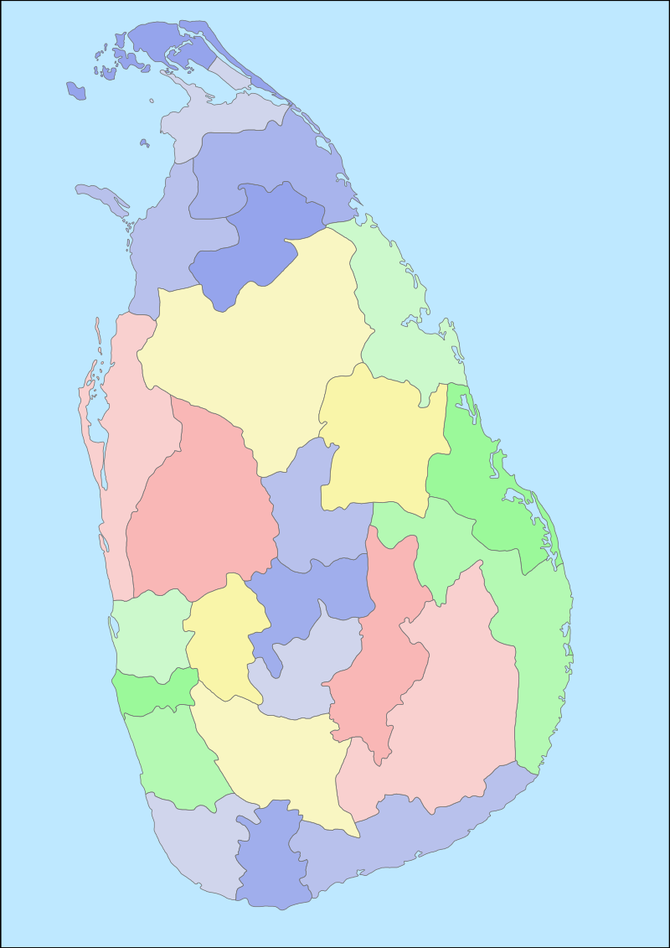
Material and Methods
Study area
Central province
Uwa province
Southern province
Matale
Kandy
Badulla
Nuwara Eliya
Monaragala
Galle
Figure: Study locations
Matara
Hambantota

Slide 7
Province | District | Area | Latitude | Longitude
Central Province | Kandy district | Gannoruwa | 7.271546˚N | 80.596307˚E
 |  | Gampola | 7.281422˚N | 80.593561˚E
 | Matale district | Yatawatta | 7.626949˚N | 80.610212˚E
 |  | Ambanganga | 7.57160˚N | 80.6707˚E
 | Nuwara-eliya district | Haguranketha | 7.0319˚N | 80.7806˚E
 |  | Kothmale | 7.081814˚N | 80.650305˚E

Slide 8
Province | District | Area | Latitude | Longitude
Uwa Province | Badulla district | Haldummulla | 6.753942˚N | 80.86454˚E
 |  | Hali-ela | 6.96˚N | 81.005˚E
 |  | Nikapotha | 6.74235˚N | 80.970058˚E
 | Monaragala district | Badalkumbura | 6.892685˚N | 81.228661˚E
 |  | Maduruketiya | 6.838829˚N | 81.322014˚E
 |  | Medagama | 7.034794˚N | 81.277398˚E

Slide 9
Province | District | Area | Latitude | Longitude
Southern Province | Matara district | Makandura | 6.14014˚N | 80.54507˚E
 |  | Dediyagala | 6.16418˚N | 80.42501˚E
 | Galle district | Yakkalamulla | 6.107699˚N | 80.346889˚E
 |  | Baddegama | 6.1176˚N | 80.1762˚E
 | Hambantota district | Middeniya | 6.251266˚N | 80.760764˚E
 |  | Katuwana | 6.264725˚N | 80.691011˚E

Slide 10
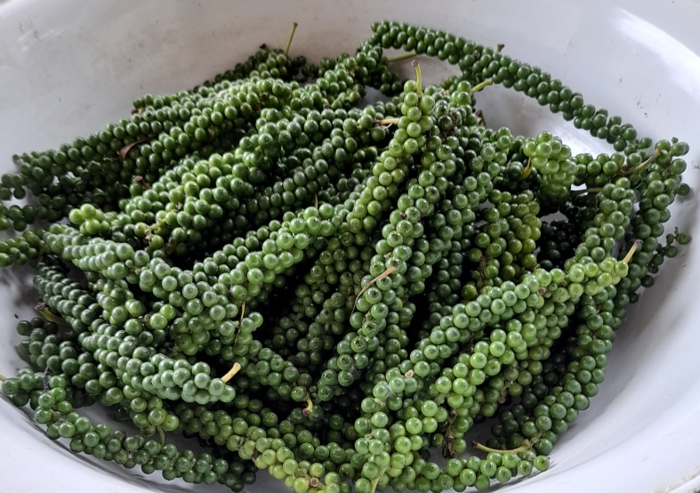
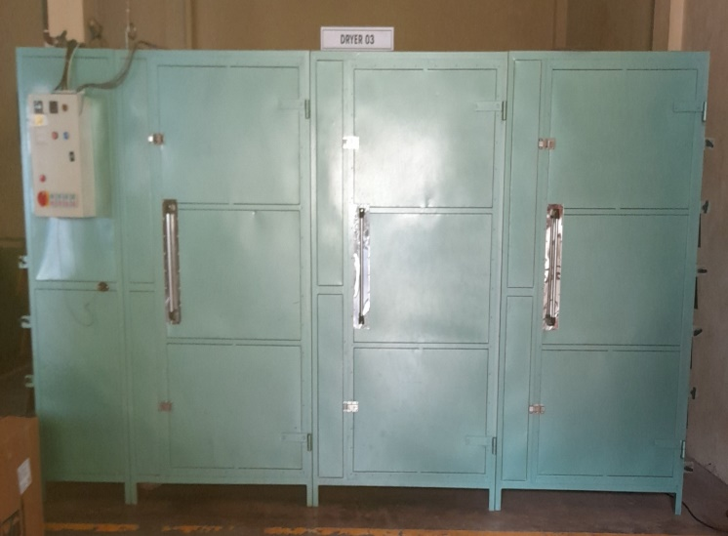
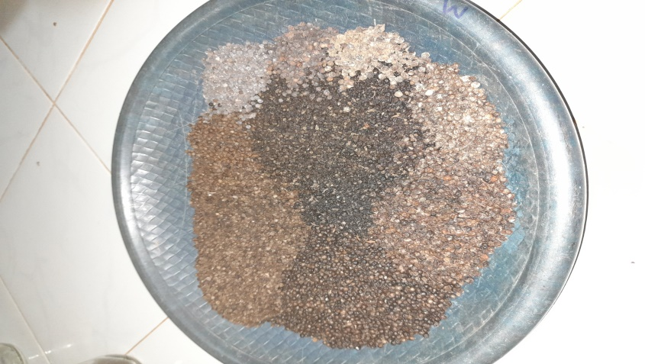
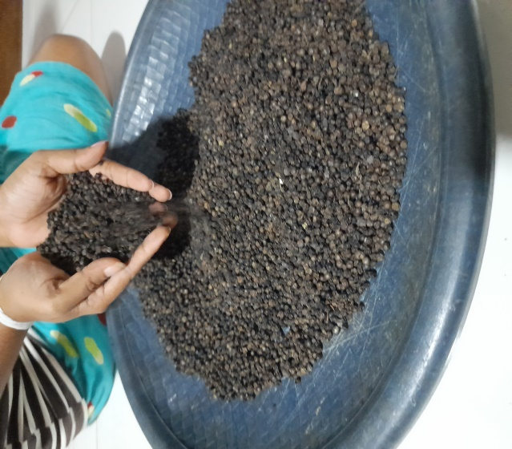
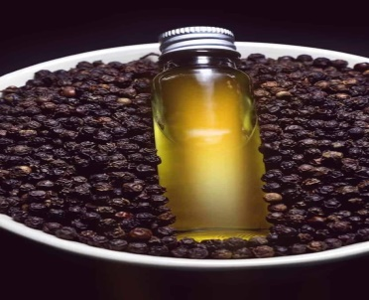
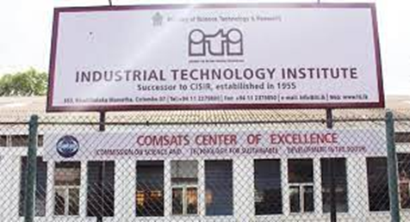
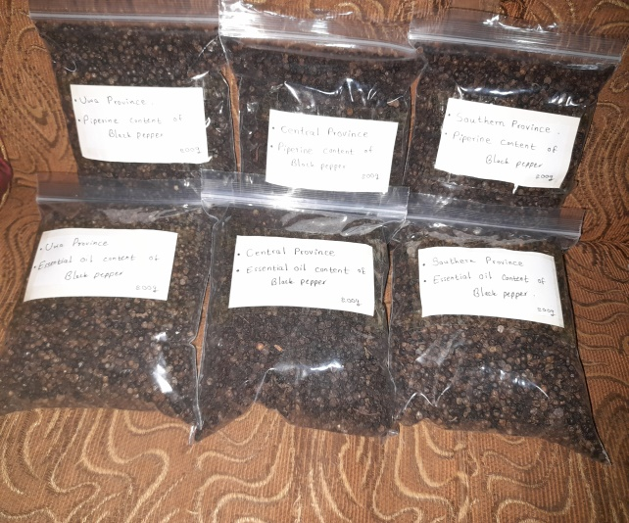
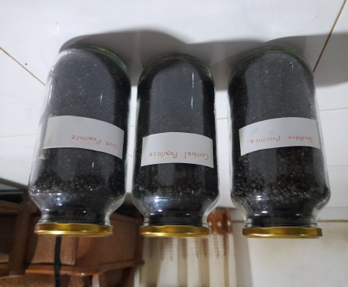

Preparation of Samples
Essential oil
Piperine

Slide 11
Data interpolation and mapping
Methodology
Study area
This study was conducted in Central, Southern and Uwa provinces.
Data collection
Required data: Soil pH, Bulk density, CEC
Source: Nation-wide open soil property maps of up to 100 cm depth for Sri Lanka Version 2
Data Harmonization
The soil depth harmonized into 0-100cm
Data interpolation and Mapping
Geostatistical Analysis Software: ESRI ArcGIS 10.4.1

Slide 12
Data
Required data: Daily maximum temperature, daily minimum temperature, daily relative humidity, annual rain fall data.
Source : Nasa power, Power Data Access Viewer v2.00
Time period : 2021 October 01 to 2022 October 01
Required data: Soil pH, bulk density, CEC
Source : Nation-wide open soil property maps of up to 100 cm depth for Sri Lanka Version 2
Farmers management practices: Questionnaire

Slide 13


Data Analysis
Data were analyzed using SAS version 9.0 statistical software with simple linear regression analysis.
Graphical analysis was done by using the GraphPad Prism version 9.

Slide 14

Results and Discussion

Slide 15
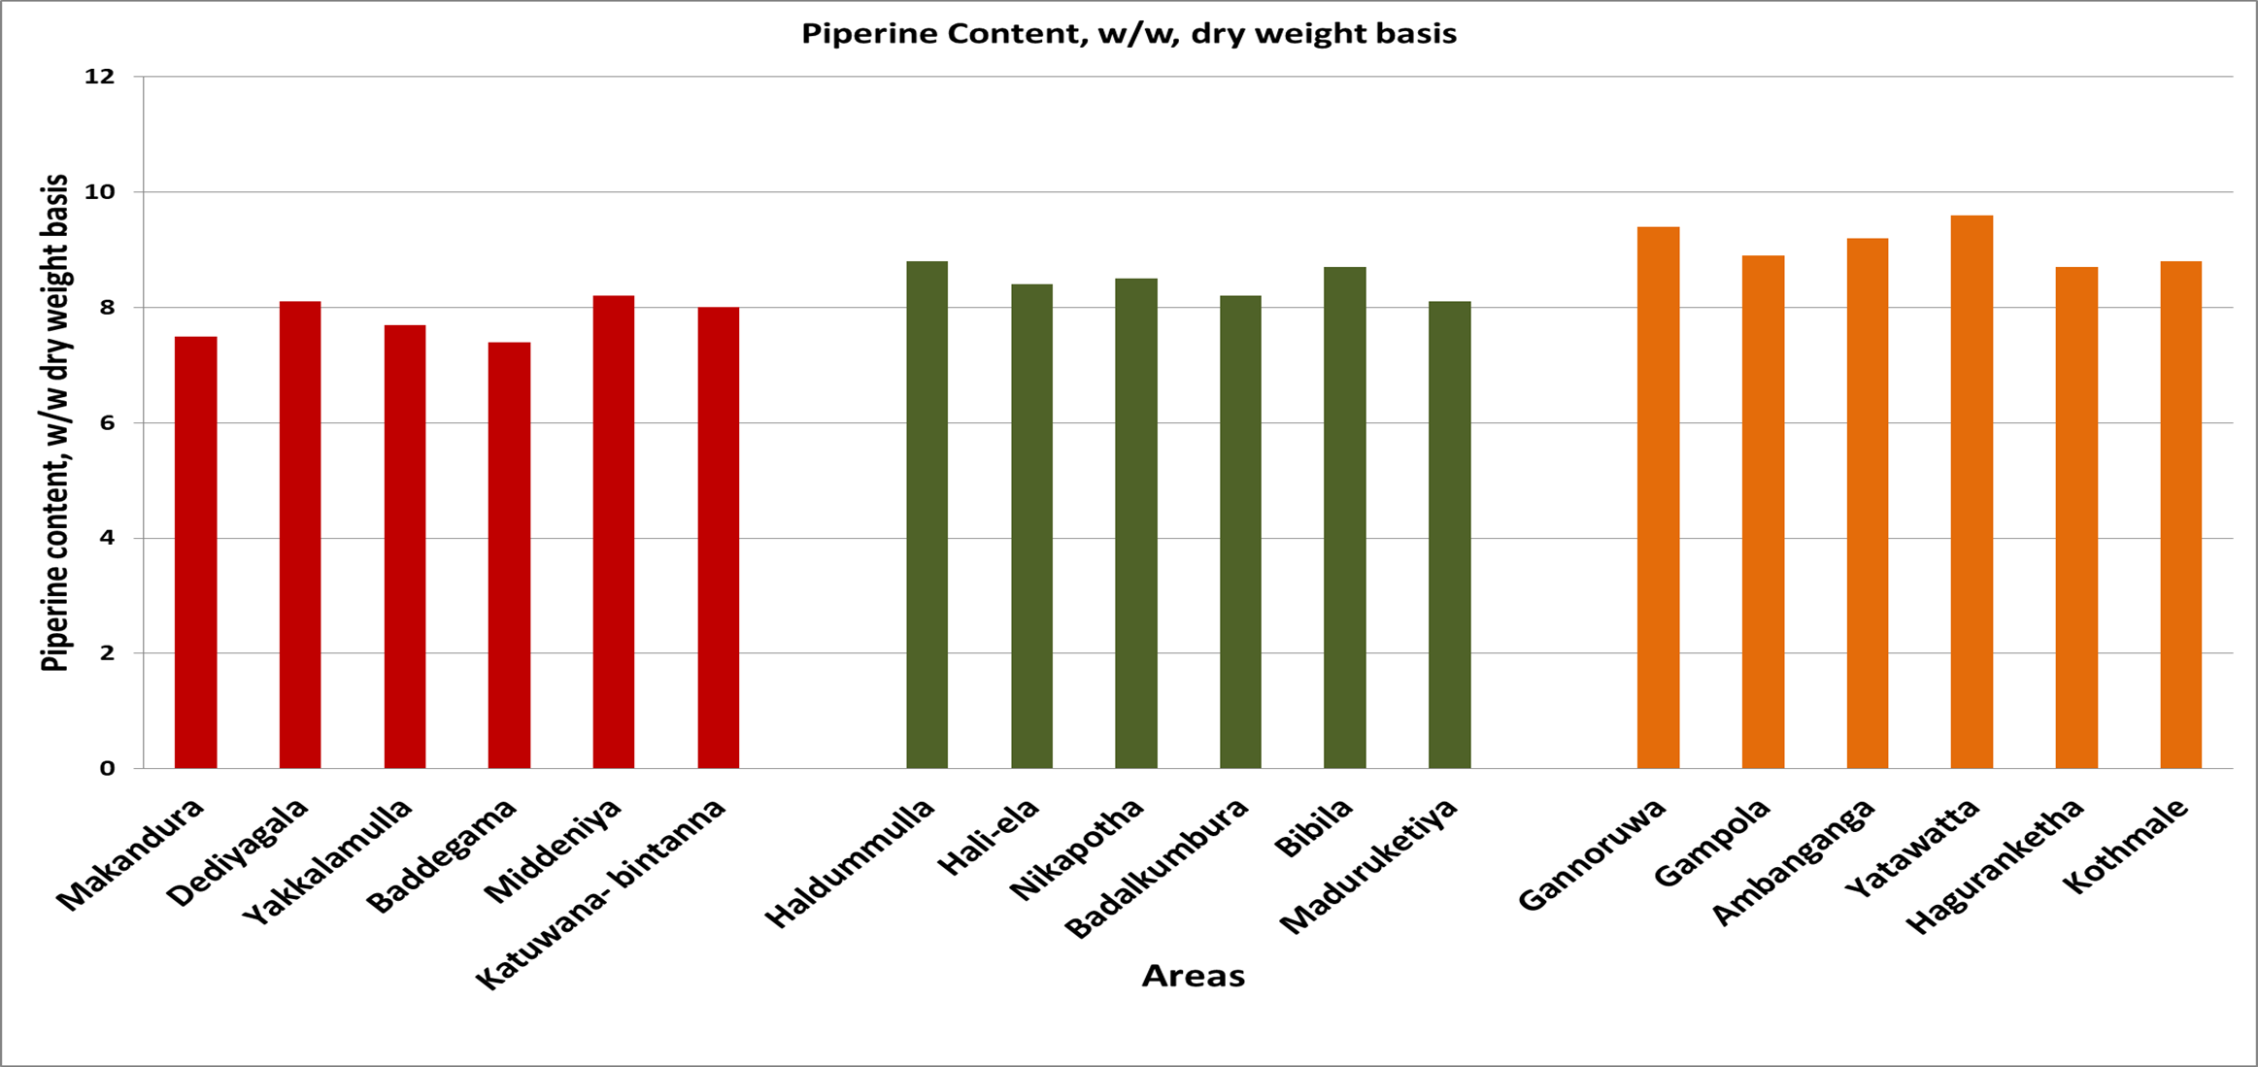

Piperine content of black pepper with study locations.

Slide 16
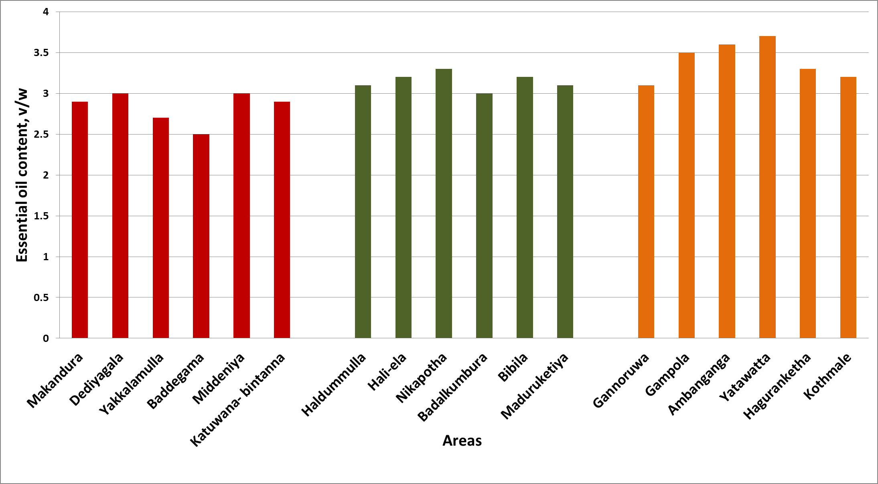
Essential oil content of black pepper with study locations.

Slide 17
R²= 0.06296
Y = -0.1414*X + 12.43
p < 0.05
R²= 0.03815
Y = -0.02389*X + 3.800
p < 0.05

Slide 18
R²= 0.4298
Y = -0.1914*X + 12.76
p < 0.05
R²= 0.3374
Y = -0.08134*X + 4.956
p < 0.05

Slide 19
R²= 0.4108
Y = 0.1380*X - 3.474
p < 0.05
R²= 0.2610
Y = 0.05275*X - 1.433
p < 0.05

Slide 20
R²=0.1380
Y = -0.0004183*X + 9.211
p > 0.05
R²= 0.1472
Y = -0.0002072*X + 3.502
p > 0.05

Slide 21
R²= 0.01318
Y = -0.2372*X + 9.788
p > 0.05
R²= 0.0003238
Y = -0.01783*X + 3.228
p > 0.05

Slide 22
R²= 0.6131
Y = -4.422*X + 13.97
p < 0.05
R²= 0.5294
Y = -1.971*X + 5.587
p < 0.05

Slide 23
R²= 0.06374
Y = 0.1527*X + 6.556
R²= 0.1436
Y = 0.1099*X + 1.760
p > 0.05
p > 0.05

Slide 24
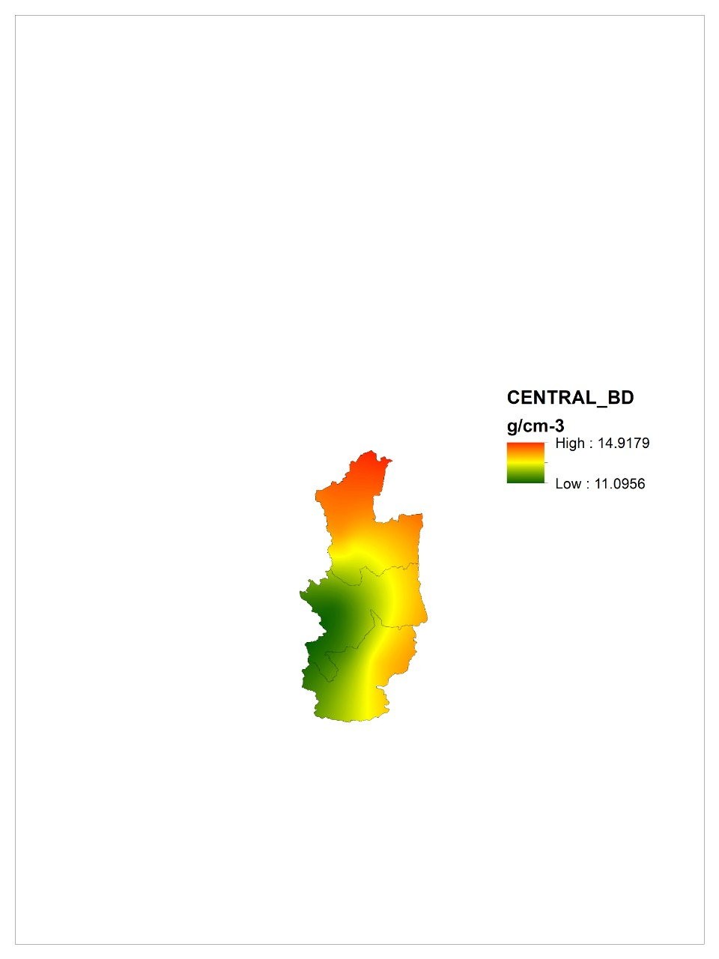
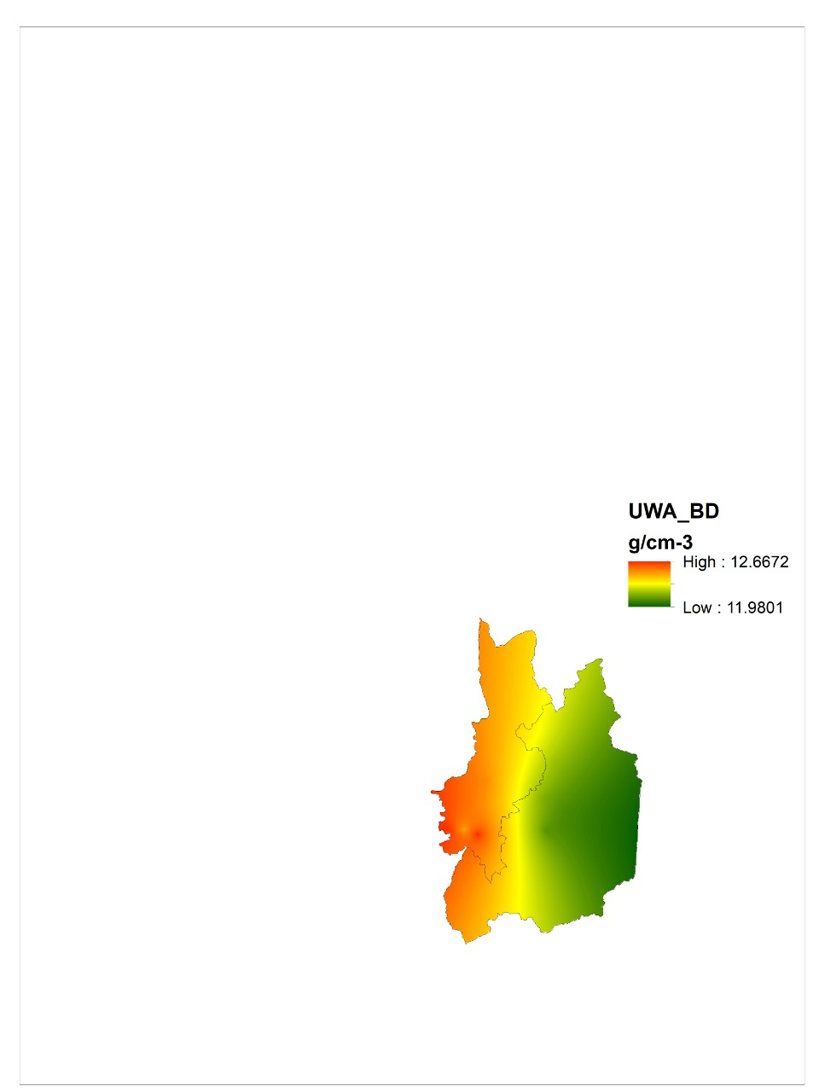
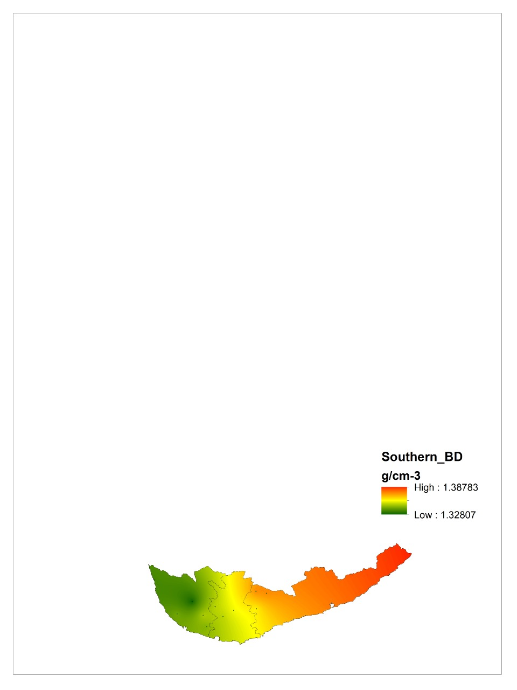
Soil properties – Bulk density of Central, Uwa and Southern province
1.37732
1.16482
1.18743
1.0674
1.3878
1.3280

Slide 25
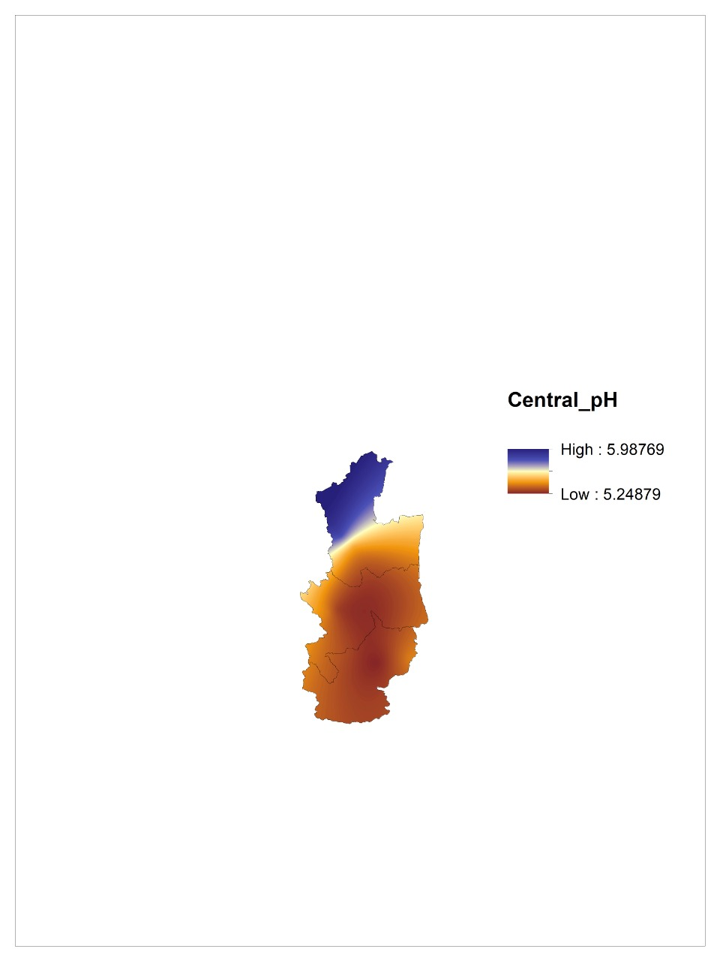
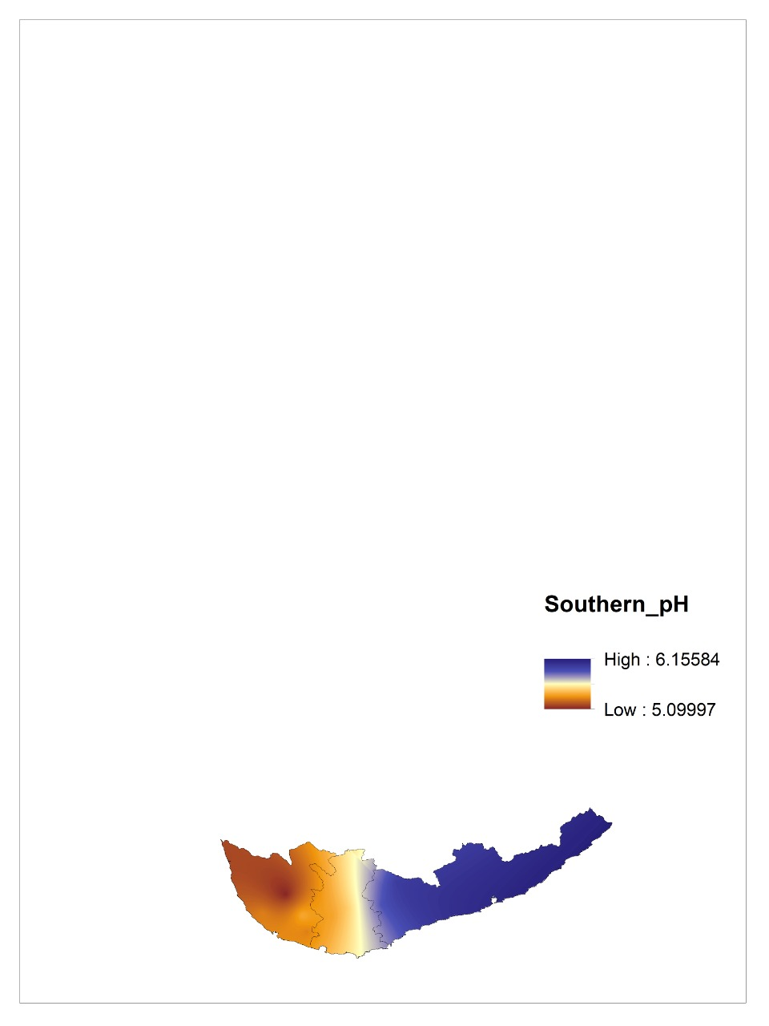
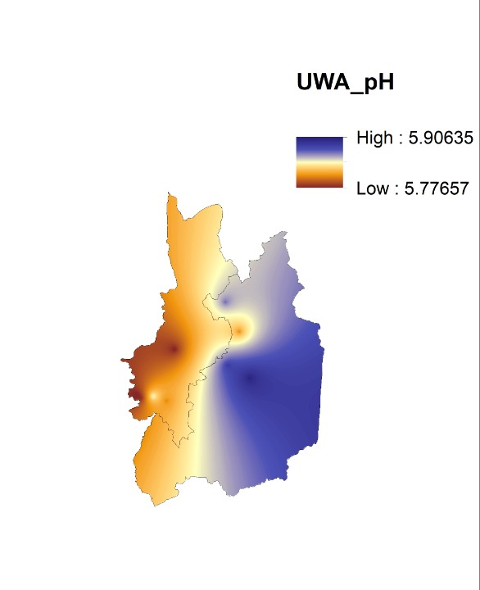
Soil pH of Central, Southern and Uwa provinces

Slide 26
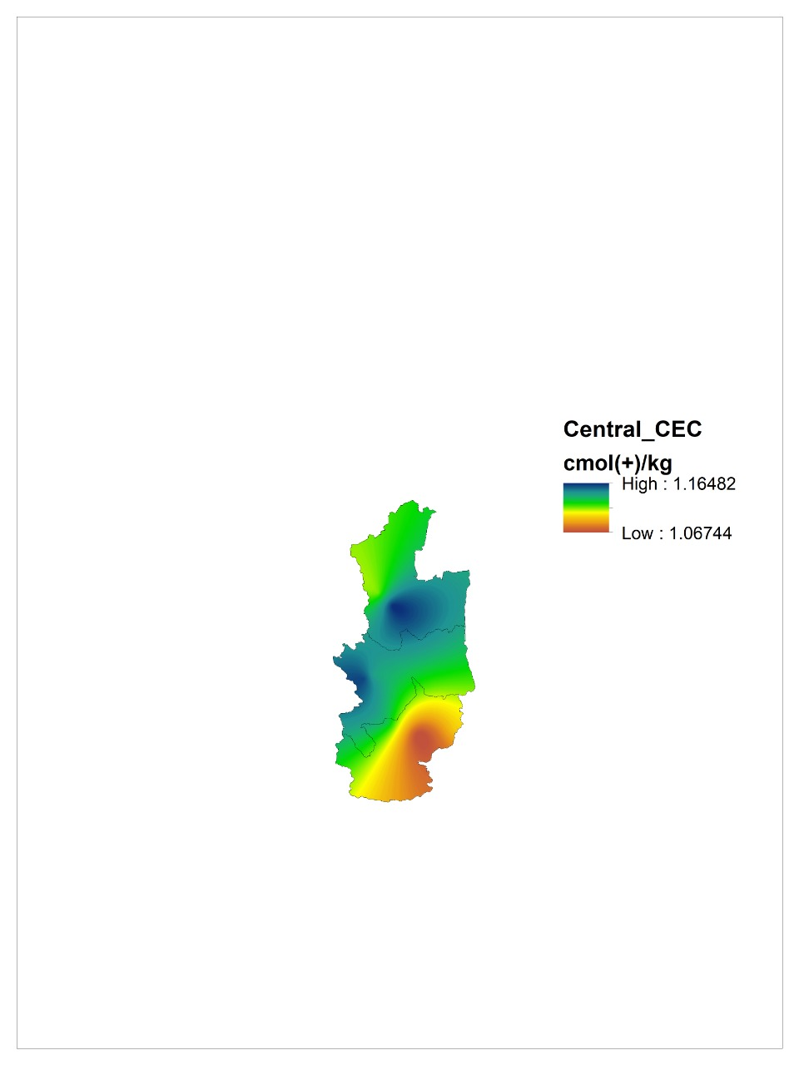
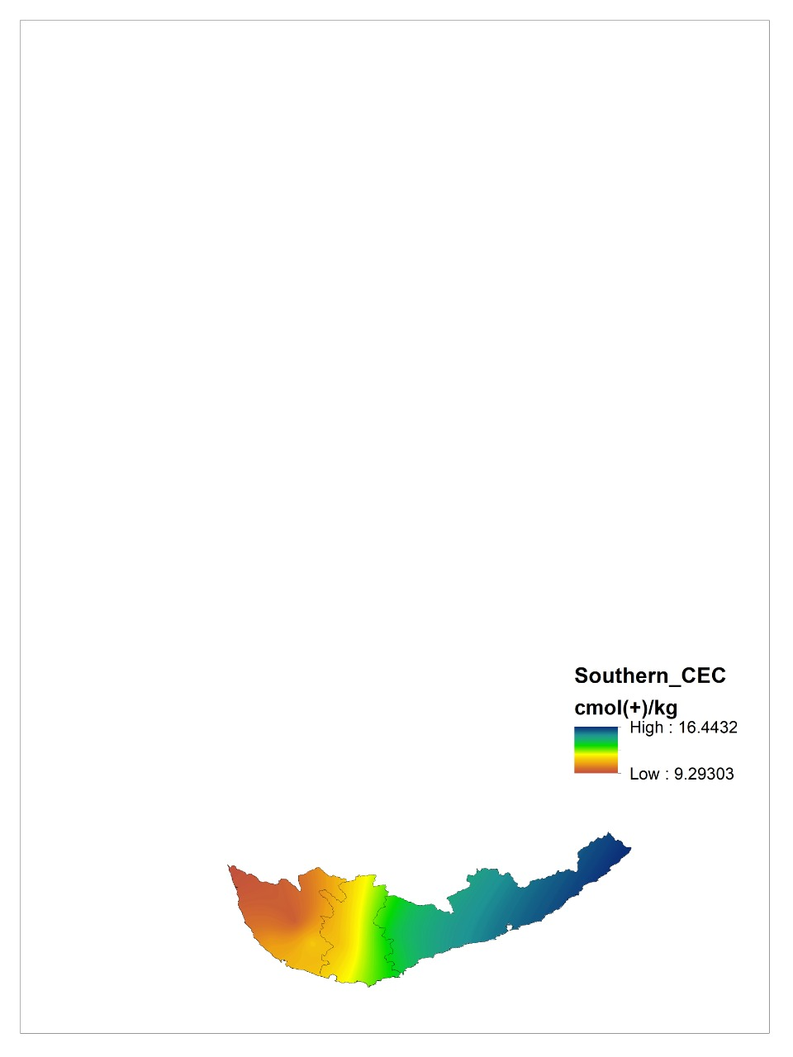
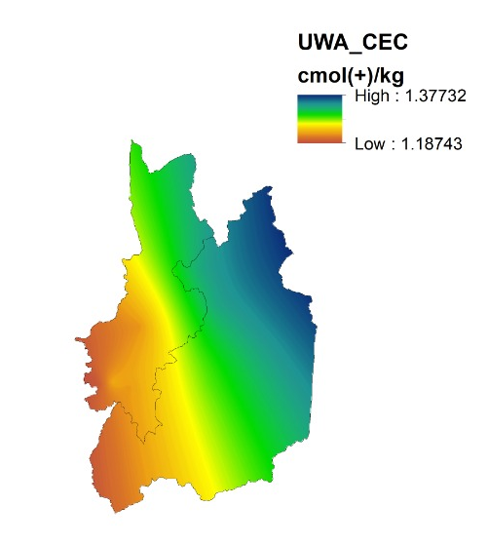
Soil CEC of Central, Southern and Uwa provinces
14.9179
12.6672
11.9801
11.0956

Slide 27
Conclusion and Recommendations
Highest percentages of piperine (9.1% w/w dry weight basis) and essential oil (3.4%,v/w) were obtained in Central province.
Lowest piperine (7.8%, w/w, dry weight basis) and essential oil (2.8%, v/w) percentages were obtained in Southern province.
There was a significant effect (p<0.05) in temperature, relative humidity, and soil bulk density with piperine and essential oil content.
  Therefore temperature, relative humidity, and soil bulk density affect for the piperine and essential oil content of black pepper.

Slide 28
There was no significant effect (p>0.05) in rainfall, soil pH and CEC with piperine and essential oil content of black pepper.
  Therefore rainfall, soil pH and CEC do not affect for the piperine and essential oil content of black pepper.
Farmers don’t practice any specific management practices except training and pruning of plants where the samples were taken.

Slide 29
Recommendations
Extend the study:
Sample collection should be carried out for all the black pepper growing areas in Sri Lanka.
Designing the study to investigate variations in piperine and essential oil content with different varieties of black pepper.

Slide 30
References
Abdulazeez, M. A., Sani, I., James, B. D., & Abdullahi, A. S. (2015). Black Pepper (Piper nigrum L.) Oils. In Essential Oils in Food Preservation, Flavor and Safety. Elsevier Inc. https://doi.org/10.1016/B978-0-12-416641-7.00031-6
Ashokkumar, K., Murugan, M., Dhanya, M. K., Pandian, A., & Warkentin, T. D. (2021). Phytochemistry and therapeutic potential of black pepper [Piper nigrum (L.)] essential oil and piperine: a review. Clinical Phytoscience, 7(1). https://doi.org/10.1186/s40816-021-00292-2
Chopra, B., Dhingra, A. K., Kapoor, R. P., & Prasad, D. N. (2016). Piperine and Its Various Physicochemical and Biological Aspects : A. 75–96. https://doi.org/10.2174/1874842201603010075
Dosoky, N. S., Satyal, P., Barata, L. M., Da Silva, J. K. R., & Setzer, W. N. (2019). Volatiles of black pepper fruits (Piper nigrum L.). Molecules, 24(23), 1–13. https://doi.org/10.3390/molecules24234244
Epstein, W. W., & seide, J. L. (1993). Isolation of Piperine from Black Pepper.

Slide 31
Jansz, E. R., Pathirah-A A N, I. C., & Packiyasothy, D. E. V. (1983). Determination of Piperine in Pepper (Piper nigrum L). In Natn. Sci. Coun. Sri Lonka (Vol. 11, Issue 1).
Motta, M. H., Schneider, A., Codevilla, C. F., Menezes, C., & Da Silva, C. D. B. (2018). Analytical Method By Liquid Chromatography To Assay Piperine Associated in Nanoemulsions. Drug Analytical Research, 2(1), 1–7. https://doi.org/10.22456/2527-2616.80366
Nair, K. P. (2020). The Geography of Black Pepper (Piper nigrum). In The Geography of Black Pepper (Piper nigrum) (Vol. 1). https://doi.org/10.1007/978-3-030-52865-2
Paduit, N., Pampolino, M., Maung Aye, T., & Oberthür, T. (2018). Nutrient Uptake and Distribution in Black Pepper. Better Crops with Plant Food, 102(4), 24–27. https://doi.org/10.24047/bc102424

Slide 32
Acknowledgement
Dr. W. M. A. U. K. M Wijesekara (Internal supervisor), Senior Lecturer, Department of Export Agriculture, Faculty of Agricultural Sciences, Sabaragamuwa University of Sri Lanka.
Mr. Leel Prasanna, Director, Samagi Organic (Pvt) Ltd, Makandura.
Dr. G. E. M Wimalasiri, Department of Export Agriculture, Faculty of Agricultural Sciences, Sabaragamuwa University of Sri Lanka.
Ms. D. D. M Ovini Dissanayaka, Department of Export Agriculture, Faculty of Agricultural Sciences, Sabaragamuwa University of Sri Lanka.
Dr. Selvaluxmy Chelvendran, Research Scientist, Herbal Technology Section, Industrial Technology Institute.

Slide 33
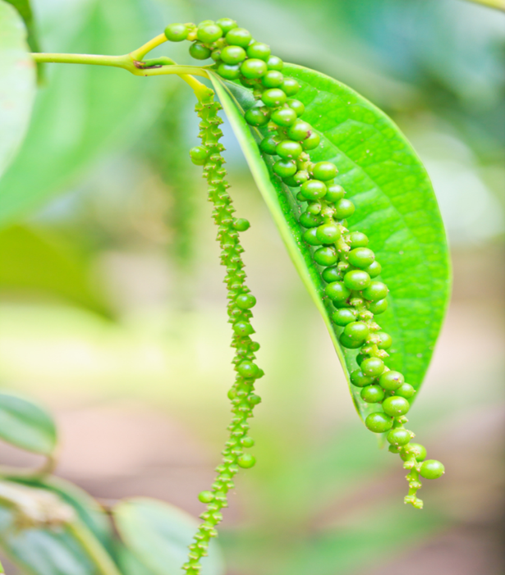
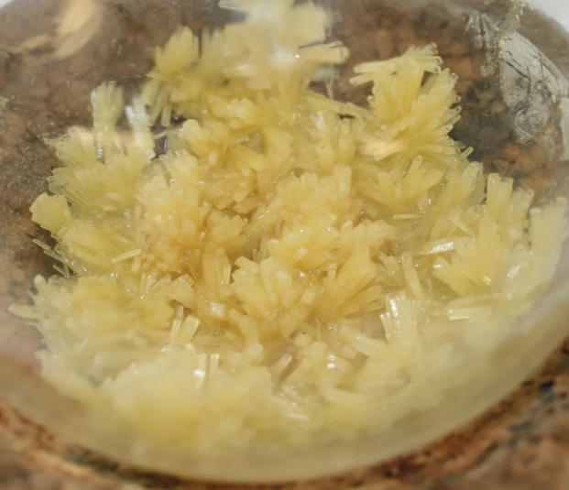
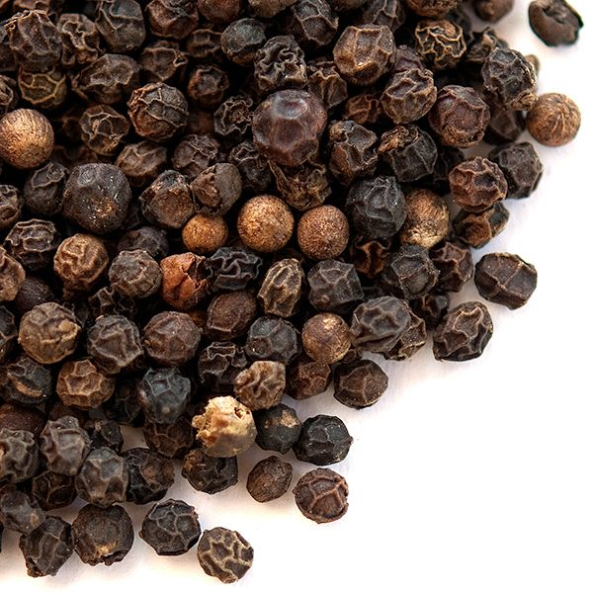
Thank You

