Slide 1
Analysis of Energy Balance of the Teaching Farm of Faculty of Agricultural Sciences, Sabaragamuwa University of Sri Lanka
WMS Dhanapala¹, GEM Wimalasiri¹, EPRHHW Nilmalgoda²
¹Department of Export Agriculture, Faculty of Agricultural Sciences, Sabaragamuwa University of Sri Lanka, Belihuloya, Sri Lanka
²Department of Biosystem Technology, Faculty of Technology, Sabaragamuwa University of Sri Lanka, Belihuloya, Sri Lanka

Slide 2
Introduction
Energy is a driving force of existence and it is required for all agricultural activities.
Agriculture
Energy
Energy Input
Energy Output
Energy Input
Energy Output
Energy Output
Energy Input
Energy Loss
(Negative Energy Balance)
Energy Gain
(Positive Energy Balance)
Energy Balance

Slide 3
Introduction cont..
LCA is a compilation and evaluation of the inputs, outputs and potential environmental impact of a product system through its life cycle (ISO 2004).
Sustainability assessment tool
Can be applied for any systems

Slide 4
Objectives
Main Objective
To analyze the energy balance of crop and livestock production in the farm of the Faculty of Agricultural Sciences, Sabaragamuwa University of Sri Lanka using the Life Cycle Assessment (LCA) approach.
Specific Objectives
To assess the total energy input and output in crop and livestock production in the faculty farm.
To determine the Net Energy Ratio (NER) of crop and livestock production.
To determine the water use efficiency (WUE) of crop production in the faculty farm.

Slide 5
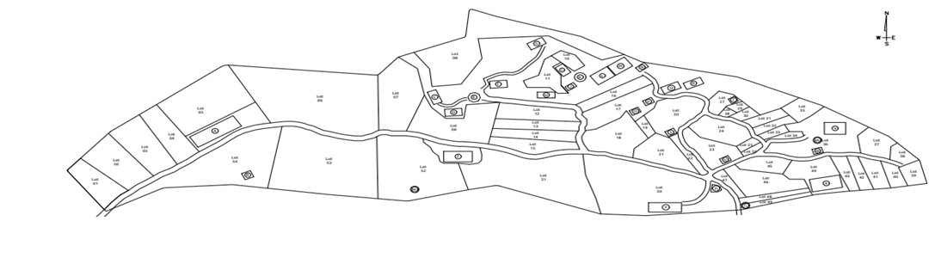
Material and Methods
Study Area
Farm of the Faculty of Agricultural Sciences, Sabaragamuwa University of Sri Lanka.
Mid country intermediate zone (IM2)
(6.7148833⁰ N, 80.7870949⁰ E)
Figure 1: Map of the farm of the Faculty of Agricultural Sciences, Sabaragamuwa University of Sri Lanka

Slide 6
Material and Methods
Data collection
Primary data
- Direct contact with farm manager, farm supervisor and
workers.
- Official records in the faculty farm (2020 to 2022
production period)
Secondary data
- Previously published literature

Slide 7
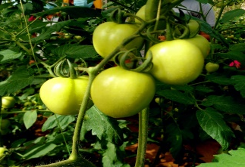
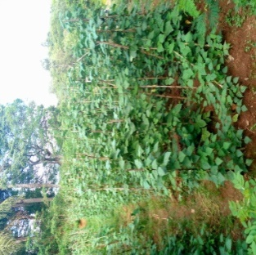
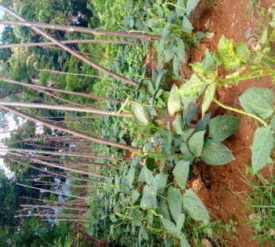
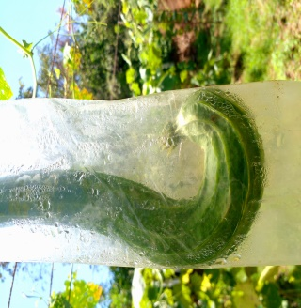

Material and Methods
Crop production
18 crops have been selected to estimate the energy balance of crop production.
These crops are, coconut, banana, cassava, tea, okra, bean, long bean, wing bean, cabbage, radish, tomato, brinjal, thorn apple/elabatu (Solanum insanum), cucumber, snake gourd, luffa, rice and corn.

Slide 8
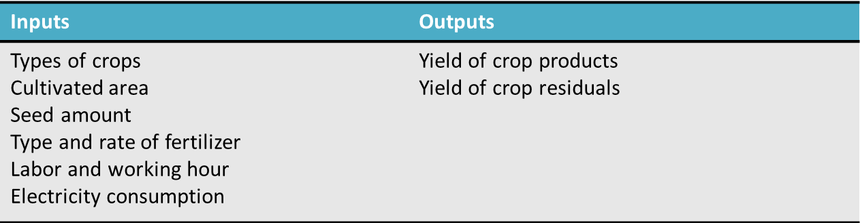
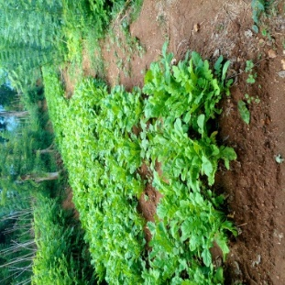
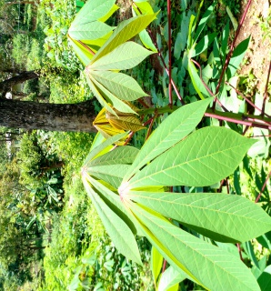
Material and Methods

Slide 9
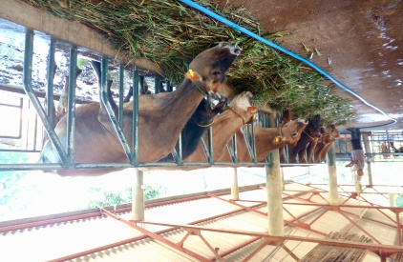
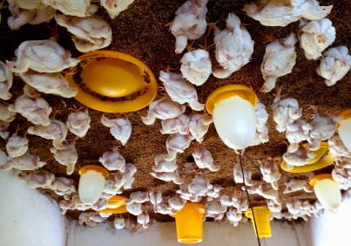
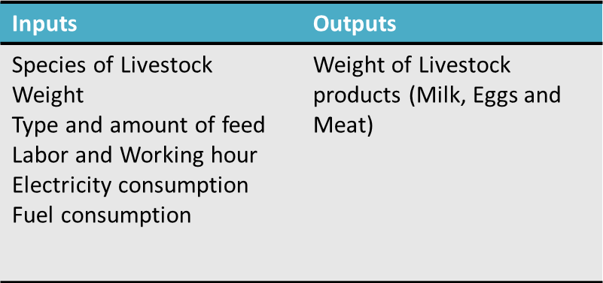
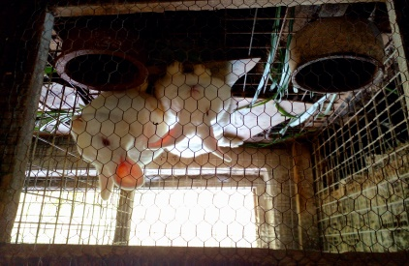
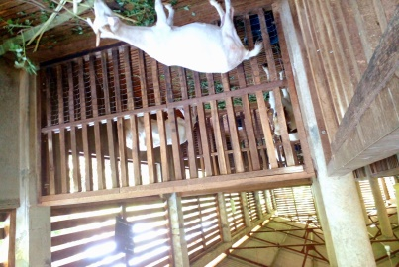
Material and Methods
Livestock production
Cattle, goat, piggery and poultry unit have been selected to estimate energy balance of livestock production.

Slide 10
Calculation
Co-efficient of energy factor
(MJkg⁻¹)
Input
or
Output
(Kg)
Energy Input
or
Energy Output
(MJ)
X
Example –
Bean Seeds
1 kg
Energy Factor
14.9 MJ kg⁻¹
Energy Input
14.9 MJ
=
X

Slide 11

Calculation
Energy Input
Yan et al., (2020)
Where,
${EI}_{crop }$= Total energy inputs (MJ)
$i$ = Crop Type
$n$ = Number of crops
$CI$ = Farm input
$EC$ = Energy coefficient for the crop type
$l$ = Inputs of labor (h), male and female inputs with separate value
$s$ = Seeds (kg)
$f$ = Fertilizer (kg)
$p$ = pesticides (kg)
$ie$ = Electricity for irrigation (kWh)
$pm$ = Plastic films (kg)
$dc$ = Diesel fuel (L)
$md$ = machinery (kg)

Slide 12
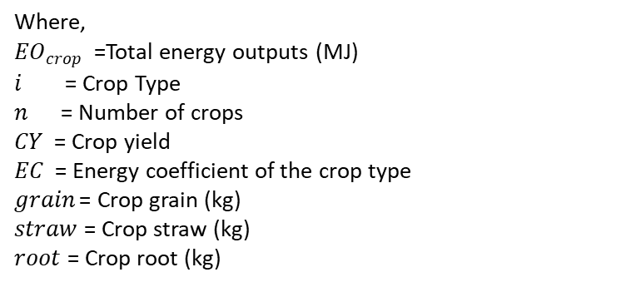
Energy Output
Where,
${EO}_{crop }$ =Total energy outputs (MJ)
$i$ = Crop Type
$n$ = Number of crops
$CY$ = Crop yield
$EC$ = Energy coefficient of the crop type
$grain$ = Crop grain (kg)
$straw$ = Crop straw (kg)
$root$ = Crop root (kg)
Yan et al., (2020)

Slide 13
Energy Balance
$${EB}_{crop }={(EO}_{crop})−\left({EI}_{crop}\right) \left(3\right)$$
Yan et al., (2020)

Slide 14
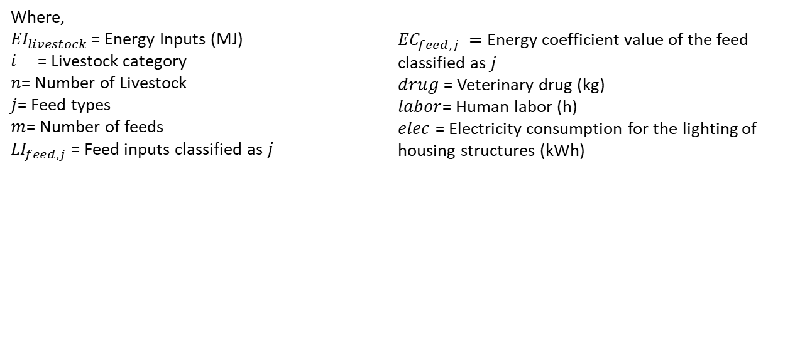
Calculation
Energy Input
(4)
Yan et al., (2020)
Where,
${EI}_{livestock }$= Energy Inputs (MJ)
$i$ = Livestock category
$n$= Number of Livestock
$j$= Feed types
$m$= Number of feeds
${LI}_{feed,j}$ = Feed inputs classified as $j$
${EC}_{feed,j} =$ Energy coefficient value of the feed classified as $j$
$drug$ = Veterinary drug (kg)
$labor$= Human labor (h)
$elec$ = Electricity consumption for the lighting of housing structures (kWh)

Slide 15
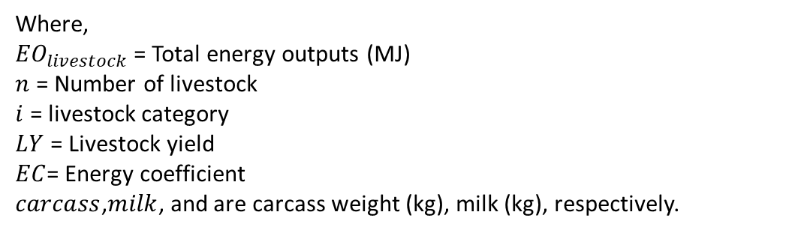
Energy Output
$${EO}_{livestock }=\sum_{i=1}^{n}{(}{LY}_{carcass,i}×{EC}_{carcass,i}+{LY}_{milk,i}×{EC}_{milk,i}+{LY}_{egg,i}×{EC}_{egg,i})$$
(5)
Where,
${EO}_{livestock }$= Total energy outputs (MJ)
$n$ = Number of livestock
$i$ = livestock category
$LY$ = Livestock yield
$EC$= Energy coefficient
$carcass$,$milk$, and are carcass weight (kg), milk (kg), respectively.
Yan et al., (2020)

Slide 16
Energy Balance
$${EB}_{livestock}={(EO}_{livestock})−\left({EI}_{livestock}\right) \left(6\right)$$
Yan et al., (2020)

Slide 17
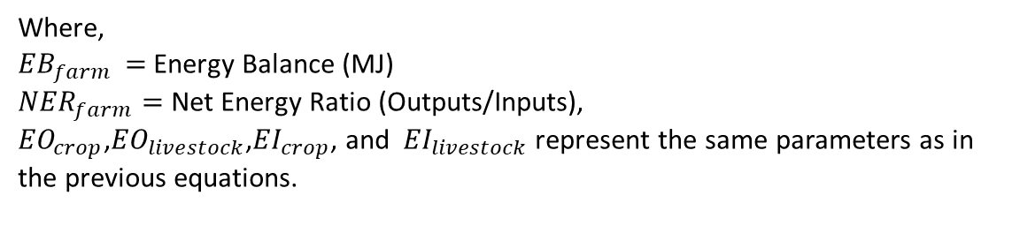
Calculation
The Energy Balance and Net Energy Ratio
Where,
${EB}_{farm }=$Energy Balance (MJ)
${NER}_{farm}=$ Net Energy Ratio (Outputs/Inputs),
${EO}_{crop}$,${EO}_{livestock}$,${EI}_{crop}$, and ${EI}_{livestock}$ represent the same parameters as in the previous equations.
Yan et al., (2020)

Slide 18
Water Use Efficiency of Crop Production based on Energy
Yan et al., (2020)

Slide 19
Results and Discussion
Crop production
Input Energy = 75.71 GJ (400.24 GJ ha⁻¹)
Output Energy = 107.06 GJ (717.11 GJ ha⁻¹ )
Energy Balance = -31.35 GJ (-316.87 GJ ha⁻¹)
NER = 1.79
WUE = - 31.35 MJ m⁻³
Figure 2:Energy Input and Output in Crop Production

Slide 20
Results and Discussion
Livestock Production
Input Energy = 867.44 GJ
Output Energy = 108.70 GJ
Energy Balance = 758.73 GJ
NER = 0.13
Figure 3:Energy Input and Output in Livestock Production

Slide 21
Crop and Livestock Production
Total Energy Input = 956. 36 GJ
Total Energy Output = 215.76 GJ
Energy Balance = 740.6 GJ
NER = 0.23
Figure 4:Total Energy Input and Output in Faculty Farm

Slide 22
Conclusions
Crop production system in faculty farm shows the negative energy balance (-31.35 GJ ).
Livestock production system shows the positive energy balance (758.73 GJ).
Overall, there is a positive energy balance in the faculty farm (740.6 GJ)
WUE of crop production was - 31.35 MJ m⁻³

Slide 23
Recommendations
This study can be further developed to calculate carbon footprint in the faculty farm
The analyzed data will be included into the database of the farm of the Faculty of Agricultural Sciences, Sabaragamuwa University of Sri Lanka.
Development of the data recording system and inputs management system in crop and livestock production in the faculty farm.

Slide 24
References
Ozkan, Burhan, Handan Akcaoz, and Cemal Fert. 2004. “Energy Input-Output Analysis in Turkish Agriculture.” Renewable Energy 29 (1): 39–51. https://doi.org/10.1016/S0960-1481(03)00135-6.
Sefeedpari, Paria. 2012. “Assessment and Optimization of Energy Consumption in Dairy Farm: Energy Efficiency” 3 (3): 213–24. https://doi.org/10.5829/idosi.ijee.2012.03.03.
Yan, Zhengang, Fuqin Hou, and Fujiang Hou. 2020. “Energy Balances and Greenhouse Gas Emissions of Agriculture in the Shihezi Oasis of China.” Atmosphere 11 (8): 1–17. https://doi.org/10.3390/ATMOS11080781.
Yan, Zhengang, Fuqin Hou, and Fujiang Hou. 2020. “Energy Balances and Greenhouse Gas Emissions of Agriculture in the Shihezi Oasis of China.” Atmosphere 11 (8): 1–17. https://doi.org/10.3390/ATMOS11080781.

Slide 25
Thank You

