Slide 1
Effect of Different Types of Wood Chips on the Sensory Properties and Microbial Status of Smoked Emulsion-Type Chicken Sausages
M.C.G.Vithanage, H.A.D. Ruwandeepika, D.N.N. Madushanka, H.D.H.M. Ariyasena
Department of Livestock Production, Faculty of Agricultural Sciences, Sabaragamuwa University of Sri Lanka
Cargills Quality Foods Ltd, Ja-Ela, Sri Lanka

Slide 2
Content for the presentation
Introduction
Research Problem
Objectives
Material and Methods
Results and Discussion
Conclusion and Recommendations
References

Slide 3
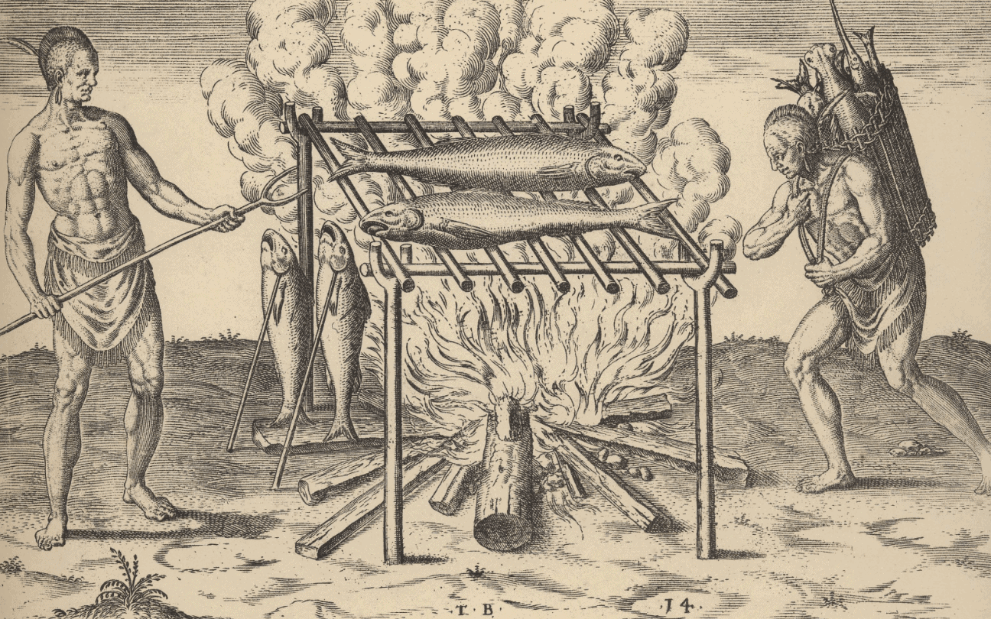
Introduction
Any incomplete combustion of organic material produces smoke.
The smoke used in food smoking is produced by the slow, deliberate combustion of untreated wood.
Depending on the level of the smoke temperature and the characteristics of the smoke, a distinction is drawn between cold, warm, and hot smoking.

Slide 4
Introduction Cont…
Wood is made up of roughly 50% cellulose, 25% hemicellulose, and 25% lignin.
Smoking increases the shelf-life of meat products by:
Antimicrobials
Antioxidants
Cellulose and Hemicelluloses
Pyrolysis
Brown color
Pyrolysis
Flavor, Antimicrobial and Antioxidative compounds
Lignin

Slide 5


Research Problem
The banned of the importation of non-essential items to Sri Lanka due to the current economic crisis.
As a solution, it is better to find alternative quality wood types that can be found locally.

Slide 6

Objectives
The present study was undertaken with the following objectives:
To find a local wood chip as an alternative for commercial imported wood chips and to study the qualities of the smoked sausage during storage.
To reduce import costs for smoking material in sausage production.
To effectively use local wood material.

Slide 7


Material and Methods
Experimental Site

Slide 8
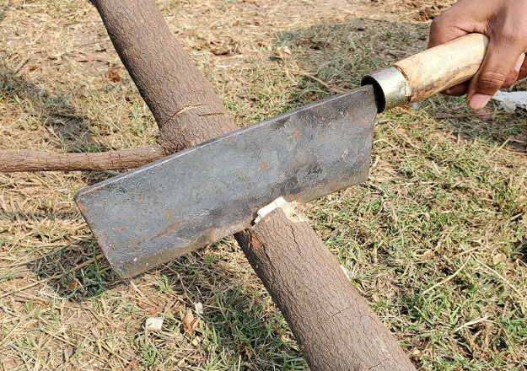
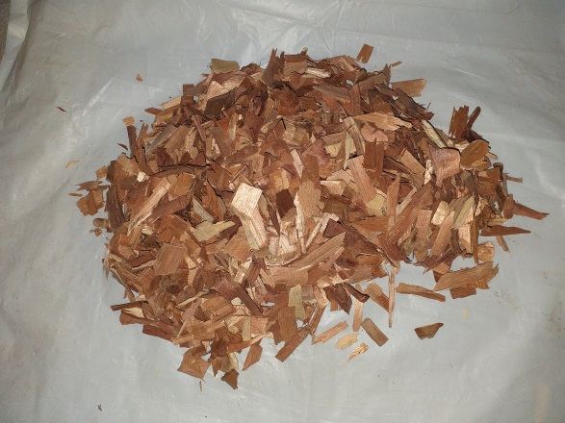
Material and Methods Cont…
Preparation of woodchips
Cinnamon (Cinnamomum verum)
Mahogany (Swietenia macrophylla)
Acacia (Acacia auriculiformis)
Teak (Tectona grandis)
Cut
Dry in the air for 48 hrs
Timber
Woodchips

Slide 9

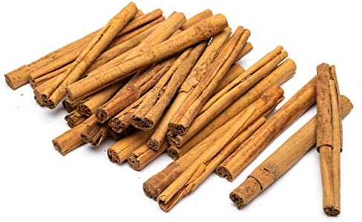
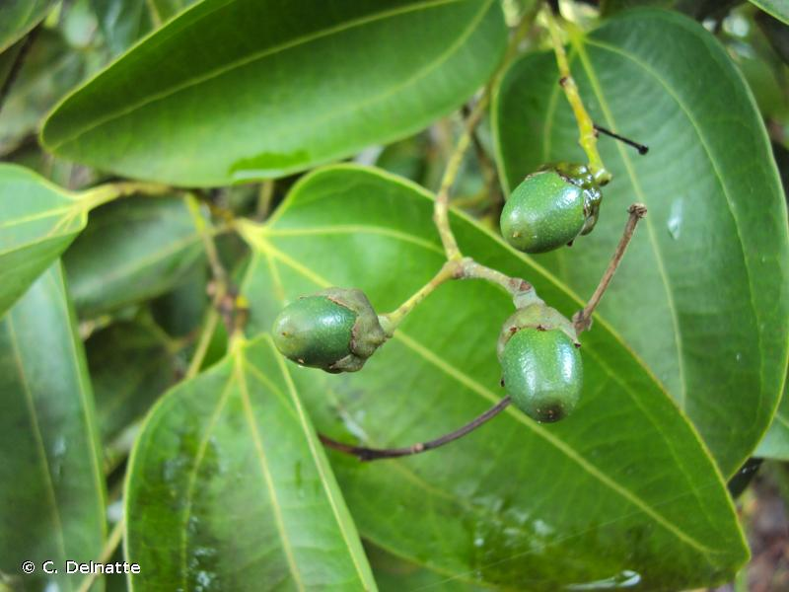
Material and Methods Cont…
Cinnamon (Cinnamomum verum)

Slide 10
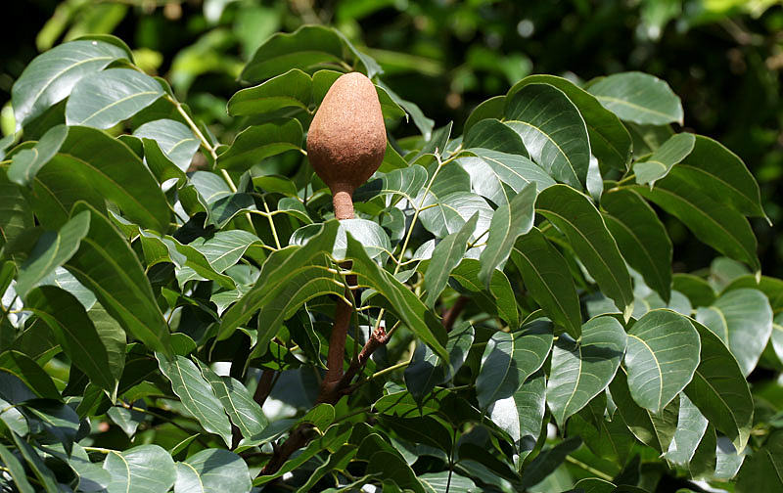
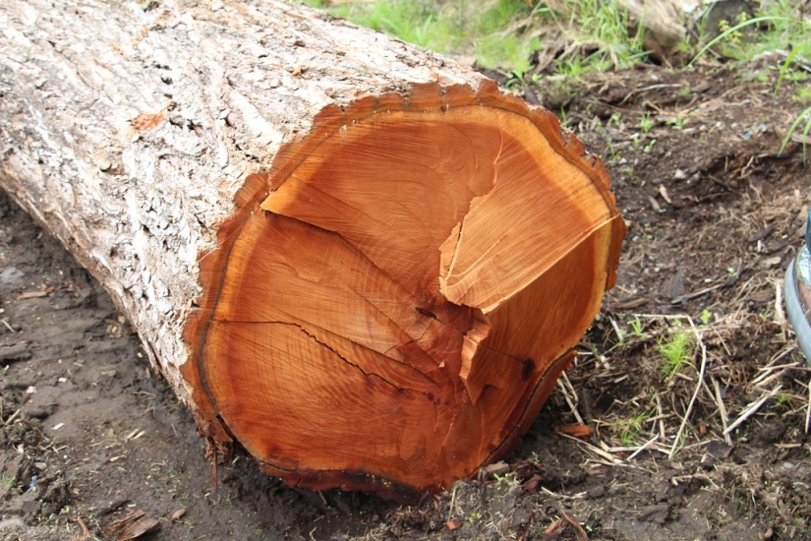
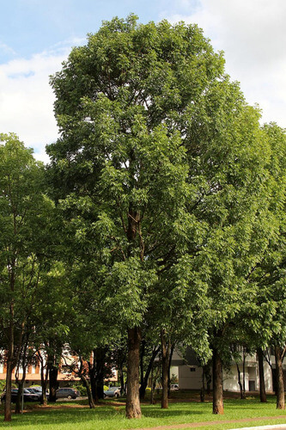
Material and Methods Cont…
Mahogany (Swietenia macrophylla)

Slide 11
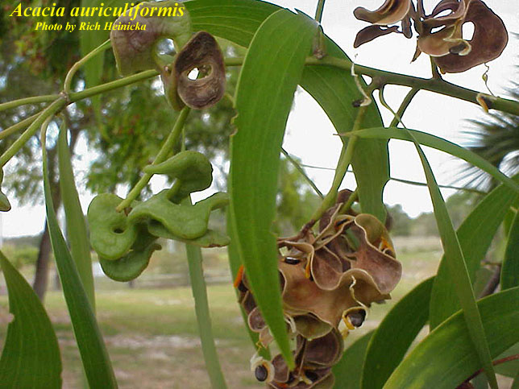
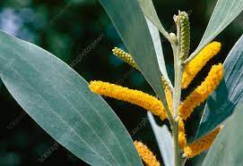
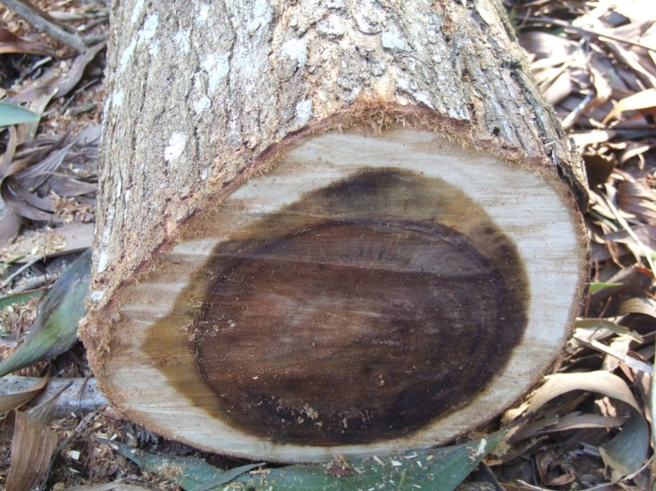
Material and Methods Cont…
Acacia (Acacia auriculiformis)

Slide 12
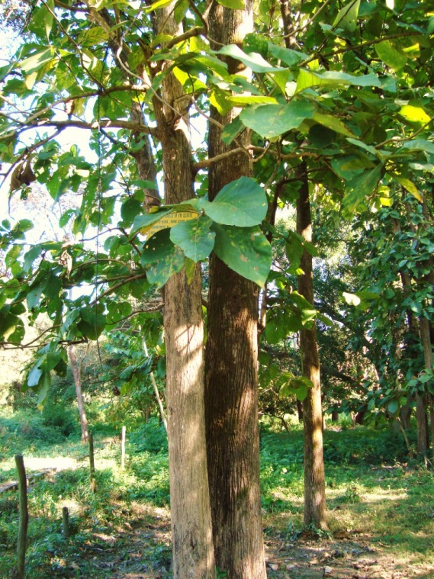
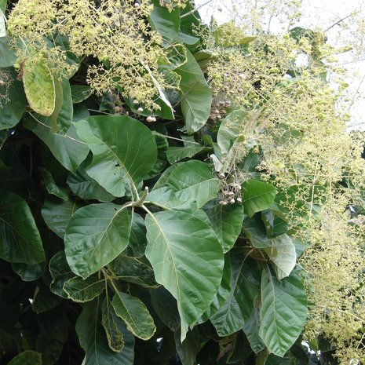
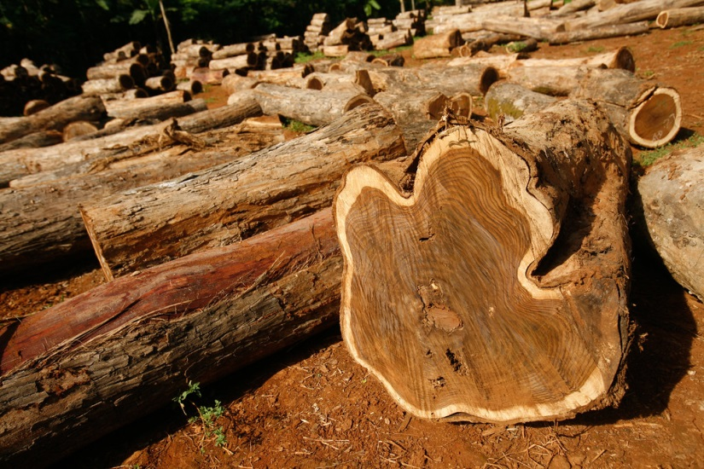
Material and Methods Cont…
Teak (Tectona grandis)

Slide 13
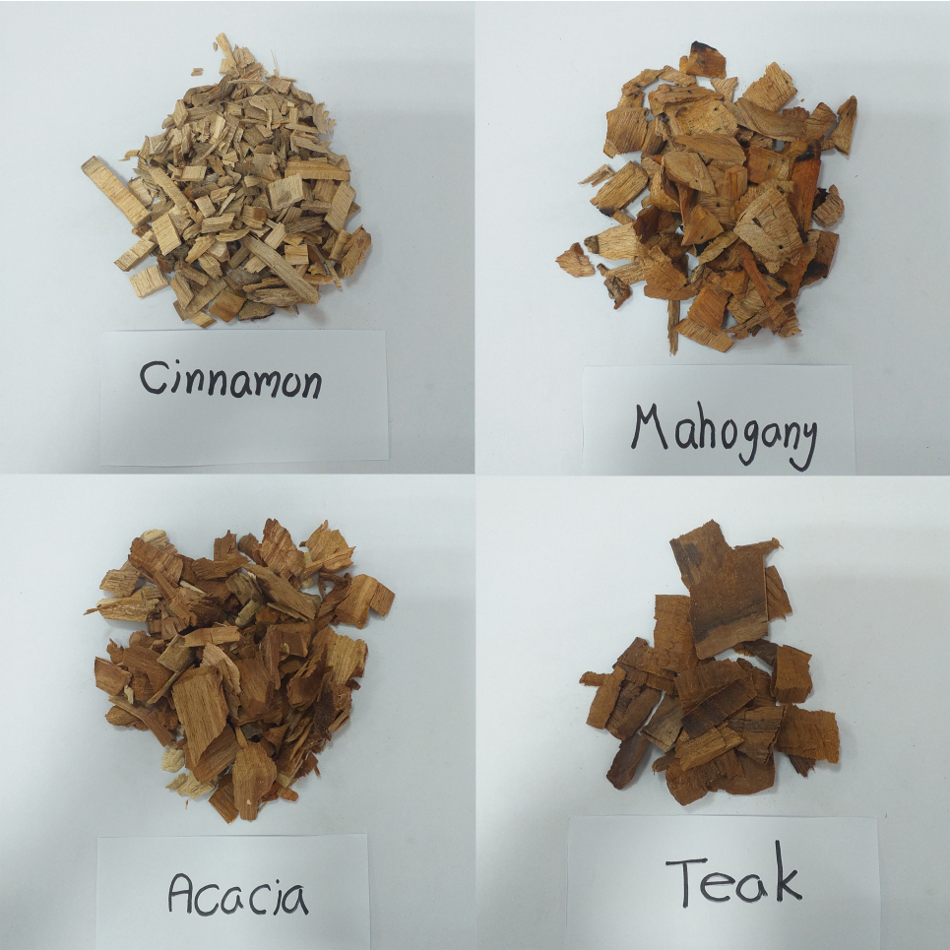
Material and Methods Cont…
Woodchips

Slide 14
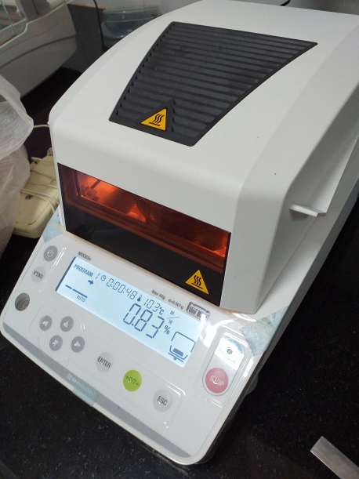
Material and Methods Cont…
Analysis of moisture content of woodchips
The sample with the minimum mass of 5 ± 0.31 g was dried at 105 ± 2 °C until giving a reading and conducted in triplicate.
Type of woodchips | Moisture (%)
Cinnamon | 17.57
Mahogany | 14.60
Acacia | 14.93
Teak | 14.94
"Shimadzu“ moisture analyzer, Philippine

Slide 15
Material and Methods Cont…
Preparation of smoked sausages
The formula of sausages samples use in the study was designed according to the recipes of the Cargills Quality Foods Lmt.
The ingredients:
chicken, chicken skin, modified tapioca starch, isolated soy protein, cereal binder, water, vacuum salt, sodium nitrite, sodium tripolyphosphate, sugar, Ascorbic acid and spice mix (containing pepper, garlic powder, ginger, chili powder, nutmeg, cardamom)

Slide 16
Material and Methods Cont…
Production flow chart of smoked chicken sausages
Grinding chicken
(use mincer)
Weighing of other non-meat ingredients
Preparation of emulsion
(use bowl chopper)
Mixing
(use mixer)
Emulsification (8 – 10 ⁰C)
(use emulsifier)
Stuffing to casing
(use stuffer)
Chamber operation

Slide 17
Material and Methods Cont…
Production flow chart of smoked chicken sausages cont…
Chamber operation
Showering
Drying
(65 ⁰C, 30 minutes)
Chilling
(0 – 4 ⁰C)
Smoking
(65 ⁰C, 30 minutes)
Peeling
Cooking
(85 ⁰C, 5 minutes)
Vacuum Packing
Freezing
(-18 ⁰C)

Slide 18
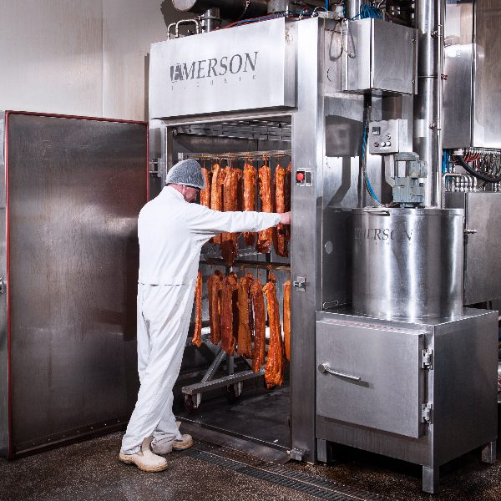
Material and Methods Cont…
Chamber operation
Chamber (CA40A, Emerson Technik, Germany)
Smoke generator (GC2+, Emerson Technik, Germany)

Slide 19
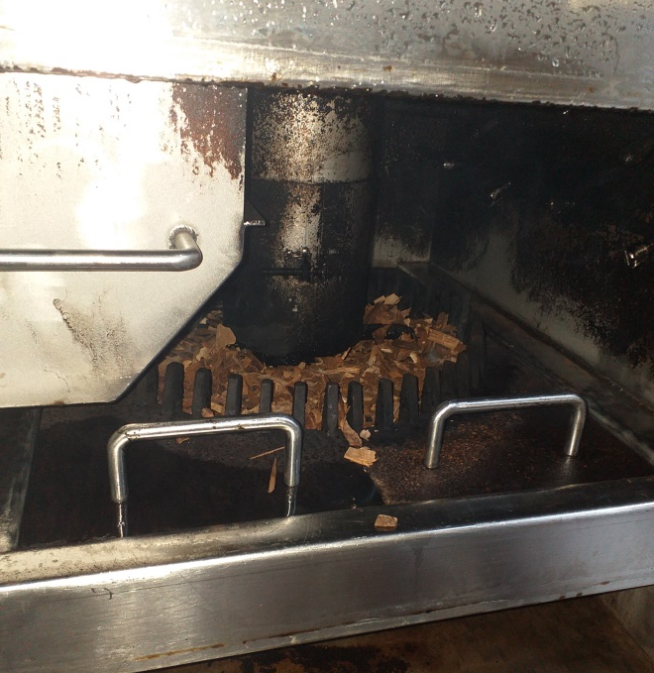
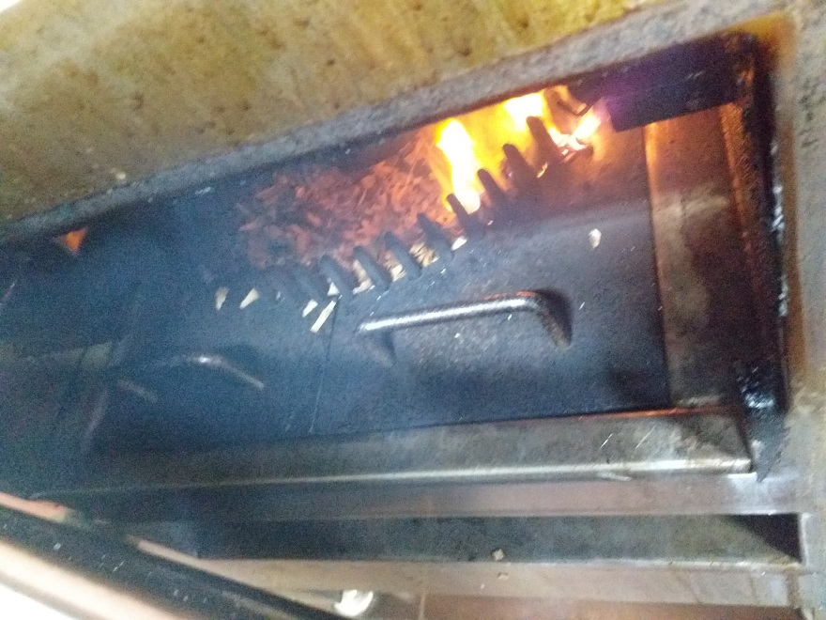
Material and Methods Cont…
Chamber operation – inside of smoke generator
Before smoke generation
During smoke generation

Slide 20
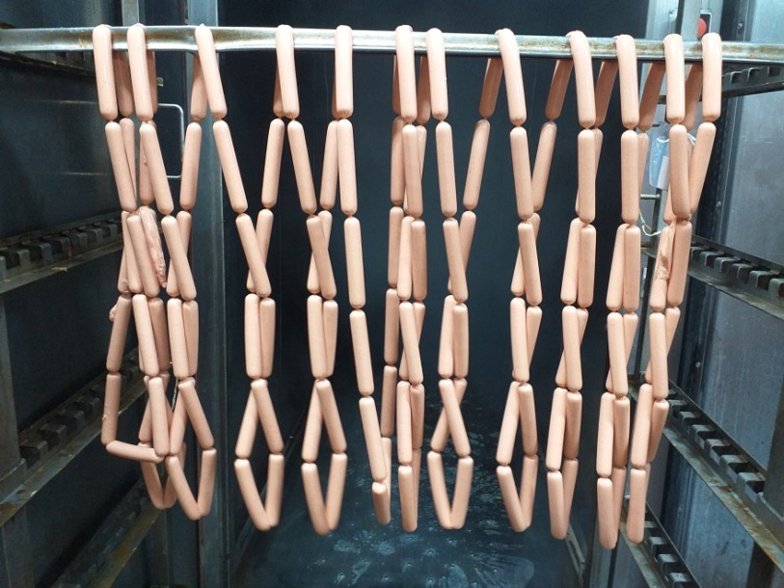
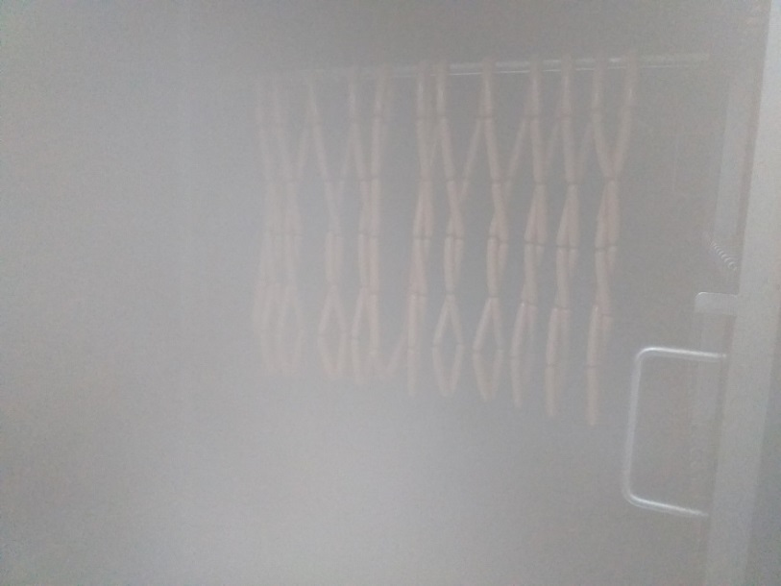
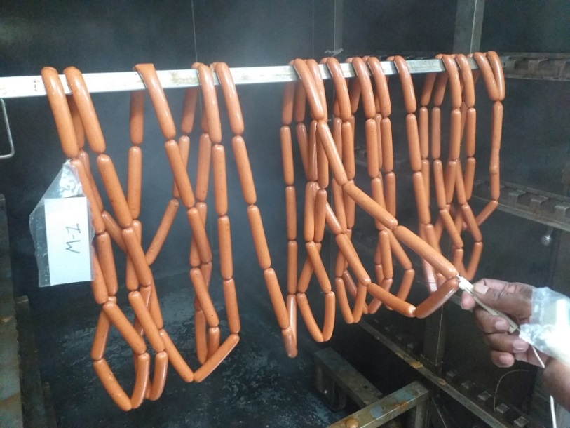
Material and Methods Cont…
Chamber operation – inside of chamber
Before
During
After

Slide 21
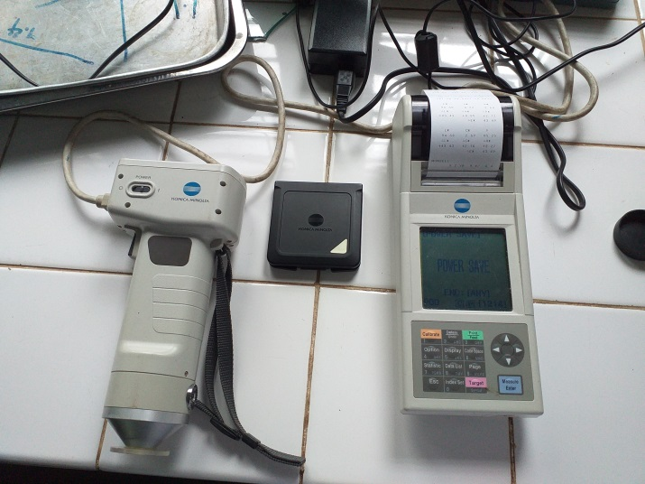
Material and Methods Cont…
Analysis of color measurement of smoked sausages
The instrumental color of each treatment was determined using a Chroma meter.
The intensity of the color of sausages was represented as L* (lightness), a* (redness), and b* (yellowness) values.
Chroma meter, CR-400/410, Japan

Slide 22
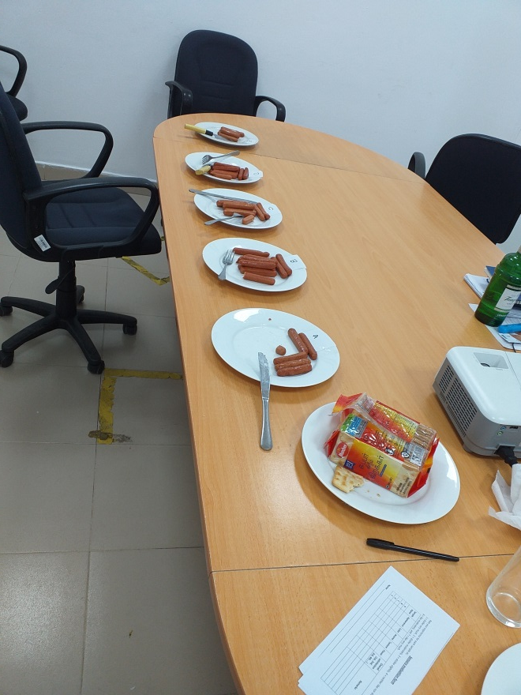
Material and Methods Cont…
Sensory evaluation
Recruited 31 trained and untrained panelists.
Sensory attributes were evaluated using a seven-point hedonic scale.
The scaling was used to assess the degree of liking of:
  appearance,
  color,
  aroma,
  flavor,
  texture and
  overall satisfaction.

Slide 23
Material and Methods Cont…
Sensory evaluation

Slide 24
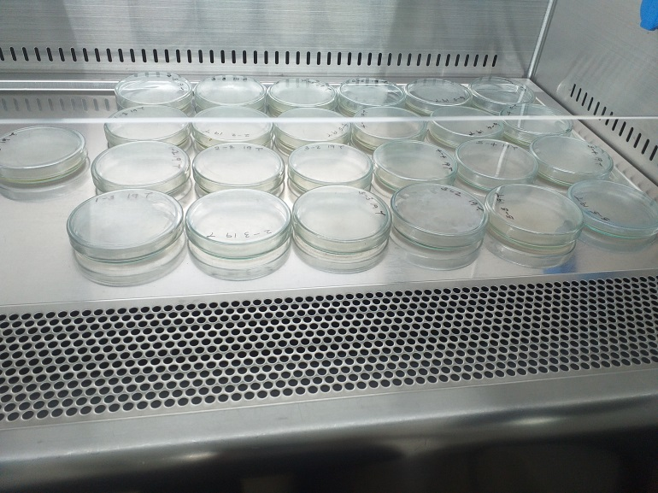
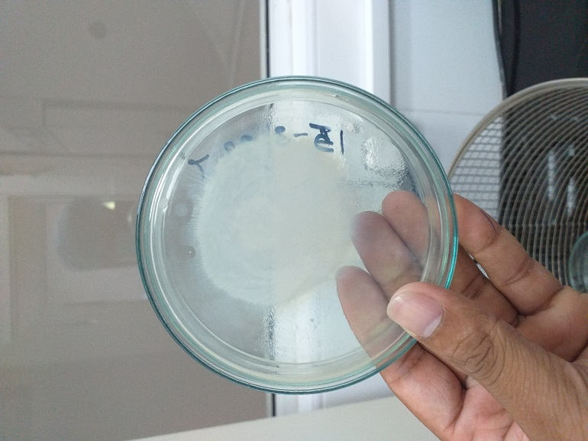
Material and Methods Cont…
Aerobic plate counts to evaluate the anti-microbial effect of wood smoke
Total plate count (TPC) was performed for the samples to assess the reducing percentage of microbial load during the chamber process.

Slide 25
Material and Methods Cont…
Aerobic plate counts to evaluate the anti-microbial effect of wood smoke
Microbial load reducing percentage was calculated after the chamber process using the following equation:

Slide 26


Material and Methods Cont…
Statistical Analysis
The experimental design, completely randomized design (CRD), was used in the whole study, except for the sensory test which employed the non-parametric Friedman test using application of SPSS version 25.0 (IBM SPSS, Chicago, IL, USA) with 95% confidence level (p<0.05).
Differences of means were determined in Tukey’s multiple comparison test using the online web application of SAS® OnDemand for Academics (SAS Institute Inc. in the USA) with 95% confidence level (p < 0.05).

Slide 27
Results and Discussion
Color analysis of sausages
a – e Means within the same line with different letters differ significantly (P < 0.05). All data are expressed as the mean ± standard deviation of measurements.
L* :- Lightness value
a* :- Redness value
b* :- Yellowness value

Slide 28
Results and Discussion Cont…

Slide 29
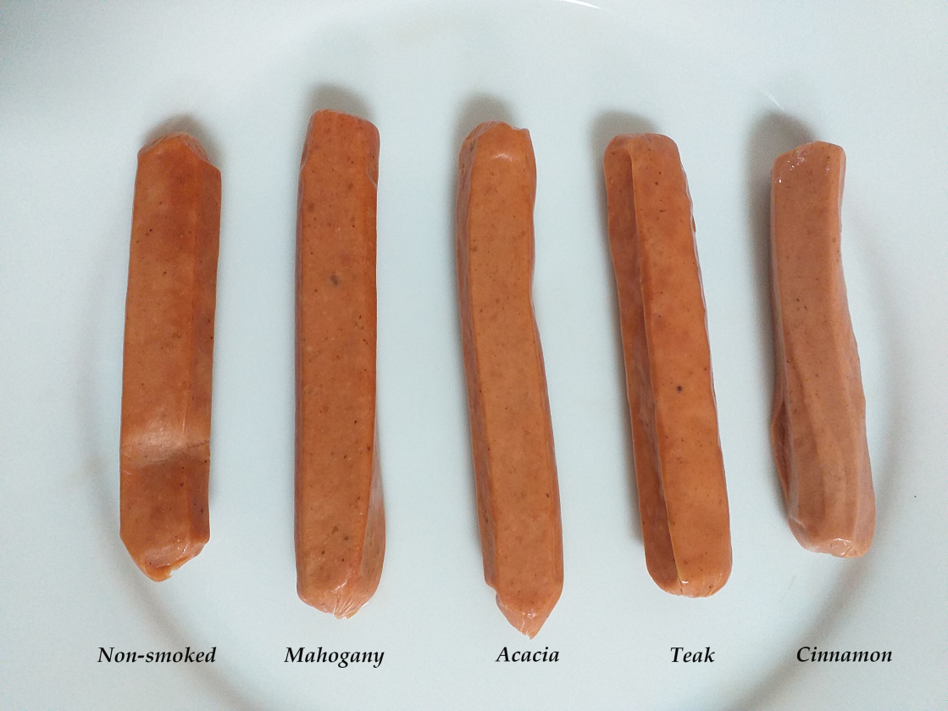
Results and Discussion Cont…
Color analysis of sausages

Slide 30
Results and Discussion Cont…
Sensory evaluation
Spider web chart of sensory evaluation data for chicken sausage smoked with different types of woodchips

Slide 31
Results and Discussion Cont…
Total Plate Count and microbial load reducing percentage analysis after the chamber process
Total plate counts (log CFU/g) of sausages before and after the chamber process and microbial load reducing percentage after chamber process of sausages smoked using different types of woodchips.

Slide 32
Conclusion and Recommendations
The overall results suggested that the Acacia, Cinnamon and Mahogany woodchips could be potentially utilized as local woodchips for smoking sausage in the meat industry.
Further studies need to be done to compare the microbial effect that occurred due to these woodchips smoke.

Slide 33
References
Additives, A. F. (1997). Smoke 25.1. 5–6.
Du, H., Chen, Q., Liu, Q., Wang, Y., & Kong, B. (2021). Evaluation of flavor characteristics of bacon smoked with different woodchips by HS-SPME-GC-MS combined with an electronic tongue and electronic nose. Meat Science, 182(April), 108626
Hui, Y. H., Aalhus, J. L., Cocolin, L., Guerrero-Legarreta, I., Nollet, L. M. L., Purchas, R. W., Schilling, M. W., Stanfield, P. S., & Xiong, Y. L. (2012). Handbook of MEAT AND MEAT PROCESSING, Second Edition. In Handbook of Meat and Meat Processing, Second Edition.
Ledesma, E., Rendueles, M., & Díaz, M. (2017). Smoked Food. In Current Developments in Biotechnology and Bioengineering: Food and Beverages Industry. Elsevier B.V.

Slide 34
References
Lelwela, G. K. T. N., Wijesinghe, S. K. D., Himali, S. M. C., & Abeyrathne, E. D. N. S. (2021). Effect of Selected Wood Smoke on Physicochemical and Sensory Qualities of Tilapia (Oreochromis niloticus). Journal of Aquatic Food Product Technology, 30(1), 85–94.
Pöhlmann, M., Hitzel, A., Schwägele, F., Speer, K., & Jira, W. (2013). Influence of different smoke generation methods on the contents ofpolycyclic aromatic hydrocarbons (PAH) and phenolic substances inFrankfurter-type sausages. Food Control, 34(2), 347–355.
Sikorski, Z. E. (2015). Smoked Foods: Principles and Production. In Encyclopedia of Food and Health (1st ed.). Elsevier Ltd.
Sikorski, Z. E., & Sinkiewicz, I. (2014). Principles of Smoking. Handbook of Fermented Meat and Poultry: Second Edition, 39–45.

Slide 35
Thank You

