Slide 1
Evaluation of fabricated fuel briquettes made out of agricultural waste in coconut industry
DRSK Pathirana ¹* , BGRR Bandara² , LLWC Yalegama² , LP Vidhana Arachchi¹ , and
DDMO Dissanayake¹
¹Department of Export Agriculture, Faculty of Agricultural Sciences, Sabaragamuwa University of Sri Lanka
²Coconut Processing Research Division, Coconut Research Institute, Lunuwila, Sri Lanka

Slide 2
Content for the presentation
Introduction
Objectives
Material and Methods
Results and Discussion
Conclusion and Recommendations
References

Slide 3
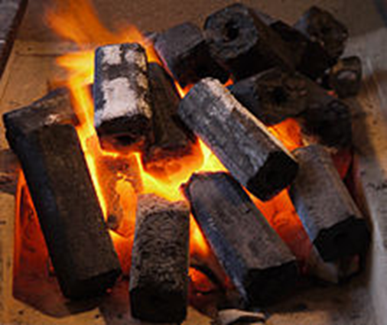
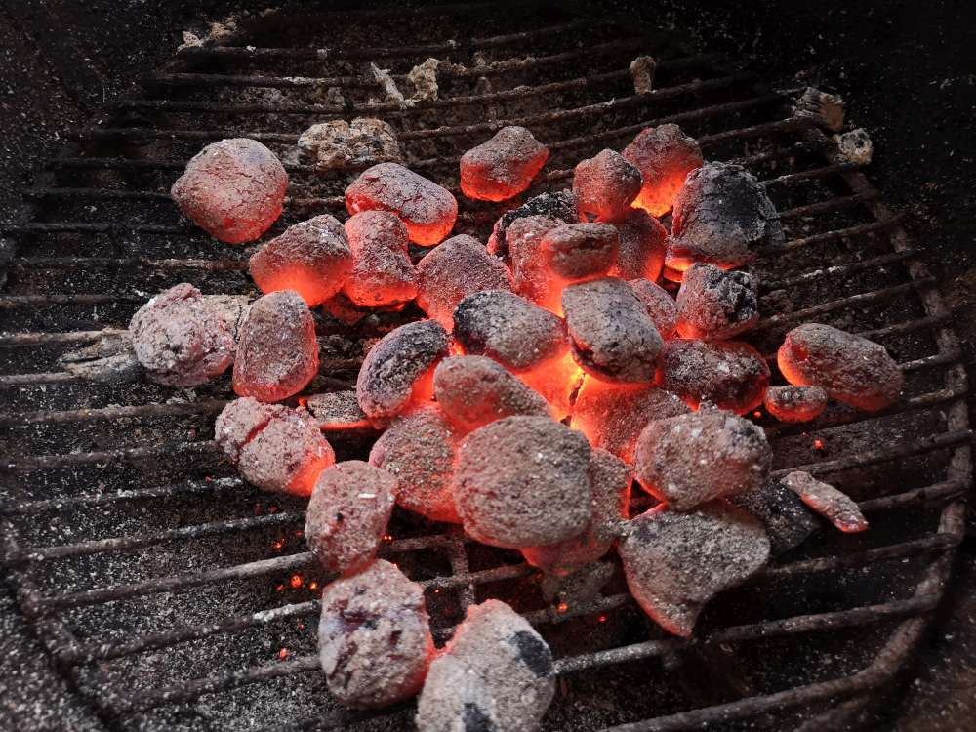
Introduction
Energy is a crucial need for households and industries.
Many of the modern sources of energy currently in used.
Which most are not economically feasible and affordable and are non renewable.
Fuel crisis is a huge problem around the world and specially in Sri Lanka.

Slide 4
Research problem
High wastage of the Coconut industry-based by-products.
Developing countries and poor countries faced huge trouble due to low accessibility and there is no affordable energy source.
Most of fuel briquettes developed by using starch of potato, manioc and wheat as a binding agent.

Slide 5
Objectives
General Objective
To develop the fuel briquettes from the coconut industry-based bio waste.
Specific Objective
To find a suitable binding agent for coconut waste fuel briquette.
To analyze the combustion properties of each briquette developed.

Slide 6
Material and Methods
Location
Coconut Processing Research Division in Coconut Research Institute, Lunuwila

Slide 7
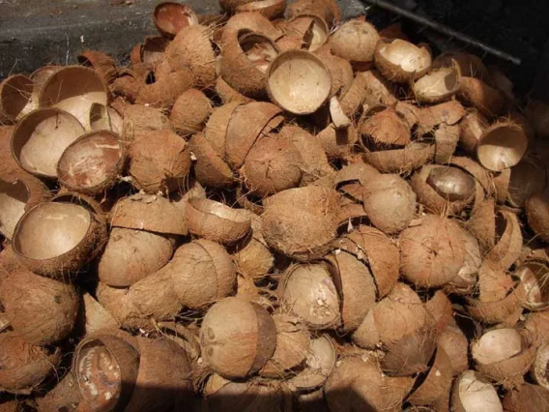
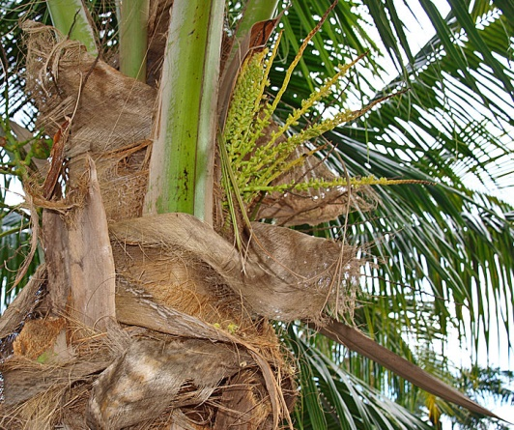
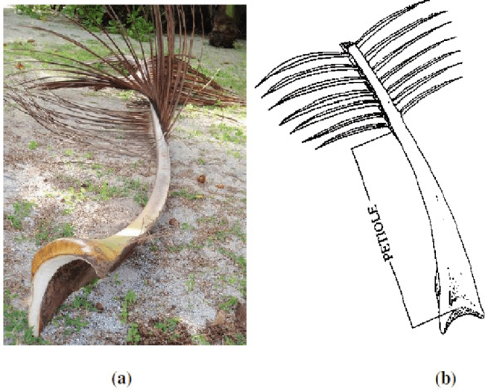
Collection of raw materials and selected binding agents
Raw materials
Coconut shell
Coconut sheath
Coconut petiole

Slide 8
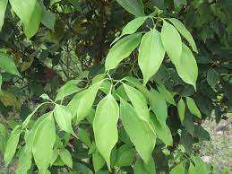
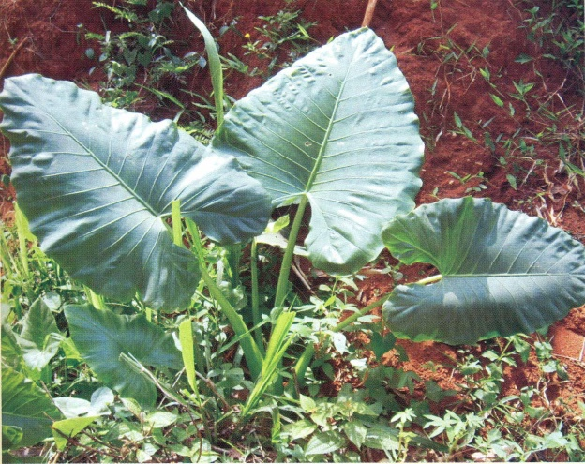
Binding agents
Dawul kurundu (Neolitsea cassia) leaves extraction
Habarala (Alocasia macrorrhiza) tuber extraction

Slide 9
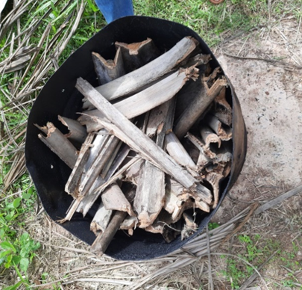
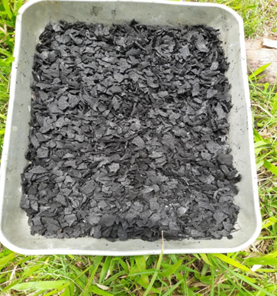
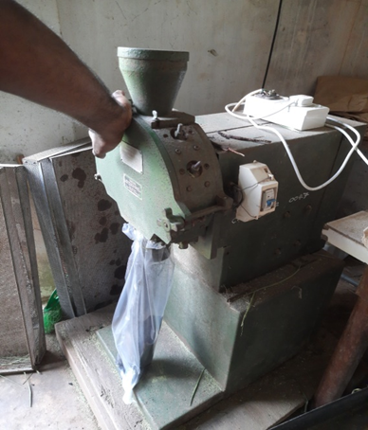
Preparation of raw materials
Coconut shell charcoal
Dried coconut shells in a barrel
Coconut petiole charcoal
Dried coconut petiole were cut into small pieces
Coconut petiole pieces were put into barrel and lid was cloased
Coconut sheath charcoal
Dried coconut sheaths were put into the barrel
After 2 hrs partially burnt coconut sheaths were cooled and removed out
Burning under low O₂ concentration
After 4 hrs, burnt coconut shells were cooled by spraying water and removed out
Burnt under low O₂ concentration
After 3 hrs, partially burnt petiole pieces were cooled and removed out
Burnt under low O₂ concentration
Charcoal was dried under sun to remove excess water
Charcoal was ground & sieved (1 mm)

Slide 10
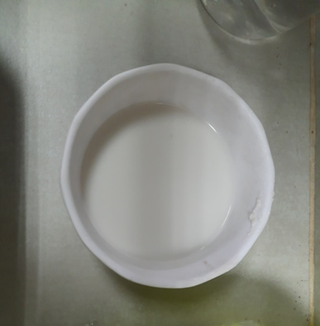
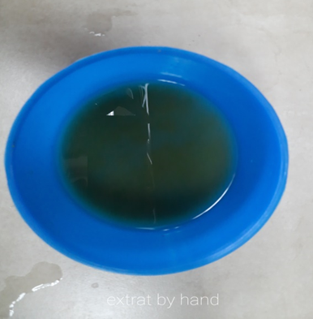
Preparation of binding agents
Habarala tuber extraction
Habarala tubers were washed
Cut into small pieces and removed peel
Pieces were put into blender and added 50 ml of water
Pieces were ground properly
10 - 15 dawul kurundu leaves were put into container
Leaves were ground by hand
Extraction was filtered by using cloths
Dawul kurundu leaves extraction
Added 50 ml of water

Slide 11
Treatment combinations
 | Composition Binding agents | Coconut shell | Coconut petiole | Coconut sheath
Sample 1 | DK | 100 % | - | -
Sample 2 | HS | 100% | - | -
Sample 3 | DK | 50 % | 50 % | -
Sample 4 | HS | 50% | 50% | -
Sample 5 | DK | 33.33 % | 33.33 % | 33.33%
Sample 6 | HS | 33.33% | 33.33% | 33.33%
Dawul Kurundu leaves extraction= DK Habarala tuber extraction = HS
Only “dawul kurundu” leaves extraction and only “habarala” were used separately to the each sample as a 30% from the composition.

Slide 12
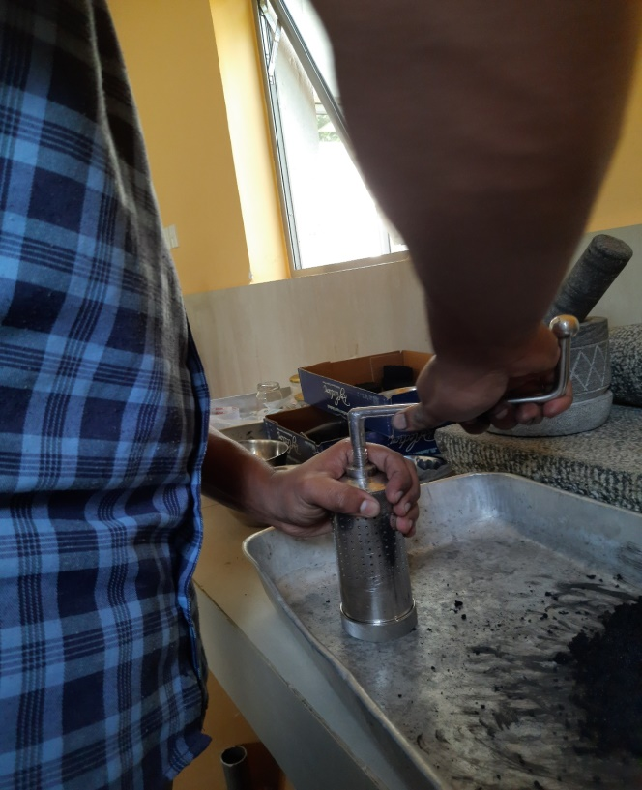
Preparation of fuel briquette
Different composition of coconut shell, coconut petiole, coconut sheath (200g)
30% of binding agents use separately with each combination of raw materials (60g)
50g of mixture was used to prepare one briquette.
The combined binder and mixture of biomass charcoal (50g) was put into the hand operated briquetting machine and compress to produce fuel briquette.
Lever was rotated for specific number of turns (12 turns).

Slide 13
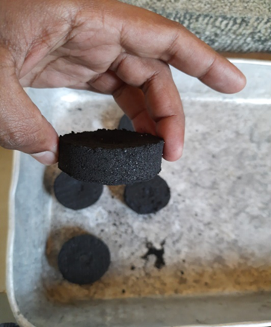
Determination of fuel briquette characteristics
Moisture Content (MC)
By heating in the oven at 105 ⁰C until the weight become constant.
$$MC=\frac{D}{A}×100$$
D – Change in weight of the sample after heating
A – Weight of the sample
(Mitchual et al., 2014)

Slide 14
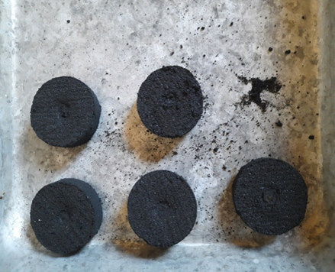
Volatile Matter Content (VMC)
Sample was kept in a furnace at 550 ⁰C for 10 min.
$$VMC=\frac{A−B}{A}X 100$$
A – Weight of the sample
B – Weight of the sample after heating
(Mitchual et al., 2014)

Slide 15
Ash Content (AC)
By heating briquette sample in the furnace at 550 ⁰C for 4 hours.
$$AC (\%)=\frac{C}{A}×100$$
A – Weight of the sample
C – Weight of the sample after heating
(Mitchual et al., 2014)

Slide 16
Fixed Carbon Content
The percentage Fixed Carbon Content was calculated by following equation using Volatile Matter Content (VMC), Ash Content (AC) and Moisture Content (MC).
Fixed Carbon Content %=100-(VMC+AC+MC)

Slide 17
Shatter Index
The shatter index was determined by using drop test.
$$shatter index \%=\frac{mass of the briquette retained}{initial weight of the briquette}×100$$

Slide 18
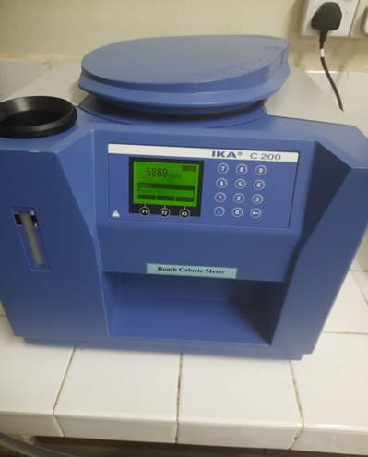
Calorific Value (CV)
By using bomb calorimeter (IKA C200).

Slide 19
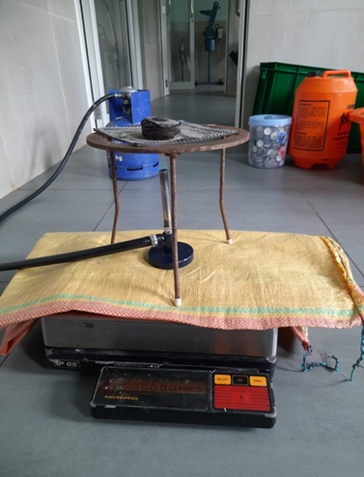
Burning Rate
Bunsen burner and wire gauze were arranged on the balance and their weight was recorded.
Then the sample was placed on wire gauze and weight was recorded. After that sample was ignited using burner.
After briquette was completely burnt and constant weight was obtained. The weight loss at specific time was calculated from the equation. (Davies & Davies, 2013)
$$Burning Rate=\frac{total weight of burnt briquette}{total time taken}$$

Slide 20
Ignition time
By igniting the sample on a Bunsen burner.
Time taken to ignite was recorded by using stop watch (Davies & Davies, 2013).

Slide 21
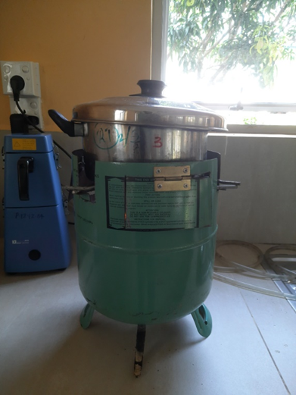
Cooking Efficiency
The cooking efficiency of briquette sample was determined by using Water Boiling Test.
A Known weight of briquette samples were used to boil 500 ml of water by using a domestic briquette stove. The time taken to boil water was recorded

Slide 22
Data Analysis
Data was analyzed by two factor factorial CRD- ANOVA test.

Slide 23
Results and Discussion
Moisture content
Treatment combinations had significant difference with other treatment combinations (p< 0.05)
All treatments, except 50% coconut shell & petiole with dawul kurundu has 5-10% moisture content.
High moisture content (>10%) of biomass results in poor ignition and reduces the combustion temperature.

Slide 24
Ash content
Each treatment combinations had significant difference with other treatment combinations (p <0.05).
100% Coconut shell with dawu kurundu treatment has lowest ash content.
Even if tolerance level of ash content for fuel is below 4% (Bot et al., 2021).

Slide 25
Volatile Matter Content
Each treatment combinations had significant difference with other treatment combinations (p < 0.05).
High Volatile Matter appropriate for pyrolysis (Obeng et al., 2020).
High volatile matter content is an indication of the readiness of fuel samples to ignite (Bot et al., 2021).
The high volatile matter implies ability to readily ignite with a high proportionate fame during combustion.

Slide 26
Fixed Carbon Content
Each treatment combinations had significant difference with other treatment combinations (p<0.05).
Generally, low fixed carbon content affect the briquettes tend to be harder, heavier and ignites much easier (Bot et al., 2021).
Fixed carbon helps to selection of combustion equipment, since its form and hardness are an indication of the cooking properties of a fuel (Sarkar, 2015)

Slide 27
Shatter Index
Each treatment combinations had significant difference with other treatment combinations (p<0.05).
According to these results habarala tuber extraction has highest binding ability comparing with dawul kurundu leaves extraction.
With comparing compositions, results shows highest shatter index has 100% coconut shell mixture that means it has high durability than other treatments.

Slide 28
Calorific Value
Each treatment combinations had significant difference with other treatment combinations (p<0.05).
Chemical compositions of briquette samples are mainly affected for the calorific value, in particular, the varying effect of lignin and extractive content.
Moreover, low ash content and high volatile matter content of 100% coconut shell treatments also affect to the calorific value (Obeng et al., 2020).

Slide 29
Ignition Time
Each treatment combinations had significant difference with each other (p<0.05).
High porosity affect to the ignition time of the briquette because it increase percolation of oxygen and out flow of combustion due to low bonding force.
Therefore, lowest ignition time shows in treatments with lowest binding force (Davies & Davies, 2013).

Slide 30
Burning Rate
Each treatment combinations had significant difference with other treatments (p<0.05).
According to this observation, more fuel might be required for cooking with briquettes produced from 100% coconut shell with habarala tuber extraction.

Slide 31
Cooking Efficiency
Treatment combination had no significant difference with other treatments (p>0.05).
According to two factors, there are significant different considering binding agent and composition (p<0.05).

Slide 32
Conclusion and Recommendations
According to the results 100% Coconut shell is the best composition compare to the other treatments.
Highest calorific value and shatter index shows in 100% coconut shell composition.
Alternative “Habarala” tuber extraction is better as a binding agent compare to the “Dawul kurundu” leaves extraction.
Therefore, “Habarala” tuber extraction can be used as an alternative substitute for the binding agents and 100% coconut shell charcoal with “Habarala” tuber extraction can be used as an alternative energy source for the future energy demand.
50% coconut shell, 50% coconut petiole with habarala treatment also shows comparatively higher performance with 100% coconut shell habarala treatment, therefore 50% coconut shell, 50% coconut petiole with habarala treatment can be used as an alternative substitute for domestic and industrial energy requirement.

Slide 33
References
Mitchual, S. J., Frimpong-Mensah, K. and Darkwa, N. A. (2014) ‘Evaluation of Fuel Properties of Six Tropical Hardwood Timber Species for Briquettes’, Journal of Sustainable Bioenergy Systems, 2014(01), pp. 1–9. doi: 10.4236/JSBS.2014.41001.
Phyu Phyu Tun1, 2,*, Chandra Bhushan Sah3, Shwe Sin Win2, K. S. (2019) The Preparation and Characteristics of Briquettes From Coconut Husks as Renewable Source of Energy. Available at: https://twasp.info/public/paper/58 -71 coconut new paper.pdf (Accessed: 29 August 2022).
Chevalier, J. M., &amp; Geoffron, P. (2016). The new energy crisis. The New Energy Crisis:Climate, Economics and Geopolitics, 1992, 1–52. https://doi.org/10.1007/978-1-137-02118-2_1
Danon, G., Stevanovic Janezic, T., Bujanovic, B., &amp; Stanojevic, G. (1997). Fuel Characteristics of Briquettes from Wood Waste and Recycled Paper. Developments in Thermochemical Biomass Conversion, 731–740. https://doi.org/10.1007/978-94-009-1559-6_58
Omer, A. M. (2014). Energy use and environmental impacts: A general review. Advances inEnergy Research, 17(2009), 1–38. https://doi.org/10.1063/1.3220701

Slide 34
Acknowledgment
Internal Supervisor- Senior Professor Lal P. Vidhana Arachchi, Senior Lecturer, Department of Export Agriculture, Faculty of Agricultural Sciences, Sabaragamuwa University of Sri Lanka
External supervisor- Dr. Chandi Yalegama, Head Coconut Processing Research Division, Coconut Research Institute, Lunuwila
Co-Supervisor- (Prob). Lecture miss D.D.M.O.Dissanayake, Department of Export Agriculture, Faculty of Agricultural Sciences, Sabaragamuwa University of Sri Lanka
Ms. Ranahansi Bandara, Research Officer, Coconut Processing Research Division, Coconut Research Institute, Lunuwila
All staff members of Coconut Processing Research Division, Coconut Research Institute, Lunuwila
Department of Livestock production faculty of agricultural sciences & management Sabaragamuwa University of Sri Lanka
All staff members of faculty of agricultural sciences & management Sabaragamuwa University of Sri Lanka

Slide 35
Thank You

