Slide 1
An assessment of factors influencing tea factory productivity: A case study at Kahawatte Plantations PLC
A, K, M, V, Bandara¹, M. Esham¹ J. Abesirigunawardhana²
¹Department of Agribusiness Management, Faculty of Agricultural Sciences, Sabaragamuwa University of Sri Lanka, Belihuloya, Sri Lanka.
²Kahawatte plantations PLC, Pelmadulla Estate, Sri Lanka.

Slide 2
Content for the presentation
Introduction
Objectives
Material and Methods
Results and Discussion
Conclusion and Recommendations
References

Slide 3
Introduction
Sri Lanka is renowned for its high-quality tea and is the 4th biggest tea producing country globally. (FAO annual report, 2020) The production share is 10%, and one of the world’s leading exporters with a market share of around 19% (Sri Lanka Tea Board,2021.)
Tea plantations started by the British were initially taken over by the government in the 1960s but have been privatized and managed by plantation companies since1992 The total extent of tea cultivation in 2020 was approximately 202,985ha (Sri Lanka Tea Board,2021.)
Tea is the most prominent plantation crop in Sri Lankan agricultural sector contributing heavily to the development of the Sri Lanka economy by generating foreign exchange.

Slide 4
Introduction
Productivity is considered one of the main parameters that measure the efficiency of an individual, institution, or state in a general. In recent years falling international tea prices and the rising cost of tea production have made the international market highly competitive. Making improvements in productivity important to be competitive.
In this context, this study was undertaken to understand the determinants of tea factory productivity, energy use and labor use efficiencies and trends.
A case study was undertaken at Kahawatte Plantation PLC which is a leading agribusiness company in the plantation industry in Sri Lanka..

Slide 5
Research problem
Although Kahawatte Plantation PLC is a leading company producing tea under the globally recognized brand name ‘Dilmah’, the productivity levels are not satisfactory. There are a number of possible reasons for low productivity such as inefficient use of energy, poor quality of green leaves, high wastage and poor labor productivity among them . However, there has been no systematic study to identify the causes of low factory productivity and the underlying reasons and the ways to overcome them. In order to bridge this knowledge gap this study was undertaken.

Slide 6
Research questions
What are the energy efficiencies and trends of electricity and firewood usage?
What are the factors influencing factory productivity measured in terms of made tea outturn?
What factors determine factory labor productivity?
What strategies can be adopted to enhance the factory productivity?

Slide 7
Objectives
Broad objective
To determine the tea factory productivity levels, trends, and factors influencing productivity.
Specific objectives
To analyze Firewood usage efficiency and the trends over the last three years.
To analyze Electricity usage efficiency and the trends over the last three years.
To determine factors influencing factory productivity measured in terms of made tea outturn.
To determine factors influencing factory labor productivity.
To propose strategies to enhance factory productivity

Slide 8
Material and Methods
Research Design : Survey strategy
Research Approach: Deductive approach
Sample
Factory productivity: Factory operations(3 years production related data organized into weekly data comprising of 140 data points (since 2020/01/01 to 2022 /12/01)
Labour productivity: Entire population was selected comprising of 65 employees in the Neelagama tea factory
Data collection method
Primary data - Questionnaire, Interviews
Secondary data - Other researches, factory data files (used past 3 years data 2020/01/01-2022/12/01)
Data analyzing method
Descriptive analysis - Frequency and graphical analysis
Statistical analysis - multiple linear regression analysis method, correlation analysis.
Data analysis tools - SPSS statistical software version 25
- MS excel

Slide 9
The tea process flow diagram
Fresh tea leaves
Withering
Electricity
Fire wood
Ambient air
Rolling
Electricity
High humidity air
fermentation
Electricity
Draying
Electricity
Fire wood
Dust, fiber and solid wastes
Packing and grading
Electricity
Black tea

Slide 10
Conceptual framework
Dependent variable
Independent variables
Made tea out turn
Firewood
Electricity
Labour productivity
Rainfall
Refused tea
Independent variables
Job knowledge
Planning and problem solving
Training programs.
New technology and machinery
Ratio of factory running capacity / full capacity
Labour

Slide 11
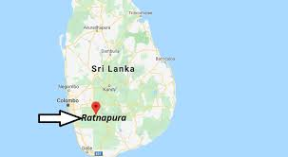
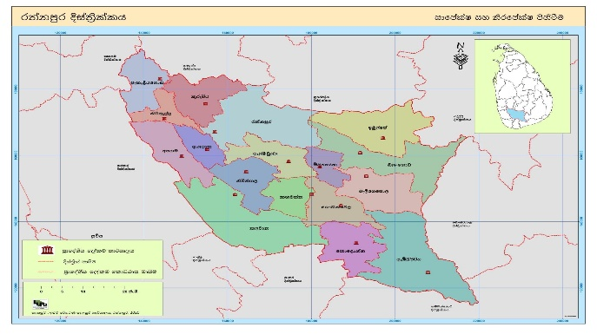
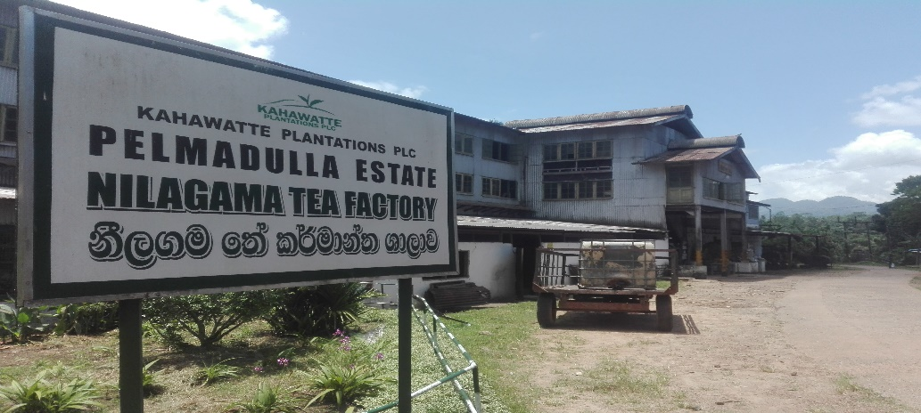
Study Location
The study was undertaken at the Neelagama tea factory belonging to Kahawatte Plantation located in Rathnapura
11

Slide 12
Results and Discussion

Slide 13
01 To determine the tea factory productivity levels, trends, and factors influencing productivity.
2020
2021
2022
Graph 01

Slide 14
02 To analyze Electricity usage efficiency and the trends over the last three years.
1
4
5
8
2
3
6
7
14
2020
2021
2022
Graph 02

Slide 15
03 To analyze firewood usage efficiency and the trends over the last three years.
5
1
m³kg⁻¹
2
4
3
6
Graph 03
2020
2021
2022
Graph 03
15

Slide 16
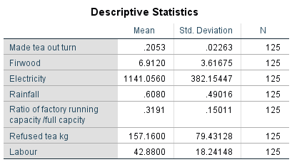
03 To determine factors influencing factory productivity measured in terms of made tea outturn.
Made tea out turn = (kg. of made tea produced using 100 kg. of green leaves)
Refused tea percentage = (Refused tea /Made tea)
Factory full capacity (kg. of green leaves per day)
Factory Running capacity (Average kg. of green leaves per day/Total withering trough capacity(1680kg*8=13440kg)
Ratio of factory running capacity to full capacity =(factory running capacity/ full capacity )
Made tea per man day= ( Made tea / Man day)

Slide 17
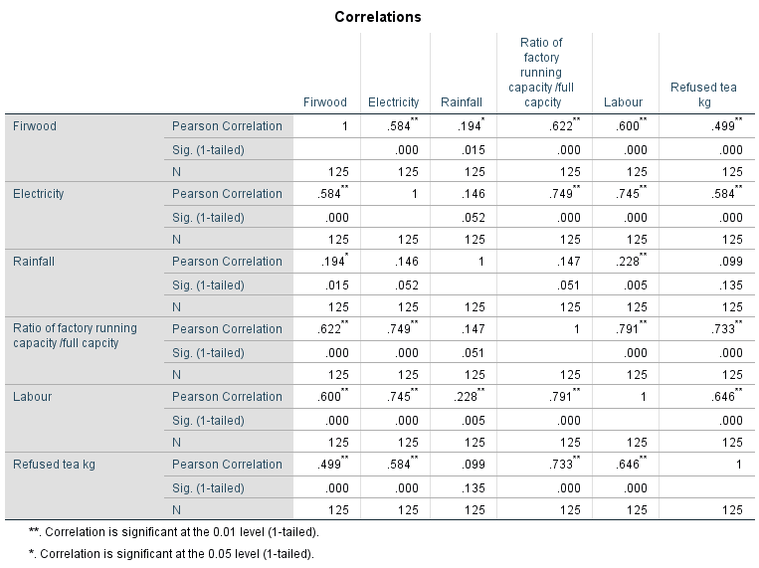
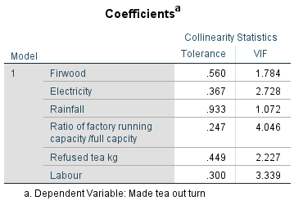
A multicollinearity diagnostic was done to check whether independent variables are highly correlated among themselves or not. the Pearson correlation coefficients form the inter-correlation matrix were found below.90 and by comparing tolerance values and variance inflation factors it was found that the tolerance values are higher than 0.2 and VIF values are less than 5 therefore the tolerance values and the VIF values are within the expected range that prevent the multicollinearity. Hence, the Multiple regression analysis can be carried out.

Slide 18
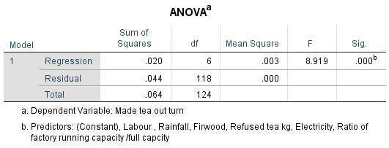
R square = 0.312 taken as set, the predictors of all five independent variables account for 31.2% of the variance in employees productivity
F – statistics is the test of significance or entire regression, this regression is statistically significant because p value is less than 0.05 and it shows the regression model is a good fit of data.

Slide 19
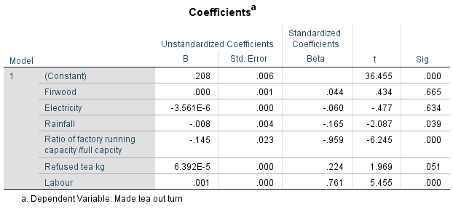
The results show that rainfall, ratio of factory running capacity/ full capacity, labour availability were statistically significant factors that affected made tea outrun at Neelagama tea factory.
The made tea outturn at the factory was significantly affected by rainfall, capacity utilization and labor availability. Rainfall was found to have tow main effects. on rainy days. Due to extra water coming with the tea leaves, it affects the reduction of made tea out turn.
It was found that when the ration of running capacity/ full capacity increases and the made tea out turn decreases due to the deficiencies in the machines and workers.

Slide 20
04 To determine factors influencing factory labor productivity.
Demographic characteristics of factory workers
Gender
Work experience
Age
Education level

Slide 21
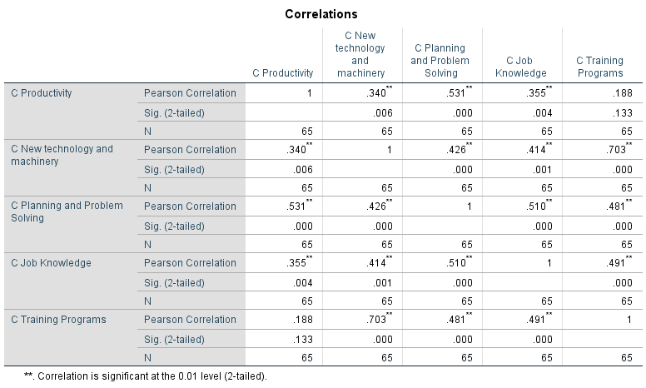
Correlation Test
The correlation between the labour productivity and new technology and machinery was statistically significance at the 0.01 level with a Pearson correlation coefficient of +0.34.it shows that there is positive relationships between the labour productivity and new technology and machinery
The correlation between the labour productivity and planning and problem solving was statistically significance at the 0.01 level with a Pearson correlation coefficient of +0.531.it shows that there is positive relationships between the labour productivity and planning and problem solving
The correlation between the labour productivity and job knowledge was statistically significance at the 0.01 level with a Pearson correlation coefficient of +0.355 .it shows that there is positive relationships between the labour productivity and job knowledge

Slide 22
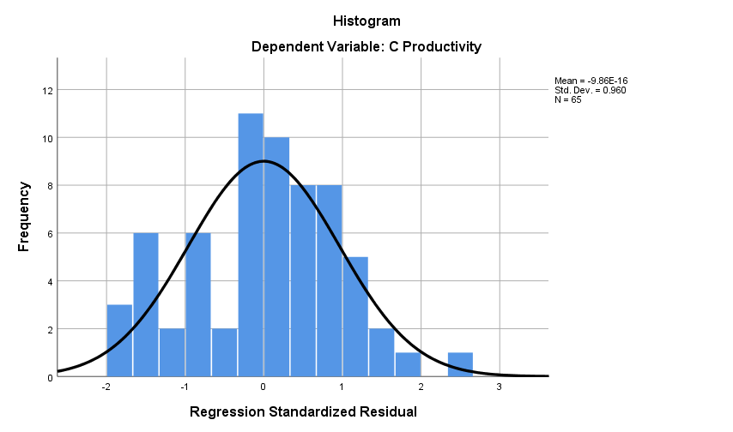
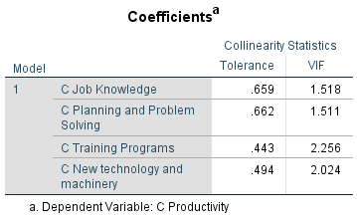
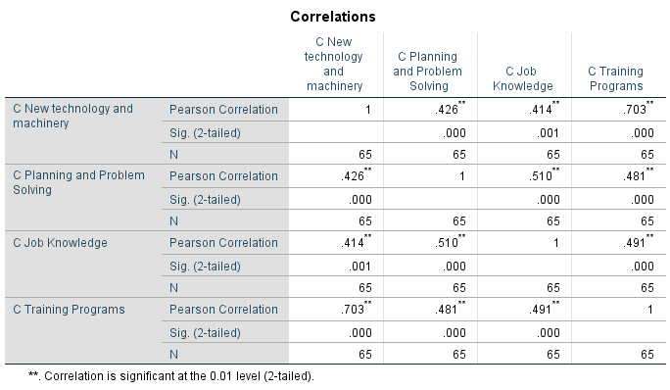
Multicollinearity Test
Where Tolerance value is not less than 0.2, no risk for Multicollinearity.
Where VIF value is not greater than 5.0, no risk for Multicollinearity.

Slide 23
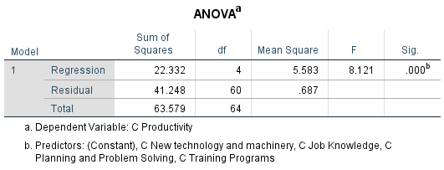
Model Summary
R square = 0.351 taken as set, the predictors of all five independent variables account for 35.1% of the variance in employees productivity
ANOVA Table
F – statistics is the test of significance or entire regression, this regression is statistically significant because p value is less than 0.05 and it shows the regression model is a good fit of data.

Slide 24
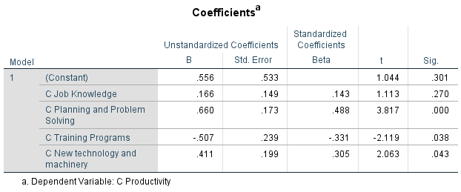
Coefficients Table
The regression results show that planning and problem solving, training and new technology and machinery are statistically significant factors that affected labor productivity at Kahawatte plantation PLC.
.

Slide 25
05 To propose strategies to enhance factory productivity
Maintenance schedule-This manual describes how to maintain all the machines used in the factory. Proper maintenance of machinery can reduce cost of production. This enables the parent company to provide necessary parts and inputs on a timely manner to maintain the machineries in good working condition.
NSA Calculator- (Net sale average)- This is mainly important for plantation companies. This is designed so that NSA can be calculated directly from a mobile application. This saves time and can be used not only for tea but also for rubber and cinnamon. http://onlinegpacla.byethost16.com/tea_bill/
Cost of production calculation software - This calculator enables to calculate the COP on real time. This is a database created using Microsoft Access. When the input details such as green leaves, electricity, firewood, transport cost, withering leaf count are fed into the system the average cost of production per kg can be obtained.

Slide 26
Recommendations
The factory productivity should be maintained at acceptable levels. For this need to ensure good quality green leaves are received at the factory especially during rainy seasons (high moisture content leads to waste of energy).
To utilize the full capacity of the factory it is necessary to ensure that enough skilled labour is available and the machineries are properly maintained and upgraded.
According to the findings of this study measures need to be taken to increase labour productivity in the tea factory. For this it is necessary to provide training to workers recruit skilled employees, adopt new production techniques and use modern machinery.
By educating and using the tools and innovations developed as part of the case study can help to enhance the factory productivity.

Slide 27
Conclusion
Energy use efficiency variation can be attributed to green leaf quality, maintenance deficiencies, machine breakdown, deficiencies in management practice.
The made tea outturn at the factory was significantly affected by rainfall, capacity utilization and labor availability. Rainfall was found to have one main effects. On rainy days due to extra water coming with the tea leaves, it affects the made tea out turn.
It was found that when the ratio of running capacity/ full capacity increases and the made tea out turn decreases due to the deficiencies in the machines and lack of enough skill workers.
The results revealed that the lack of skilled labour was a serious problem in enhancing factory productivity. Factors such as lack of new technology and machinery, poor planning and problem solving, lack of job knowledge significantly affected the labour productivity.

Slide 28
References
Amundsveen, R., & Kvile, H. M. (2017). Productivity Development Among Norwegian Electricity Distribution System Operators — The Impact of Capital Assessment and Technological Progress. Data Envelopment Analysis Journal, 3(1–2), 93–118. https://doi.org/10.1561/103.00000016
White, L., & Noble, B. (2012). Strategic environmental assessment in the electricity sector: an application to electricity supply planning, Saskatchewan, Canada. Impact Assessment and Project Appraisal, 30(4), 284–295. https://doi.org/10.1080/14615517.2012.746836
Debeni Devi, N., Chaudhuri, A., & Goud, V. V. (2022). Algae biofilm as a renewable resource for the production of biofuel and value-added products: A review. Sustainable Energy Technologies and Assessments, 53, 102749. https://doi.org/10.1016/j.seta.2022.102749
Nienow, S., McNamara, K. T., Gillespie, A. R., & Preckel, P. V. (1999). A Model for the Economic Evaluation of Plantation Biomass Production for Co-firing with Coal in Electricity Production. Agricultural and Resource Economics Review, 28(1), 106–117. https://doi.org/10.1017/s1068280500001027
Johnson, B. (2012). Co-firing with biomass can keep coal plants operating. Natural Gas & Electricity, 29(1), 1–5. https://doi.org/10.1002/gas.21622
FAO & International Institute for Applied Systems Analysis (IIASA). 2020. Global Agro-Ecological Zones (GAEZ v4.0). Laxenburg, Austria, and Rome

Slide 29
Thank You

