Slide 1
Land Suitability Assessment for Hemp (Cannabis sativa L.) Cultivation in Sri Lanka
G.M.A.D Sirishantha, E. M. Wimalasiri, Ebrahim Jahanshiri, Niluka Kuruppuarachchi,
V. G.P. Chimonyo
¹Department of Export Agriculture, Faculty of Agricultural Sciences, Sabaragamuwa University of Sri Lanka, Belihuloya, Sri Lanka.
²Crops for the Future UK, Cambridge, UK
³Postgraduate Institute of Agriculture, University of Peradeniya, Sri Lank
⁴International Maize and Wheat Improvement Center (CIMMYT), Zimbabwe

Slide 2
Content for the presentation
Introduction
Objectives
Material and Methods
Results and Discussion
Conclusion and Recommendations
References

Slide 3
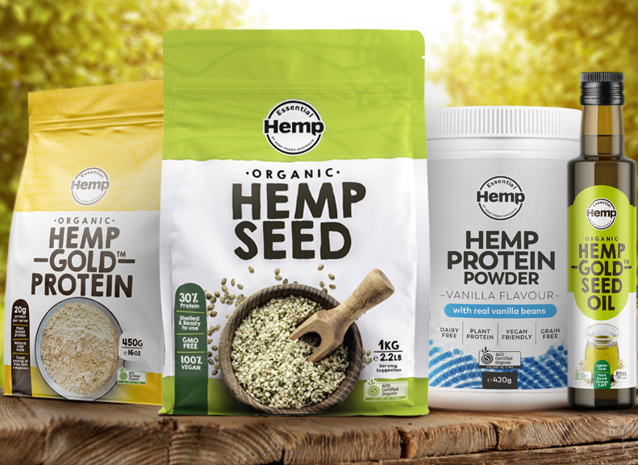
Introduction
Medicinal purpose
Essential oil
Textile
Body care production
Paper production
What is hemp?
Cosmetic
Food and beverage
Economic return
Molded plastic
Nutritional supplement

Slide 4
Research problem
Hemp cultivation is currently prohibited in Sri Lanka
The government seeks legalization of hemp for export revenue
No previous study was conducted analysis the land suitability for hemp in Sri Lanka
Land suitability analysis will be a preliminary requirement before the establishment of a field trial

Slide 5
Objectives
Broad
objective
To assess the suitability of hemp cultivation in Sri Lanka using multi-criteria decision analysis approach
Specific objectives
To predict the fiber production and seed yield of hemp under the baseline climate (1990-2019) and future climate (2040-2069)
To develop a potential map for hemp seed and fiber yield Sri Lanka
To determine the water productivity of hemp and calculate its carbon footprint

Slide 6
Methodology
Economic analysis
10 locations were selected
Yield potential map
47 locations were selected
Figure : Study area map

Slide 7
Baseline climate data (1990 to 2019)
Observed climate data
Global climate data
Meteorological department
Worldclim
(1km * 1km)
Reanalyzed climate data
NASA POWER
Extracted using Arc-GIS
Daily maximum and
minimum temperature
Daily rainfall
Monthly maximum and
minimum temperature
Monthly rainfall
Solar radiation

Slide 8
Future climate data
(2040-2069)
Soil data
CMIP6 database
GCMs ssp2 4.5
Nation-wide open 3D soil database
BCC-CSM2-MR,CMCC-ESM2,MIROC6
MRI-ESM, NorEsm-0
Extracted using Arc-GIS
Daily maximum and minimum temperature, Daily rainfall, Solar radiation
Soil moisture, Texture, Depth, Bulk density, pH

Slide 9
Land suitability analysis
Highly suitable
Suitable
Climate data
Suitability indices
(1-100)
Suitability classification
Moderately suitable
Soil data
Unsuitable
Multicritiria decision analyzing approach
Base on agro ecological zoning approach of FAO (1976)
Permanently unsuitable
(Jahanshiri et al., 2020)

Slide 10
Yield simulation
Climate data
Seed yield (t ha⁻¹)
Soil data
AquaCrop model
(version 6.1)
Fiber biomass production (t ha-¹)
Fiber yield (t ha⁻¹)
Crop parameter
Water productivity (Kg m⁻³)
Management option
(Wimalasiri et al., 2021)

Slide 11
Yield potential map
Potential yield data
Arc-GIS (10.7.1)
Interpolation
Ordinary kriging
Potential yield map

Slide 12
Carbon footprint prediction
A carbon foot can be defined as the total amount of greenhouse gases (including CO₂ and CH₄) that generated by agricultural action.
Fertilizer types and amounts
Total co₂ emission
Energy from machinery operation
The cool farm tool
N₂O emission
https://coolfarmtool.org/
Transport and electricity

Slide 13
Economic analysis
^{Cost benefit analysis}
Net Present Value
NPV = $\frac{Total present value benefit}{Total present value cost}$
-
Net Present Value Benefit
Cost
NPVP = $\frac{Present value Benefit of the tth year}{present value cost of the t th year }$
Seed yield
Fiber yield
Seed cost, Labor
Equipment, Land,
Fertilizer
Benefit Cost Ratio
Benefit
Cost
BCR = $\frac{Total present value benifit}{Total present value costion for various purposes}$

Slide 14
Monthly average climate suitability
Rainfall patterns and temperature fluctuations can be experienced throughout the year in the country
From August to December period is mostly favorable for hemp cultivation in Sri Lanka
Figure : Monthly climate suitability variation

Slide 15
Total average climate and soil suitability
Suitability class | Area (%)
Highly suitable | 73%
Suitable | 25%
Moderately suitable | 1.46%
Unsuitable | 0.23%
Permanently unsuitable | 0.31%
The majority of areas in highly suitable category
Hemp cultivation is mostly favorable in Sri Lanka
Figure : Map for total average climate and suitability

Slide 16
Baseline climate – seed and fiber yield
Figure : Average seed yield
Figure : Average fiber yield
Bar values of the graphs represent the average values of yield
The highest average potential seed and fiber yield out of ten locations was 1.42 ± 0.24 t ha-¹ and 2.41 ± 0.38 t ha-¹ respectively

Slide 17
Baseline climate – water productivity
Figure : Average water productivity for seed production and fiber production
The highest and lowest water productivity for seed production was reported as 0.38 kgm³ and 0.28 kg/m³,respectively, for fiber production, it was 0.25 kg/m³ and 0.17 kg/m³

Slide 18
Future climate variation
Figure : Variation of future rainfall and temperature in ten location during 2040 – 2069 period. The letters in each figure represent five GCMs as A=BCC-CSM2, B=MRI-ESM2-0, C=CMCC_ESM2, D=Nor-ESM2-MM and E=MIROC6. Capital and simple letters stand for maximum and minimum temperature of respective GCM. The baseline climate characteristics were also marked (symbols).

Slide 19
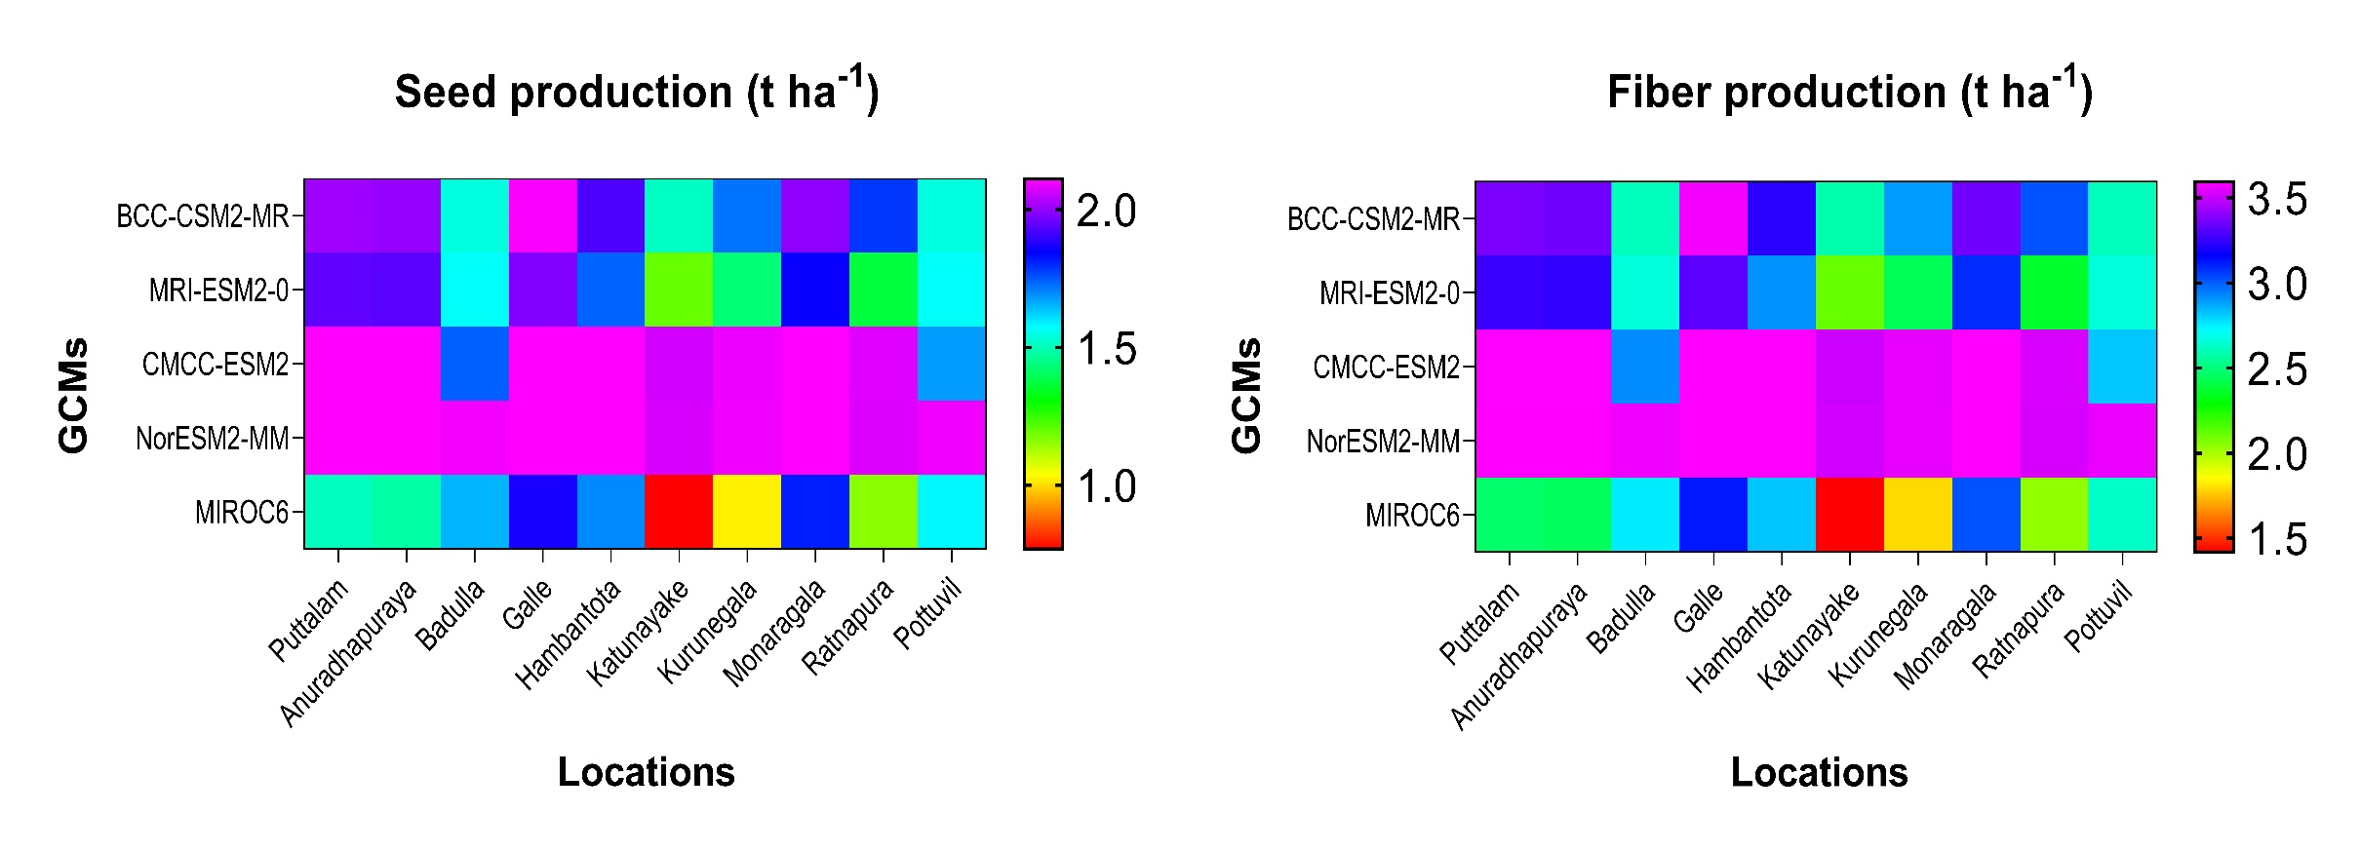
Future yield variation
Figure: Seed production (t ha¹)
Figure: Fiber production (t ha¹)
Yield variations can be observed under different GCMs
Most of the GCMs shows higher yield compared to baseline yield

Slide 20
Yield variation between baseline and future
Figure : seed yield variation
Figure : Fiber yield variation
Future climate conditions are more favorable for hemp cultivation in Sri Lanka

Slide 21
Potential yield map
Every pixel represents the potential yield value for seed and fiber production
Colour range indicates yield variation
Blue colour values represent the higher values, followed green to brown
Figure : Yield variation of seed and fiber

Slide 22
Economic analysis (1990-2019) period
Table: For fiber production
Table : For Seed production
Location | BCR | NPV (USD) | NPVB (USD)
Anuradhapura | 1.57 | 882,631 | 143,268
Hambantota | 1.24 | 380,541 | 61,769
Puttalam | 1.50 | 777,882 | 126,265
Badulla | 1.65 | 1,005,451 | 163,204
Kurunegala | 1.14 | 221,707 | 35,987
Monaragala | 1.58 | 908,018 | 147,389
Galle | 1.49 | 763,591 | 123,945
Ratnapura | 1.28 | 436,853 | 70,909
Katunayake | 0.95 | -70,328.03 | -11,415.61
Pottuvil | 1.47 | 734,773 | 119,268
Location | BCR | NPV (USD) | NPVB (USD)
Anuradhapura | 2.72 | 377,501 | 13,017
Hambantota | 2.16 | 255,580 | 8,813
Puttalam | 2.61 | 354,427 | 12,222
Badulla | 2.83 | 402,396 | 13,876
Kurunegala | 1.92 | 202,076 | 6,968
Monaragala | 2.71 | 376,847 | 12,995
Galle | 2.57 | 344,081 | 11,865
Ratnapura | 2.14 | 251,552 | 8,674
Katunayake | 1.56 | 123,349 | 4,253
Pottuvil | 2.54 | 338,651 | 11,678
Represent the economic feasibility of hemp cultivation, positive values for most of the locations
22

Slide 23
Economic analysis (2040-2069) period
Table : For fiber production
Table : For seed production
Location | BCR | NPV (USD) | NPVB (USD)
Anuradhapura | 2.10 | 14,116 | 487
Hambantota | 2.07 | 13,809 | 476
Puttalam | 2.11 | 14,221 | 490
Badulla | 1.86 | 11131 | 384
Kurunegala | 1.80 | 10,404 | 359
Monaragala | 2.14 | 14,715 | 507
Galle | 2.22 | 15,703 | 542
Ratnapura | 1.83 | 10,779 | 372
Katunayake | 1.64 | 8,368 | 289
Pottuvil | 1.83 | 10,728 | 370
Location | BCR | NPV (USD) | NPVB (USD)
Anuradhapura | 3.16 | 877 | 25,437
Hambantota | 3.15 | 872 | 25,290
Puttalam | 3.18 | 884 | 25,620
Badulla | 2.84 | 746 | 21,643
Kurunegala | 2.75 | 709 | 20,551
Monaragala | 3.24 | 911 | 26,425
Galle | 3.34 | 950 | 27,557
Ratnapura | 2.79 | 729 | 21,127
Katunayake | 2.50 | 609 | 17,665
Pottuvil | 2.78 | 724 | 20,998
Comparatively high values than the baseline climate
The seed production is more economically feasible than the fiber production

Slide 24
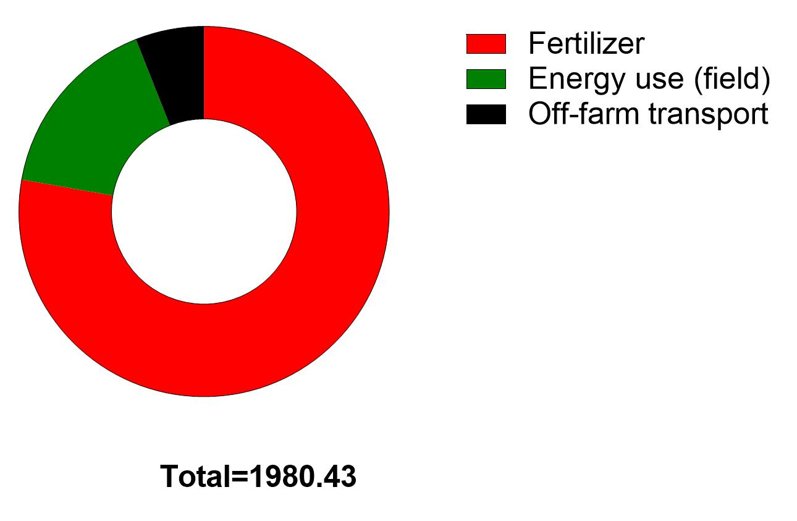
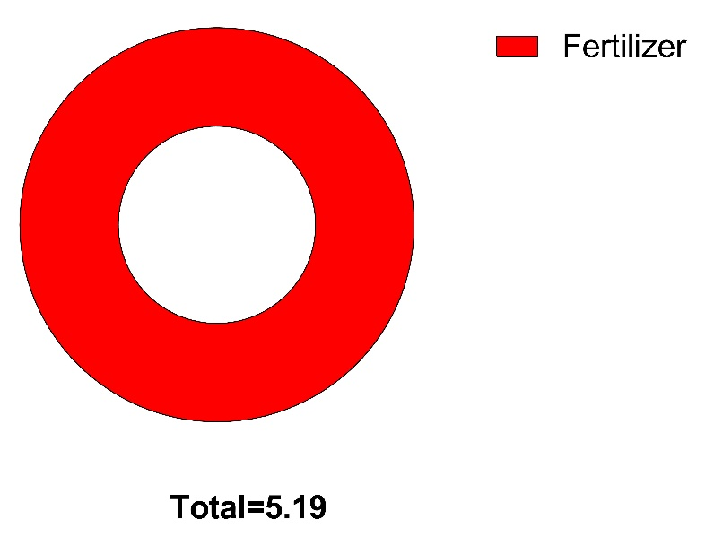
Carbon footprint
Figure : Total co₂ emission
Figure : Total CO2 kg ha -¹
Figure : N₂O emission
Fertilizer application shows considerable contribution for green house gas emission
High emission was resulted by co₂ followed by N₂O and CH4 emission comparatively negligible
The total CO2 eq per ha was reported as 1980.43 kg CO2e

Slide 25
Conclusions
According to the land suitability evaluation, more than 70% of Sri Lanka are categorized as “highly suitable” in terms of overall climate and soil stability
This study provide the initial evidence for the economic feasibility of hemp in Sri Lanka, giving positive for NPV and NPVB in most of the location
Seed production in comparatively more feasible than fiber production
Future environmental conditions are more favorable for hemp cultivation in Sri Lanka

Slide 26
Reference
Erin Michelle Young. (2005). Revival of Industrial Hemp: A systematic analysis of the current global industry to determine limitations and identify future potentials within the concept of sustainability. Revival of Industrial Hemp, 24–31. http://www.vouranis.net/uploads/6/2/8/5/6285823/hemp__sustainability.pdf.
Food and Agricultural Organization [FAO]. (2018). Cost-benefit analysis for climate change adaptation policies and investments in the agriculture sectors. February, 8. https://reliefweb.int/sites/reliefweb.int/files/resources/i8905en.pdf .
Jayasinghe, S. L., Kumar, L., & Sandamali, J. (2019). Assessment of potential land suitability for tea (Camellia sinensis (L.) O. Kuntze) in Sri Lanka using a gis-based multi-criteria approach. Agriculture (Switzerland), 9(7). https://doi.org/10.3390/agriculture9070148.
Wimalasiri, E. M., Jahanshiri, E., Syaherah, T. A., Kuruppuarachchi, N., Chimonyo, V. G. P., Azam-Ali, S. N., & Gregory, P. J. (2022). Datasets for the development of hemp (Cannabis sativa L.) as a crop for the future in tropical environments (Malaysia). Data in Brief, 40, 107807. https://doi.org/10.1016/j.dib.2022.107807.
Wimalasiri, E. M., Jahanshiri, E., Chimonyo, V., Azam-ali, S. N., & Gregory, P. J. (2021). MethodsX Crop model ideotyping for agricultural diversification. MethodsX, 8, 101420. https://doi.org/10.1016/j.mex.2021.101420.

Slide 27
Acknowledge
Dr. G.E.M. Wimalasiri (Internal supervisor, Course coordinator), Department of Export Agriculture, Faculty of Agricultural Sciences, Sabaragamuwa University of Sri Lanka
Dr. Ebrahim Jahanshiri, Crops for the Future UK, Cambridge, UK
Dr. Vimbayi G.P. Chimonyo, International Maize and Wheat Improvement Center (CIMMYT), Zimbabwe
Ms. Niluka Kuruppuarachchi, Postgraduate Institute of Agriculture, University of Peradeniya, Sri Lanka
Ms. Sumudu Senanayake, Natural Resource Management Centre, Perandeniya

Slide 28
Thank You

Slide 29
Backup slide
Figure : Seed variation among countries

Slide 30
Benefit | USD/ton
Hemp seed | 3306.9
Hemp fiber | 1307.32
Cost | USD/ha
land rent | 125,000.00
Soil Test | 870.00
Dolomite Lime - Spread | 52,500.00
Nitrogen | 3,360.00
Phosphorus | 1,345.00
Potassium | 1,345.00
land preparation | 15,000.00
Non-operator Labor Expense | 102,200.00
fiber cost | 98984.7864
Transpor/others | 10,000.00
Total | 410,604.79
Table : Cost benefit values

