Slide 1
Assessing Soil Erosion and Carbon Storage in Agricultural Soils: A Case Study in Ceylon Orchard Agro (Pvt) Ltd.
Pinsara.W.P.S¹, Asha S. Karunaratne¹, Eranga M. Wimalasiri¹
¹Department of Export Agriculture, Faculty of Agricultural Sciences,
Sabaragamuwa University of Sri Lanka

Slide 2
Content for the Presentation
Introduction
Objectives
Material and Methods
Results and Discussion
Conclusion and Recommendations
References

Slide 3
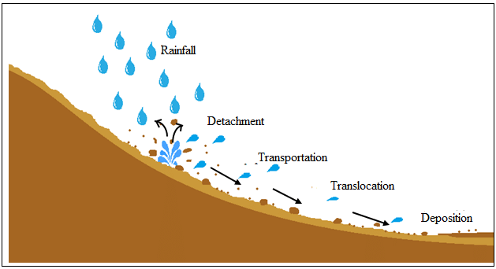
Introduction
What is Soil Erosion?
Soil erosion is the process of wind and water moving soil particles from one location and transporting and depositing them elsewhere.
Accelerate by humans
Intensive agriculture
Deforestation
Cultivation on steep slopes
Improper land management
Impacts
Nutrient losses
Loss of organic matters
Runoff and siltation
Food insecurity
Figure: Soil erosion process (Zafirah et al., 2017)

Slide 4
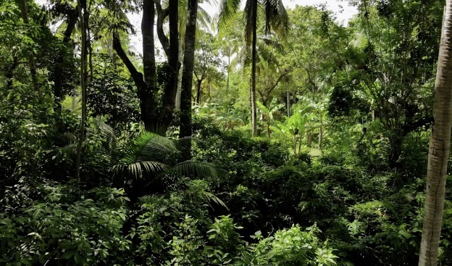
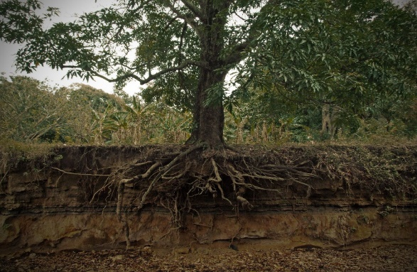
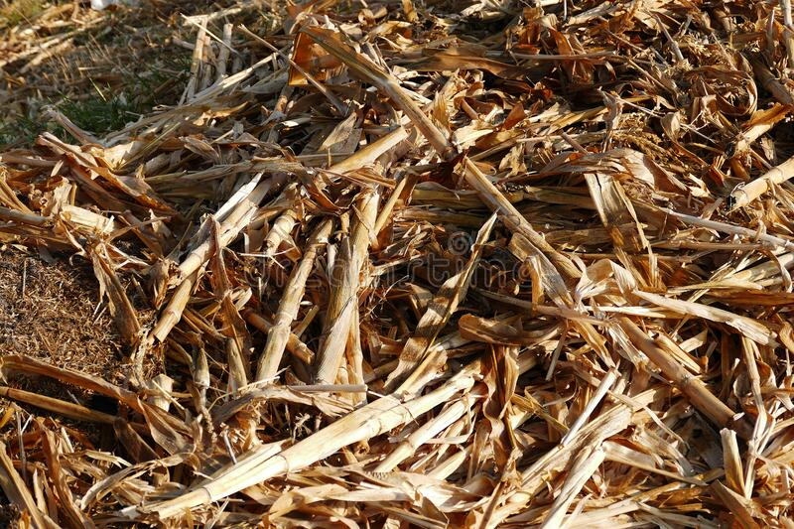
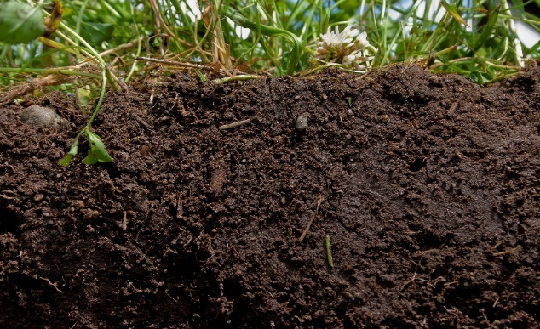
Introduction
Soil Carbon Storage
Ability of terrestrial ecosystems to capture and store carbon in the form of soil organic matters, as well as dead and live vegetation covers.
Above ground biomass
Below ground biomass
Litter organic matter
Soil organic carbon

Slide 5
Research Problem
Soil erosion is a major problem in sustainable soil management and to ensure food security
Therefore, it’s important for soil erosion to be assessed under future climate scenarios
Climate change has a direct impact on the soil erosion
Farmers been unconcerned about carbon storage in the farmlands
Soil carbon storage can improve the soil quality, soil health and productivity of the land

Slide 6
Research objectives
Main objective
To assess the soil erosion and soil carbon storage using a modelling approach of InVEST model in the Ceylon Orchard Agro (Pvt) Ltd., under current (2001-2021) and future climate (2040-2099) scenarios
Specific objectives
To develop soil erosion potential map, total soil loss map, sediment retention map, sediment export map and total carbon storage map
To assess the changes of soil erosion with future climate under the climate change scenarios
To provide suggestions and recommendations to the plantation company to reduce soil erosion and improve soil quality

Slide 7
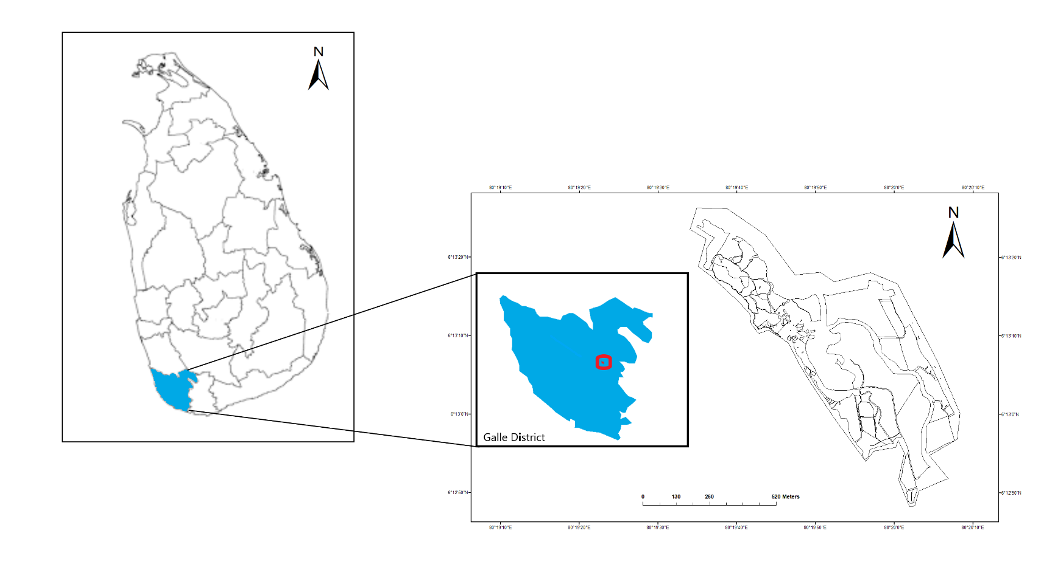
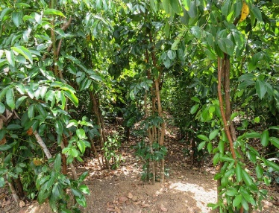
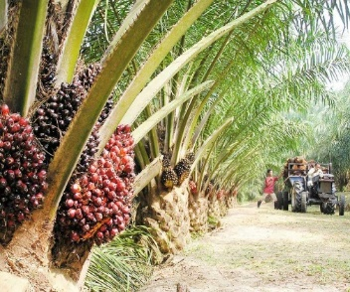
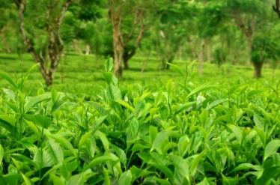
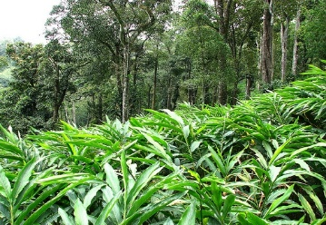
Material and Methods
Study Area
The Ginganga Estate of Ceylon Orchard Agro (Pvt) Ltd.
Covers total of 88 acres
Low country wet zone (6.5944 N, 80.0154 E)
Average temperature: 24°C to 29.2°C
Average rainfall: (2380 mm)
Main crops:
Oil palm
Tea
Cinnamon
Cardamom
Figure: Map of the Study Area

Slide 8
Material and Methods
Model description
Integrated Valuation of Ecosystem Services and Tradeoffs (InVEST) model - (version 3.12.0)
To assess soil erosion - (InVEST) Sediment Delivery Ratio (SDR) model.
To assess carbon storage - (InVEST) Carbon model
ArcGIS™ 10.8 mapping software (ArcMap 10.8)
SDR Model
Carbon Model

Slide 9
Soil Erosion Assessment Inputs
Digital Elevation Model (DEM)
Biophysical Table
Rainfall Erosivity Factor(R) Map
InVEST SDR Model
Watershed Map
Soil Erodibility Factor(K) Map
Land Use Land Cover (LULC) Map

Slide 10
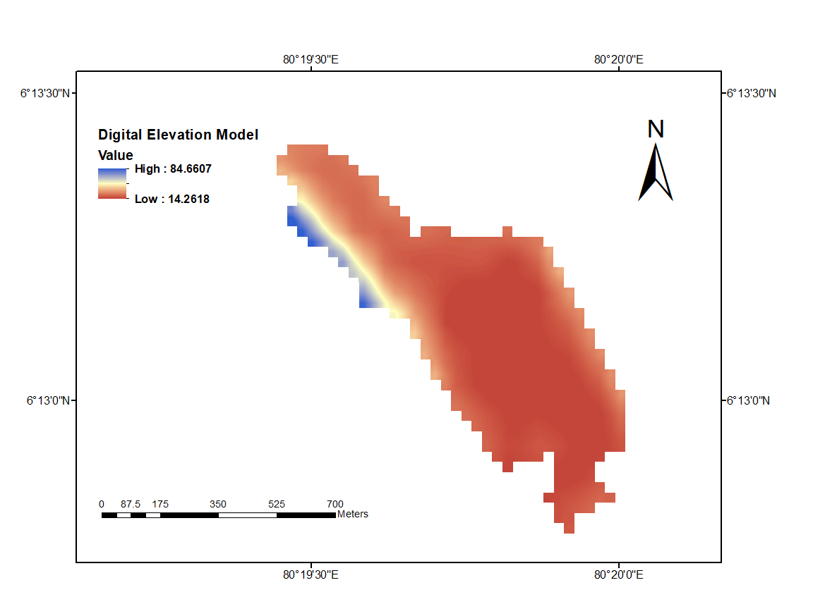
1. Digital Elevation Model (DEM)
Obtaining the relevant 30m x 30m DEM [United States Geological Survey (USGS)]
Processing the DEM using ArcGIS 10.8 clipping tool
Filling in sinks using ArcGIS 10.8 Filling Tool
Final DEM
Figure: DEM of study area

Slide 11
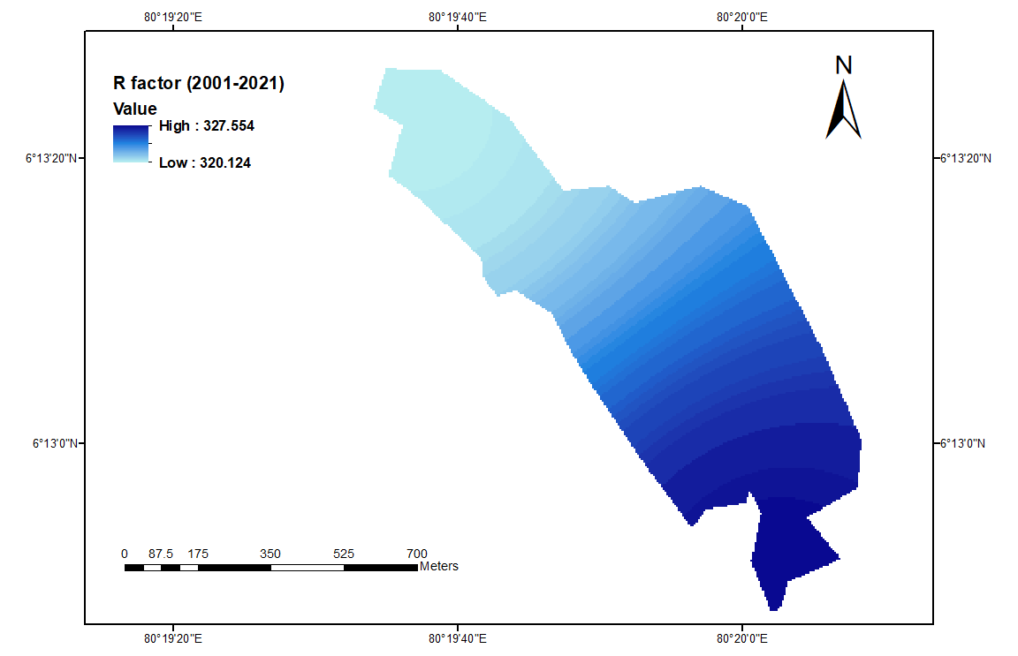
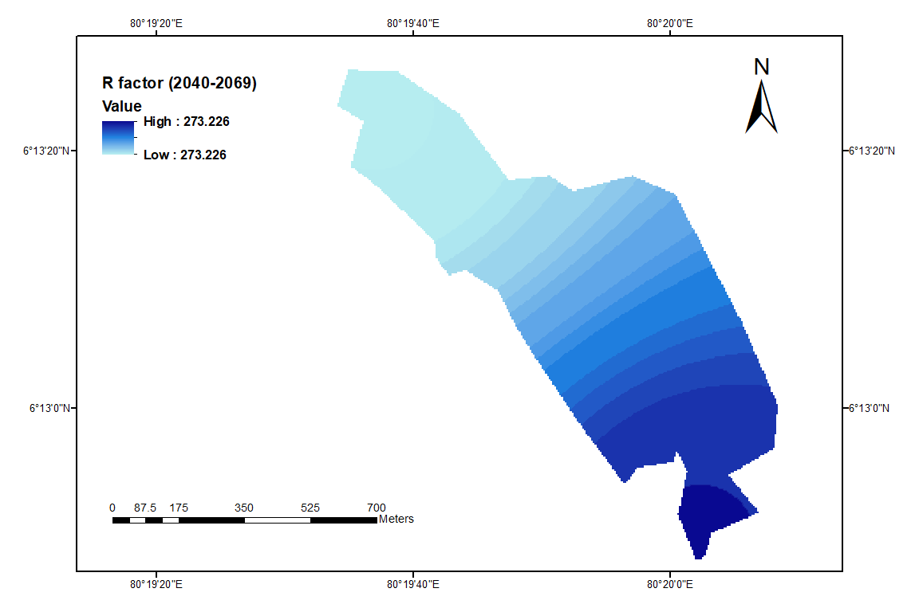
2. Rainfall Erosivity (R) Factor
Collecting monthly rainfall data (2001-2021/2040-2069/2070-2099)
Conversion of MAR into R factor map
R=(972.75 + 9.95 x MAR)/100
Preparing Mean Annual Rainfall (MAR) map using ArcGIS 10.8 IDW interpolation tool
R factor map
Figure: R factor map for 2001-2021
Figure: R factor map for 2040-2069
Figure: R factor map for 2070-2099

Slide 12
3. Soil Erodibility (K) Factor
Obtaining soil map of the Sri Lanka
Soil Type | K factor
Alluvial Red yellow podzolic soil Red yellow podzolic soils and mountain regosols Reddish brown earths and low humic gley soils Reddish brown earths and immature brown loams Reddish brown earths with non-calcic brown Reddish brown earths and solodize solonetz Steep rockland and lithosols | 0.31 0.22 0.22 0.19 0.30 0.35 0.40 0.25
Clipping study area using ArcGIS 10.8 Clipping Tool
Conversion of polygon map into raster map using ArcGIS 10.8 polygon to raster tool
K factor map
Source: Piyathilaka et al

Slide 13
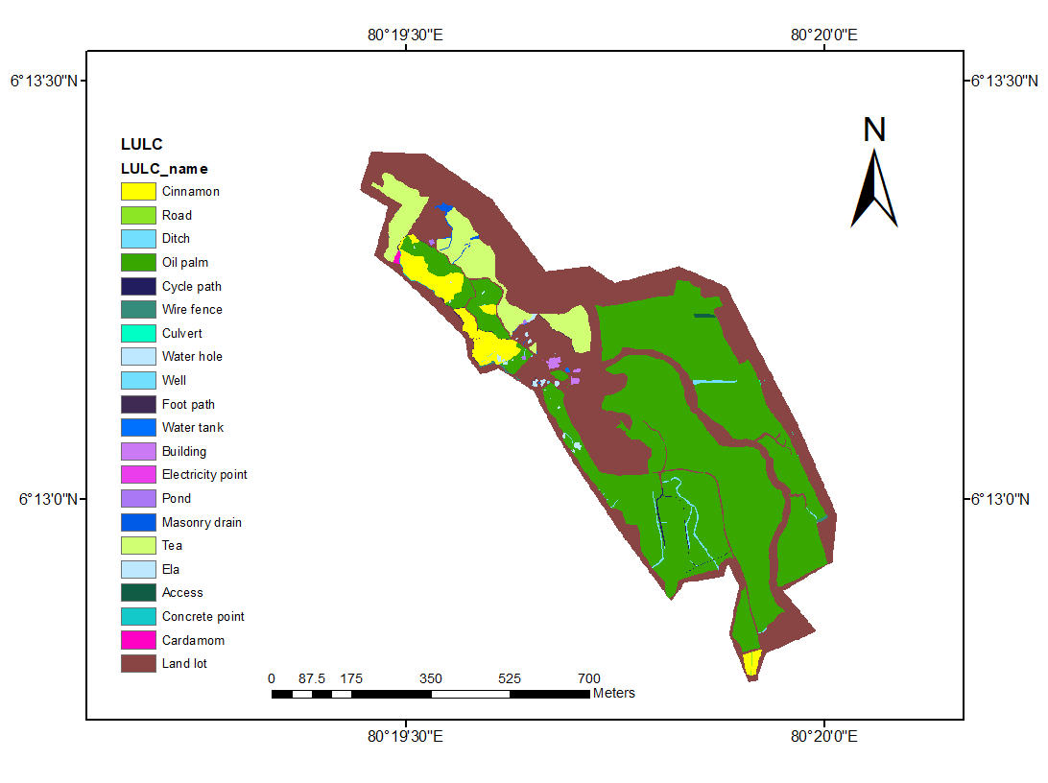
4. Land Use Land Cover (LULC) Map
Obtaining the Land Use/Land Cover (LULC) map for the study area
Editing Attribute table with LU description and LU code corresponding the biophysical table
Conversion of the polygon map into raster map using Feature of Polygon to Raster tool in ArcGIS 10.8
LULC map
Figure: LULC map of study area

Slide 14
5. Biophysical table
LULC_NAME | usle_c | usle_p
cinnamon | 0.1 | 0.25
oil palm | 0.2 | 0.35
Cardamom | 0.1 | 0.25
cycle path | 0.001 | 0.001
Road | 0.001 | 0.001
ditch | 0.001 | 0.001
cycle path | 0.001 | 0.001
wire fence | 0.001 | 0.001
Building | 0.001 | 0.001
Water tank | 0.001 | 0.001
Well | 0.001 | 0.001
Culvert | 0.001 | 0.001
Electricity point | 0.001 | 0.001
Masonry drain | 0.001 | 0.001
Figure: LULC map of study area

Slide 15
Carbon Storage Assessment
Carbon pools data
Above Ground Biomass
Below Ground Biomass
Soil Organic Matter
Dead Organic Matter
Carbon Storages for LULC types
LULC Map
InVEST Carbon Model
Carbon pools data - Global Forest Resources Assessment Report, FAO 2015
Total Carbon Storage Map

Slide 16
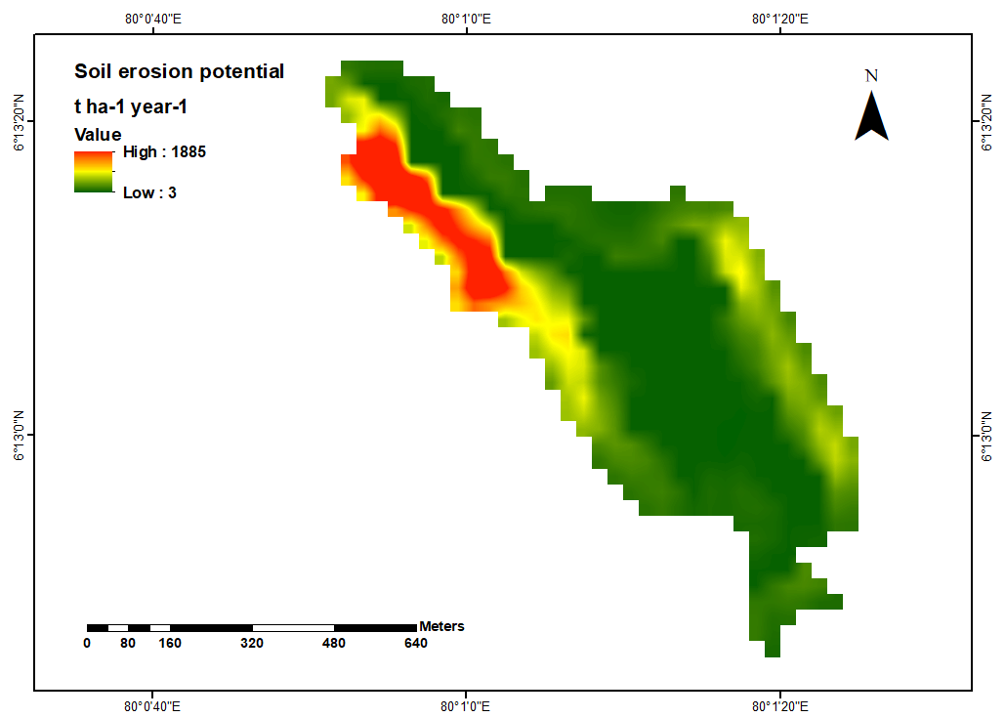
Results and Discussion
Year | Soil Erosion Potential (t ha⁻¹ year⁻¹)
 | Mean | Maximum | Minimum
2001-2021 | 242 | 1885 | 3
2040-2069 | 202 | 1572 | 2
2070-2099 | 205 | 1587 | 2
1. Soil Erosion Potential (RKLS) Map
RKLS = R x K x LS x C x P
RKLS map for 2001-2021
RKLS map for 2040-2069
RKLS map for 2070-2099

Slide 17
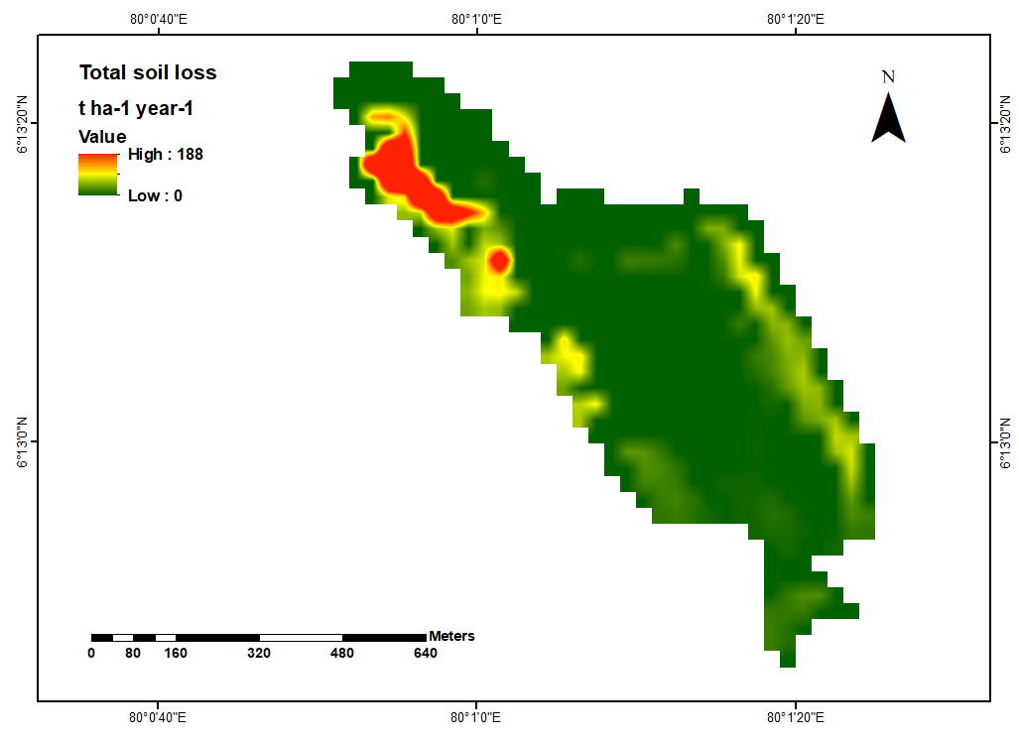
Results and Discussion
Year | Total Soil Loss (t ha⁻¹ year⁻¹)
 | Mean | Maximum | Minimum
2001-2020 | 10 | 188 | 0
2040-2069 | 8 | 157 | 0
2070-2099 | 8 | 158 | 0
2. Total Soil Loss (USLE) Map
USLE = R x K x LS x C x P
Total Soil Loss map for 2001-2021
Total Soil Loss map for 2040-2069
Total Soil Loss map for 2070-2099

Slide 18
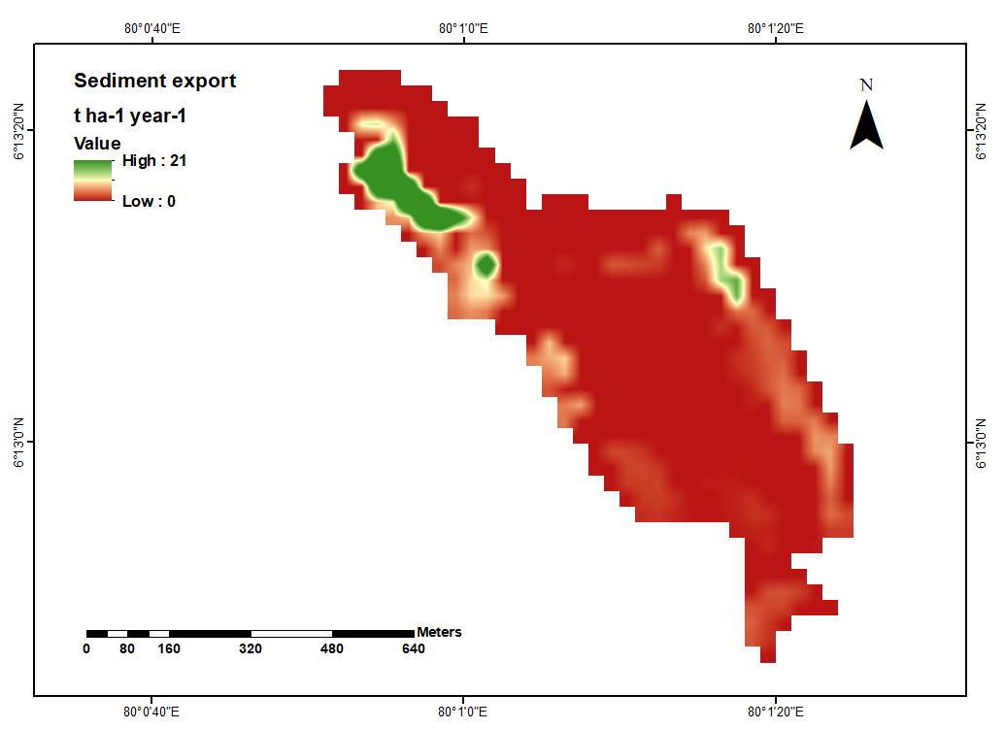
Results and Discussion
Year | Sediment Export (t ha⁻¹ year⁻¹)
 | Mean | Maximum | Minimum
2001-2020 | 1 | 21 | 0
2040-2069 | 1 | 17 | 0
2070-2099 | 1 | 18 | 0
3. Sediment export = USLE × SDR
Sediment export map for 2001-2021
Sediment export map for 2040-2069
Sediment export map for 2070-2099

Slide 19
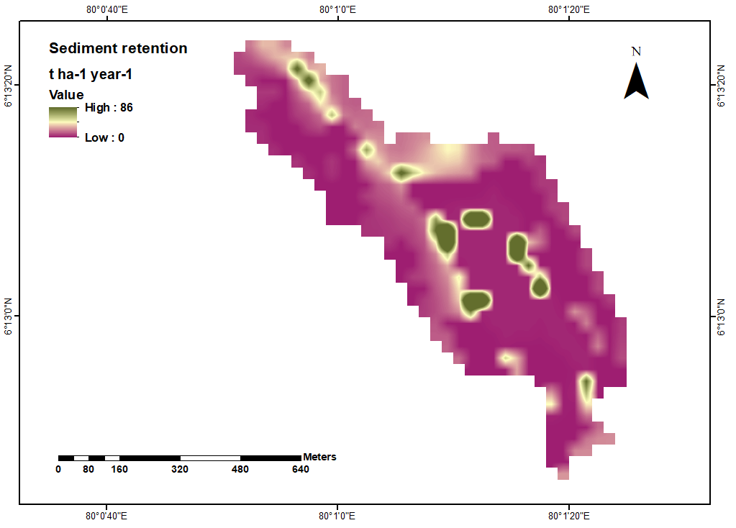
Results and Discussion
Year | Sediment Retention (t ha⁻¹ year⁻¹)
 | Mean | Maximum | Minimum
2001-2020 | 6 | 86 | 0
2040-2069 | 4 | 72 | 0
2070-2099 | 5 | 73 | 0
4. Sediment retention = K × LS(1 − CP)SDR
Sediment retention map for 2001-2021
Sediment export map for 2040-2069
Sediment export map for 2070-2099

Slide 20
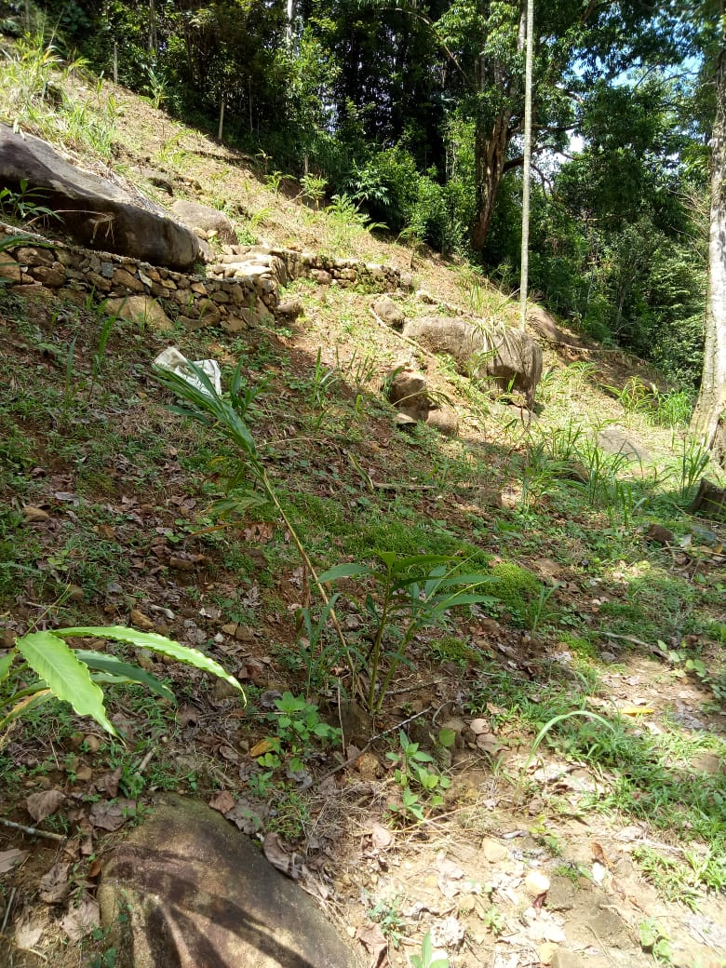
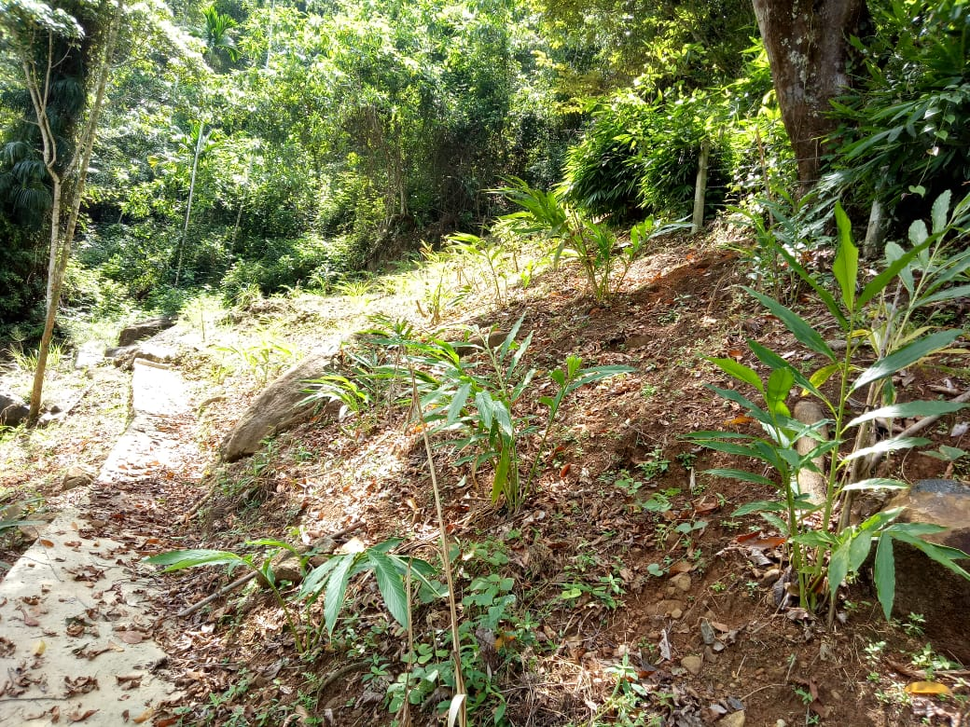
Results and Discussion
Figure: High slope of the study area

Slide 21
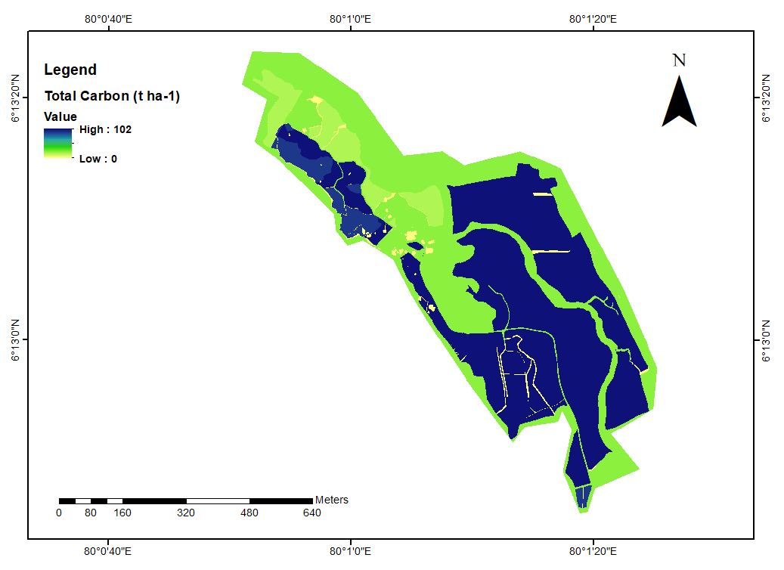
Results and Discussion
Carbon Storage Assessment
Carbon Storage Mean values (t ha⁻¹ )
Total carbon storage | 60
Carbon storage in above ground biomass | 25
Carbon storage in soil | 19
Carbon storage in below ground biomass | 14
Carbon storage in dead organic matter | 2
Figure: Total carbon storage in study area

Slide 22
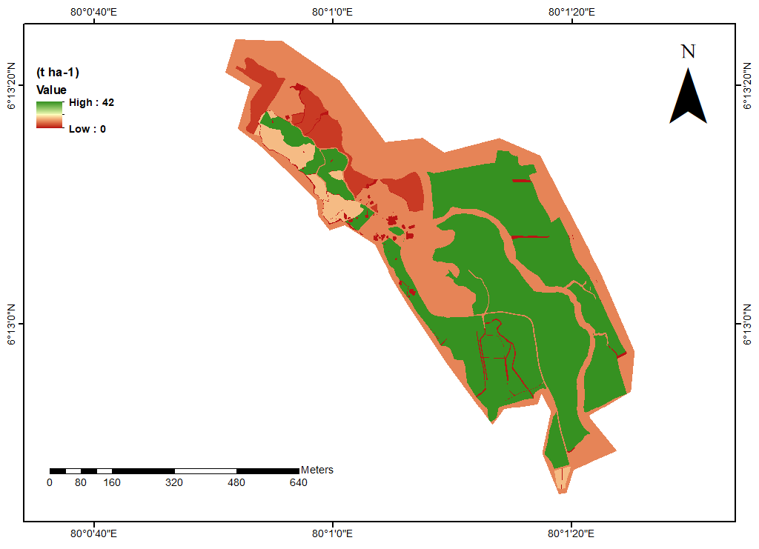
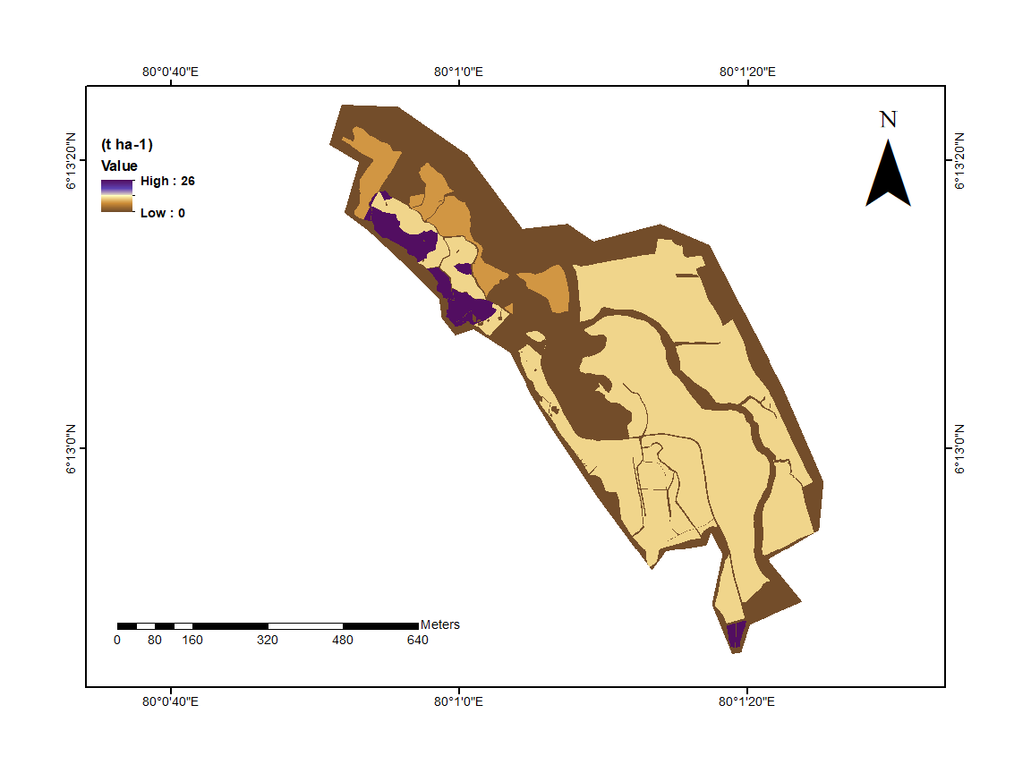
Results and Discussion
1. Above Ground Biomass
2. Below Ground Biomass
Figure: Above ground biomass (25 t ha⁻¹ )
Figure: Below ground biomass (19 t ha⁻¹ )

Slide 23
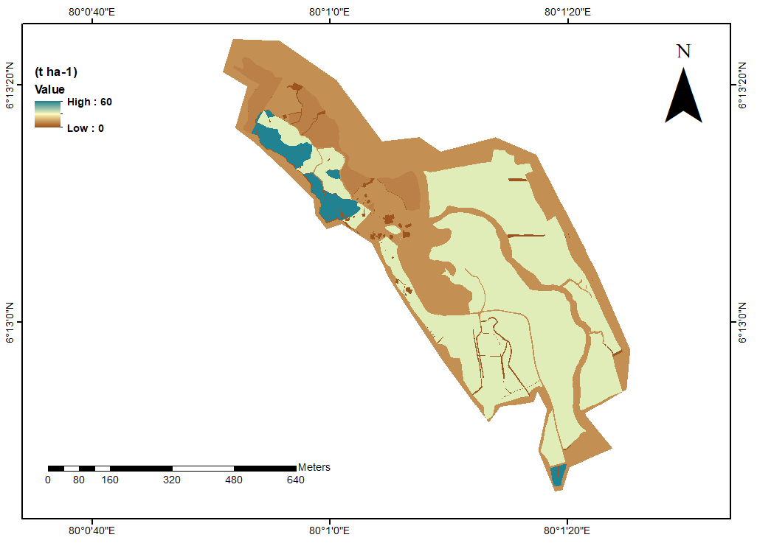
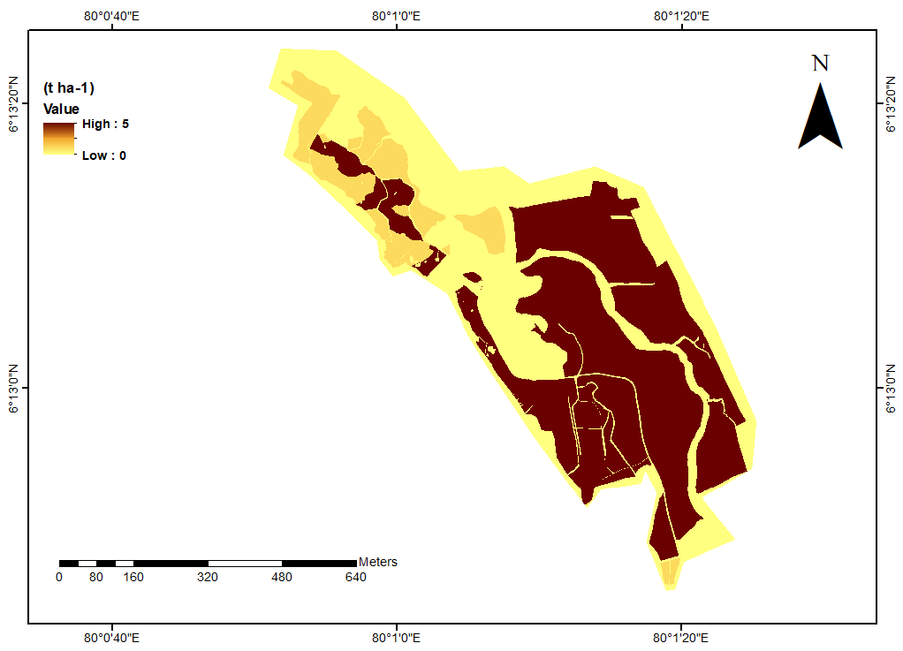
Results and Discussion
3. Soil Organic Matter
4. Dead Organic Matter
Figure: Soil organic matter (14 t ha⁻¹ )
Figure: Dead organic matter (2 t ha⁻¹ )
Agricultural Sciences Undergraduate Research Symposium 2023

Slide 24
Conclusion and Recommendations
Total soil loss in the study area for baseline period (10 t ha⁻¹), mid-century (8 t ha⁻¹) end-century (8 t ha⁻¹) can be categorized under medium soil erosion
Compared to the mid and end century, the research area experienced greater rainfall during the baseline period. So, compared to the other two periods, it can result in a higher average soil loss during the baseline period.
The total carbon storage of the study area is 60 t ha⁻¹
Aboveground biomass is the dominant source of carbon among the main carbon pools according to the obtained carbon storage maps.

Slide 25
Suggestions
Design conservation plans and management practices to reduce soil erosion
Further studies could be done using InVEST Water Yield Model (AWY) to estimate the relative contribution of water from different parts of the estate
Company could prepare a database with maps, results and descriptive statics of the study for future assessments
The company could use the output maps as monitoring tool for field observation

Slide 26
References
Gunawan, G., Sutjiningsih, D., Soeryantono, H., Sulistioweni, W., 2013. Soil erosion estimation base on gis and remote sensing for supporting integrated water resources conservation management. Int. J. Technol. 4, 147–156.
https://doi.org/10.14716/ijtech.v4i2.110
Kumarasiri, A.D.T.N., Udayakumara, E.P.N., Jayawardana, J.M.C.K., 2021. Impacts of soil erosion and forest quality on water quality in Samanalawewa watershed, Sri Lanka. Model. Earth Syst. Environ. 8, 529–544. https://doi.org/10.1007/s40808-021-01082-y
Piyathilake, I.D.U.H., Sumudumali, R.G.I., Udayakumara, E.P.N., Ranaweera, L. V, Jayawardana, J.M.C.K., Gunatilake, S.K., 2021a. Modeling predictive assessment of soil erosion related hazards at the Uva province in Sri Lanka. Model. Earth Syst. Environ. https://doi.org/10.1007/s40808-020-00944-1
Perera, K.H.K., Udeshani, W.A.C., Piyathilake, I.D.U.H., Wimalasiri, G.E.M., Kadupitiya, H.K., Udayakumara, E.P.N., Gunatilake, S.K., 2020. Assessing soil quality and soil erosion hazards in the Moneragala District, Sri Lanka. SN Appl. Sci. 2. https://doi.org/10.1007/s42452-020-03926-1

Slide 27
Acknowledgement
Prof. Asha S. Karunaratne (Internal Supervisor), Dean of Faculty of Agricultural Sciences , Sabaragamuwa University of Sri Lanka
Dr. Eranga M. Wimalasiri (Co supervisor), Module Coordinator, Agri Environmental Resource Management, Department of Export Agriculture, Faculty of Agricultural Sciences , Sabaragamuwa University of Sri Lanka
Mr. Samantha Liyanage (External supervisor), Director, Ceylon Orchard Agro (Pvt) Ltd, Ginganga estate, Udugama
Ms. Ovini Dissanayake, (Lecturer) Department of Export Agriculture, Faculty of Agricultural Sciences , Sabaragamuwa University of Sri Lanka

Slide 28
Thank You!

Slide 29
Figure: InVEST Carbon model running interface
Figure: InVEST SDR model running interface

Slide 30
Assessment of Soil Erosion
A = Annual soil loss (t (ha yr)⁻¹)
R = Rainfall erosivity factor (MJ mm (ha hr yr)⁻¹)
K = Soil erodibility factor (t ha hr (MJ ha mm) ⁻¹)
LS = Slope length-gradient factor (unitless)
C = Cover management factor (unitless)
P = Support practice factor (unitless)
A = R × K × LS × C × P

Slide 31
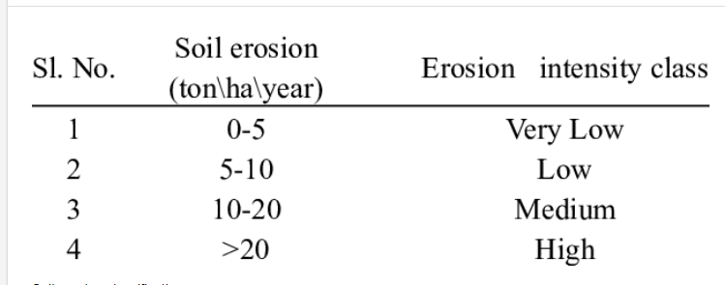
Erosion intensity class
Sharma et al., 2010

Slide 32
Mean Annual Rainfall
Baseline 2001-2021
Mid-century 2040-2069
End-century 2070-2099
Figure: Mean annual rainfall of the study area

Slide 33
Field based method vs. Modelling approach
Assessment of Soil Erosion and Carbon Storage
Field Based Methods
Modelling Approach
Labor intensive
Time consuming
Low data accessibility
Low reliability
High degree of flexibility
Time saving
Data accessibility
Convenient & inexpensive
Comparability of results

