Slide 1
Screening the Genetic Diversity of Selected Interim Clones in Rubber (Hevea brasiliensis) Using SSR Molecular Markers
DSKR Dewapriya¹, SP Withanage², JBDAP Kumara¹ and PWM Tharindi¹
¹Department of Export Agriculture, Faculty of Agricultural Sciences, Sabaragamuwa University of Sri Lanka.
²Department of Genetics & Plant Breeding, Rubber Research Institute of Sri Lanka, Substation Niwitigalakelle, Mathugama.

Slide 2
Content for the presentation
Introduction
Problem Statement
Objectives
Methodology
Results and Discussion
Conclusion
Suggestions
References

Slide 3
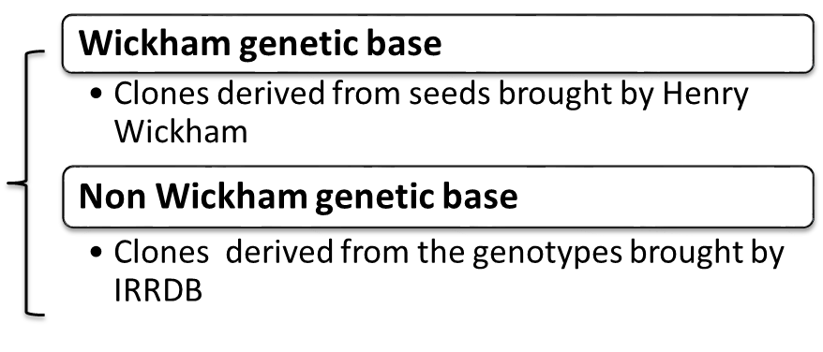
Introduction
Hevea brasiliensis
Euphorbiaceae family
Long breeding process
Two genetic foundations
IRRDB = International Rubber Research Development Board

Slide 5
Problem Statement
Very narrow genetic diversity
Essential to introduce widely diversified clones
Expand genetic diversity of local breeding pool with adding new genotypes from Non-Wickham germplasm
Few molecular based studies for Non-Wickham genetic base

Slide 6
Objectives
Broad Objective
To accelerate the introduction procedure of diverse clones in to the clone recommendation
Specific Objectives
To study the molecular diversity of selected interim (Hevea brasiliensis) clones by using Simple Sequence Repeats (SSR) molecular markers
To find out the most appropriate SSR markers to analyze the polymorphism

Slide 7
Methodology

Slide 8
Experimental Location
Sample collection
Laboratory Experiments
Nuechattle Estate,
Narthupana,
Horana
Department of Genetics & Plant Breeding,
Rubber Research Institute of Sri Lanka,
Substation Niwitigalakelle, Mathugama

Slide 9
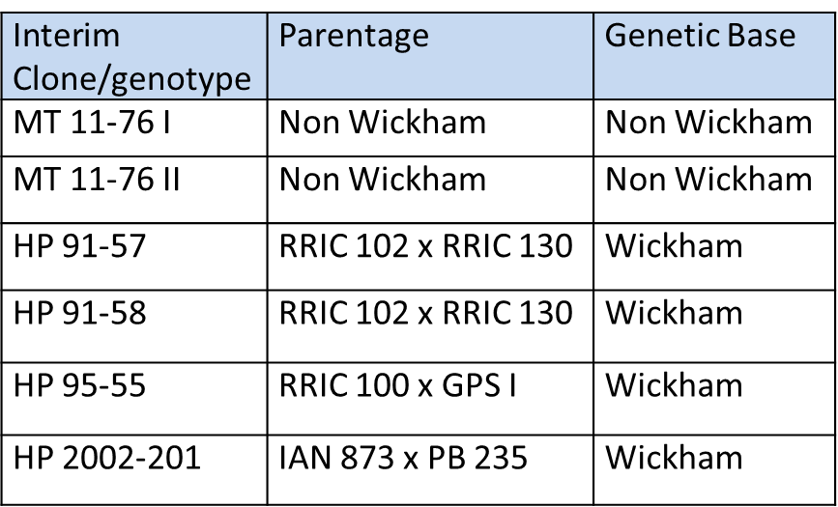
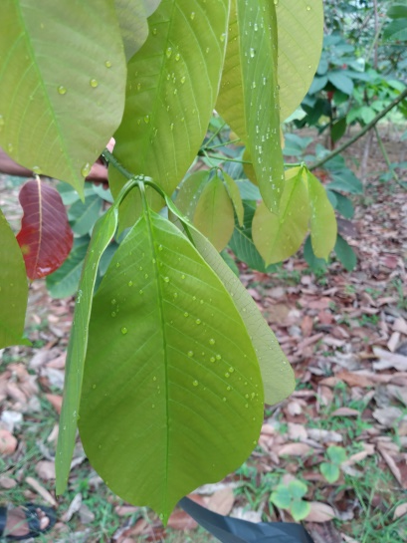
Sample collection
Apple green color, disease-free and damage free leaves
Stored in a -20⁰C freezer until DNA extraction

Slide 10
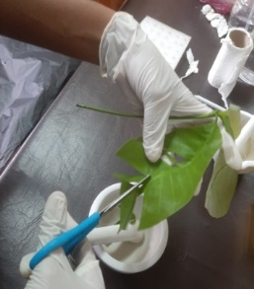
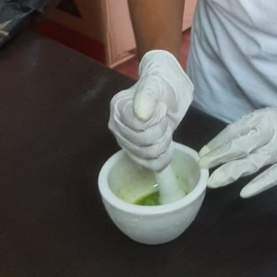
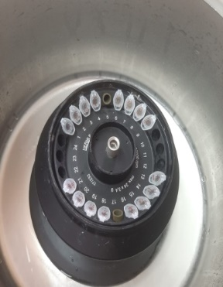
DNA Extraction
SDS method (Withanage et al., 2015 with some modifications)
Cut leaves cut
Grind with SDS buffer
Add Chloroform
Got the supernatant
Centrifuge
Mixed well

Slide 11
DNA Extraction cont,

Slide 12
DNA Quantification

Slide 13
The DNA samples which were showed a single intact band were selected for PCR amplification.

Slide 14
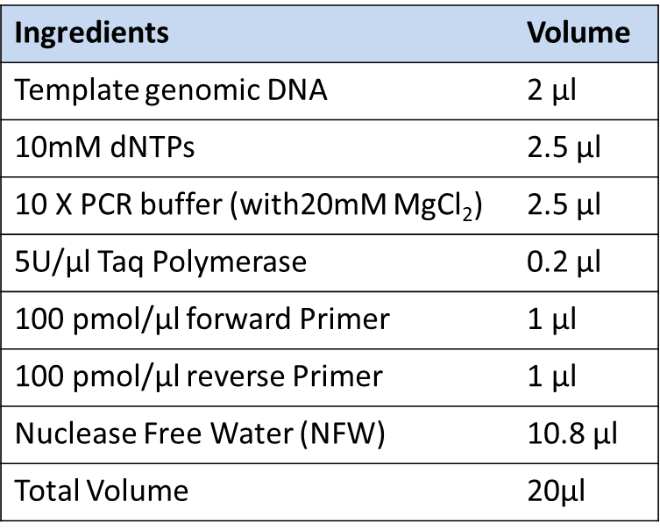
PCR Amplification
PCR mixture for one reaction volume

Slide 15
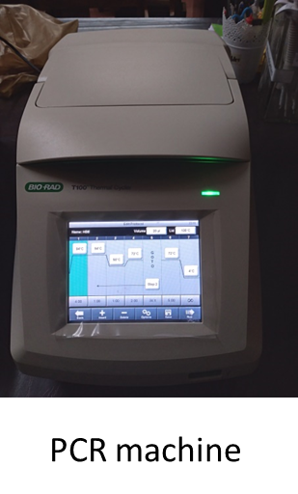
Thermal cycler

Slide 16
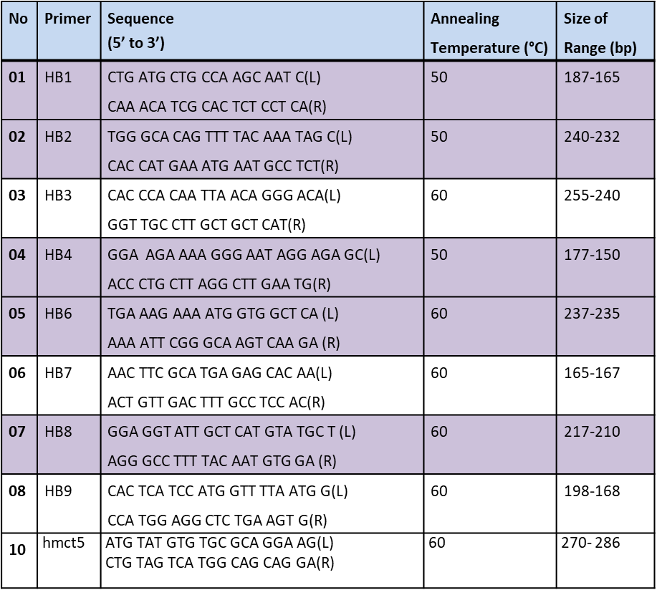
Primer Optimization SSR Primers
(Tharanaga et al., 2019)

Slide 17
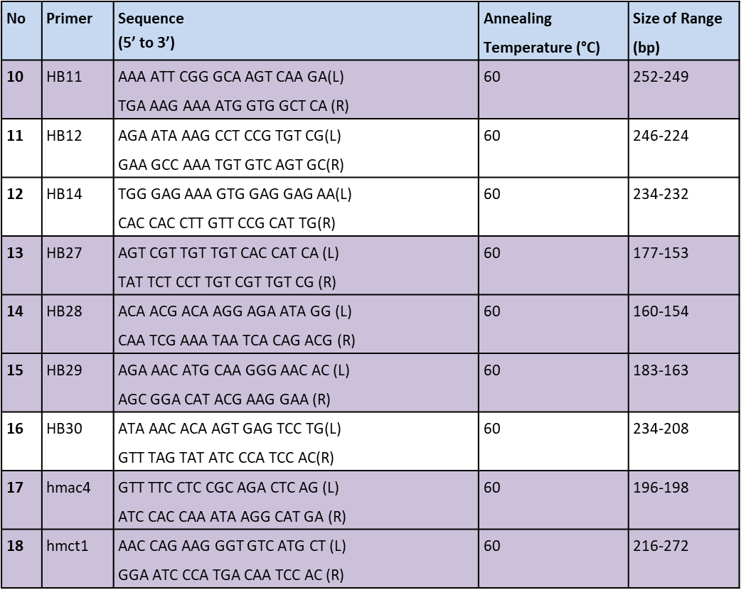
SSR Primers cont…

Slide 18
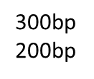

Slide 19
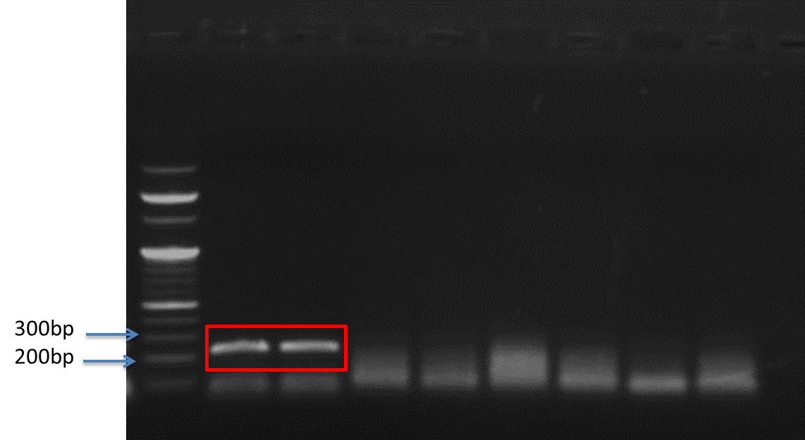
HB8,HB3, HB9 and HB12 Primers

Slide 20
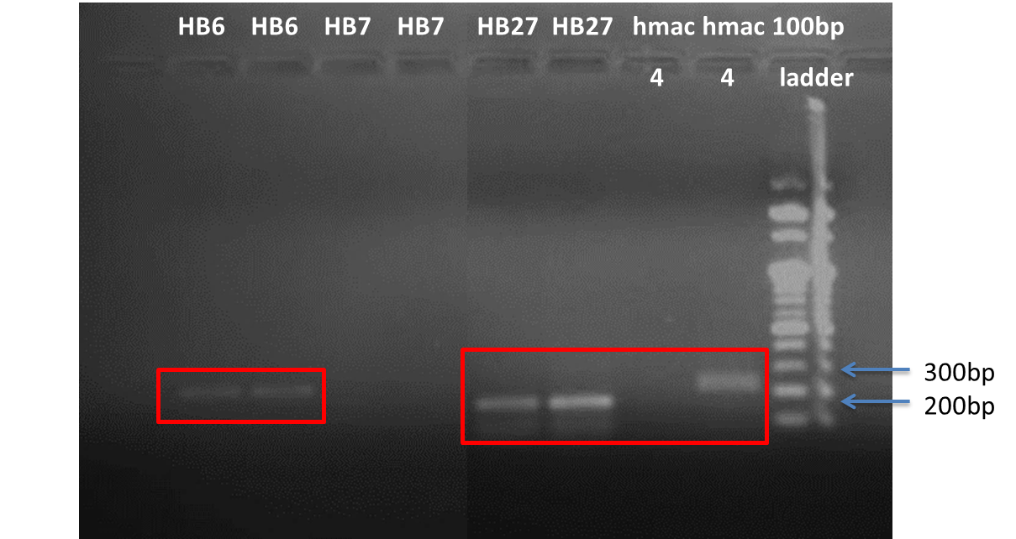
HB6, HB7, HB27 and hmac4 Primers

Slide 21
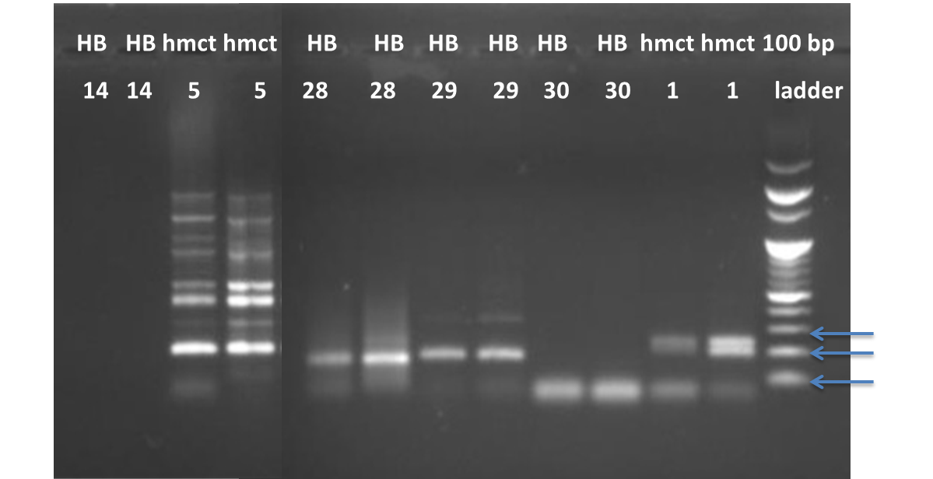
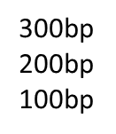
HB14, hmct5, HB28, HB29, HB30 and hmct1 Primers

Slide 22
Detection of amplified PCR products

Slide 23
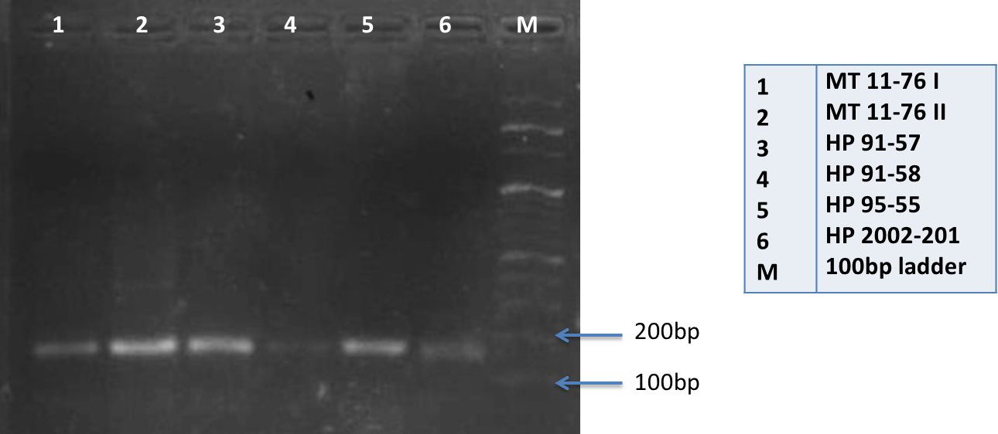
Results and Discussion
HB 1 Primer

Slide 24
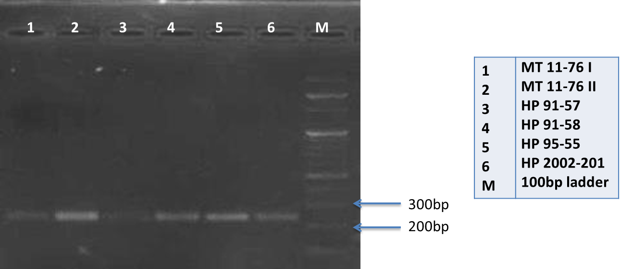
HB 2 Primer

Slide 25
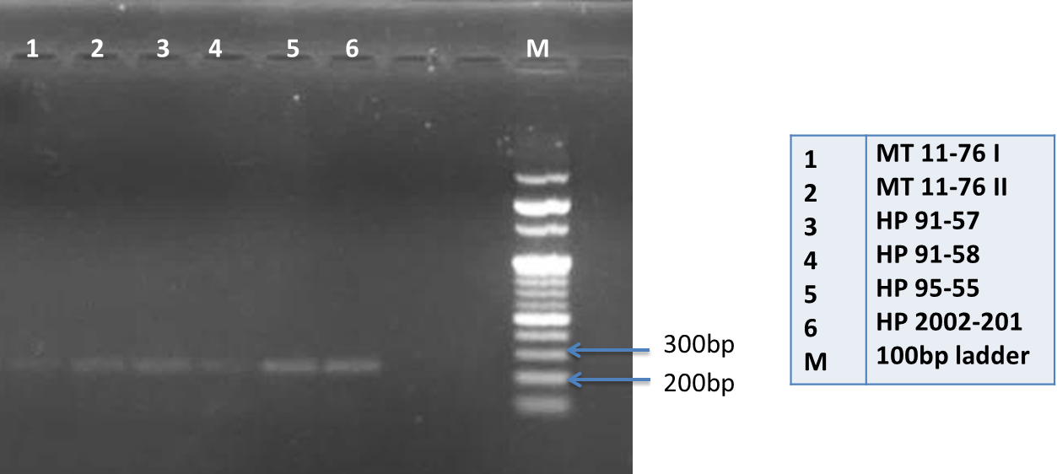
HB 4 Primer

Slide 26
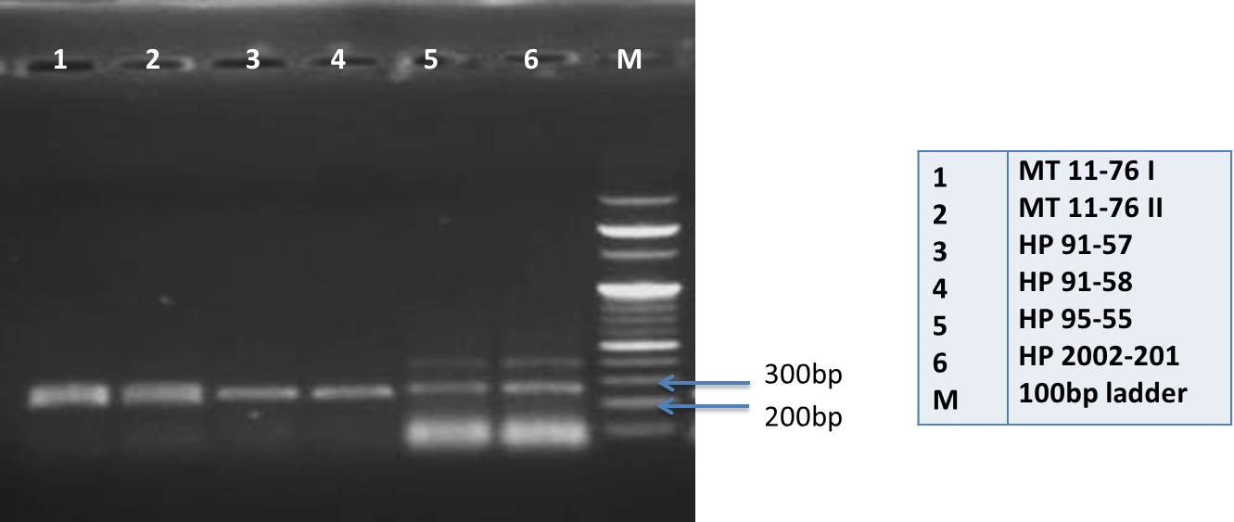
HB 6 Primer

Slide 27
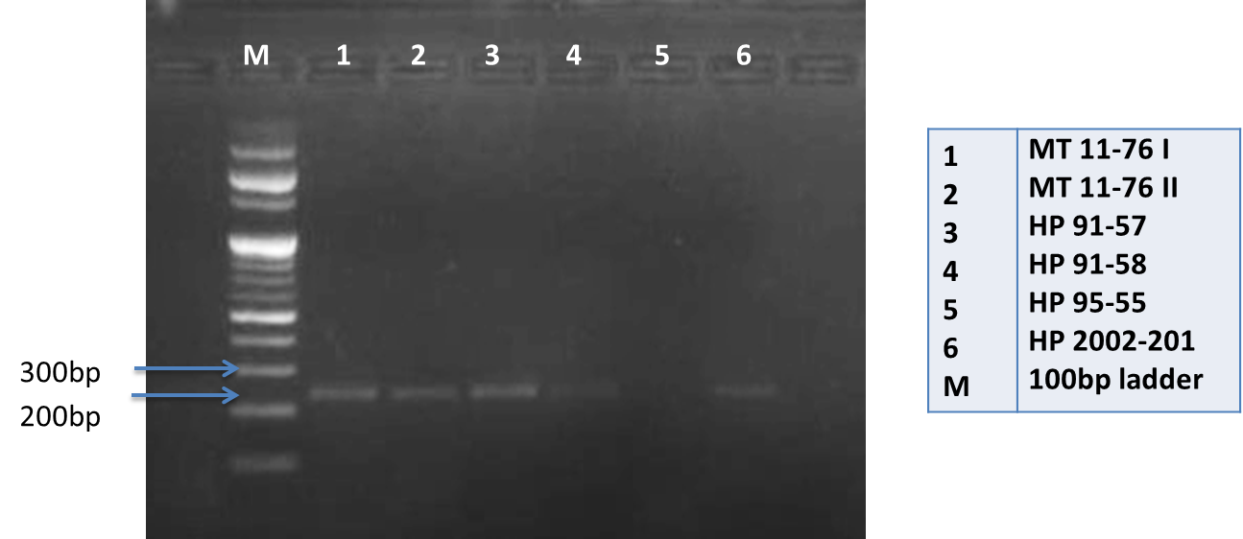
HB 8 Primer

Slide 28
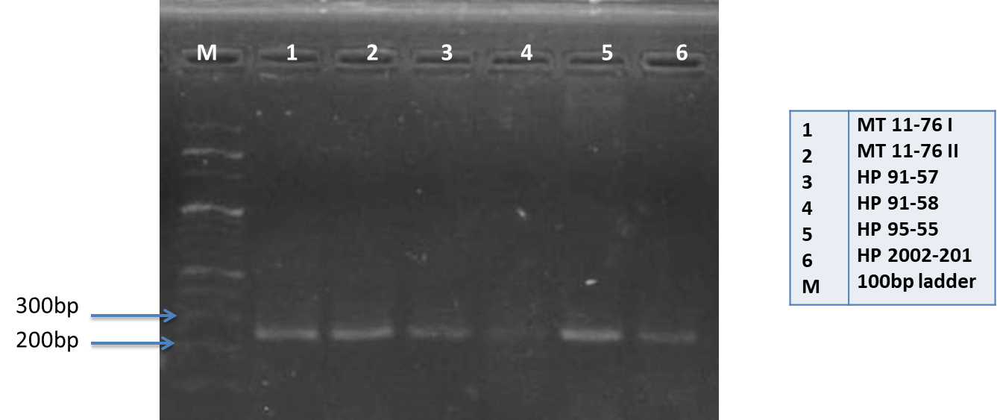
HB 11 Primer

Slide 29
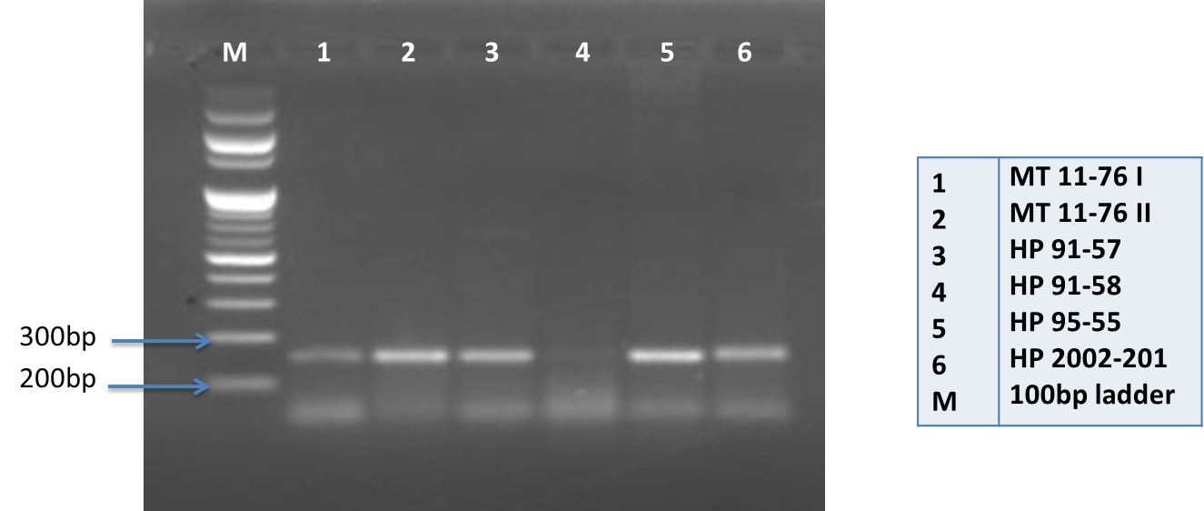
HB 27 Primer

Slide 30
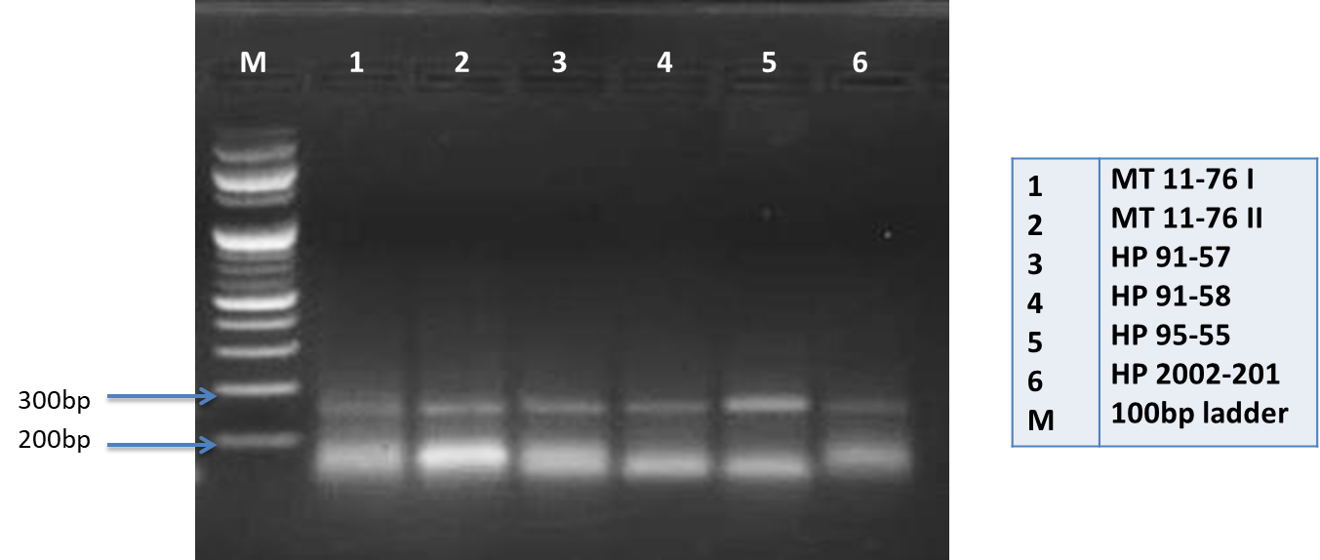
HB 28 Primer

Slide 31
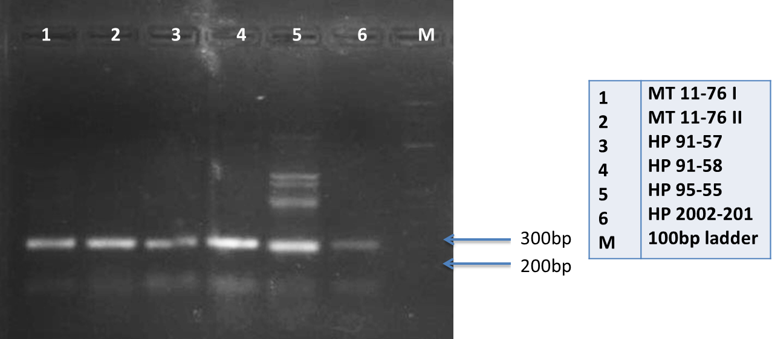
HB 29 Primer

Slide 32
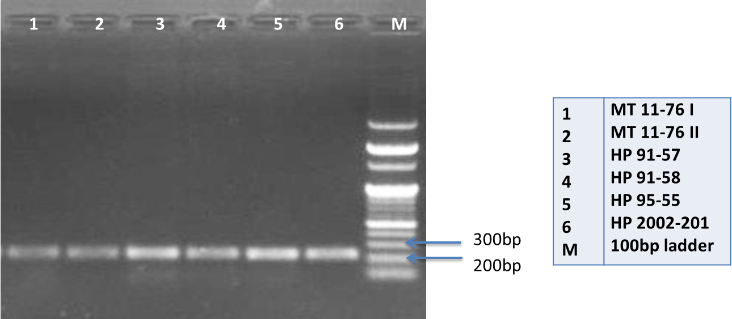
hmac 4 Primer

Slide 33
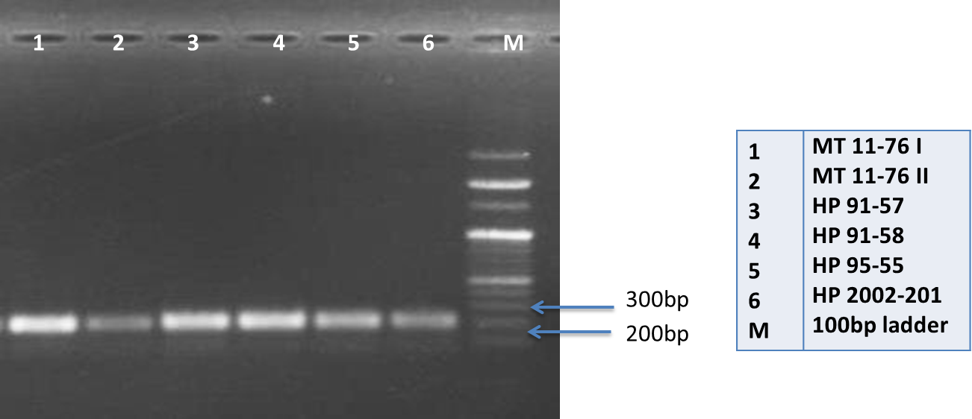
hmct 1 Primer

Slide 36
Pedigree of selected Interim Clones

Slide 37
Conclusion
Considerable polymorphism was not detected
A narrow genetic variation exists between the Wickham and Non-Wickham genetic base
The narrow genetic diversity probably occurred due to sharing the same parentage

Slide 38
Suggestions
Molecular screening with RAPD primers are more convenient to analyze the genetic diversity
Polyacrylamide gels are more appropriate to detect slight genetic variations among clones

Slide 39
References
Tharanaga, W.A.D.R., Withanage, S.P. and Kumara, W.K., 2019. Screening of Microsatellite Markers for Early Detection of Corynespora Leaf Fall Disease Resistance in Rubber (Hevea brasiliensis) Clones.
Withanage, S.P. and D.P.S.T.G. Attanayaka (2005). The simplest method for isolation of Hevea DNA. Journal of Rubber Research Institute.
Withanage, S.P. (2021). Genetic improvement of Hevea and Suitable Genotypes. In: Rodrigo, V.H.L. and Seneviratne, P. (Eds.), Hand book of rubber Agronomy. Rubber Research Institute of Sri Lanka, Dartonfield, Agalawatta,12200, Sri Lanka, pp. 54-71.
Bhandari, H.R., Bhanu, A.N., Srivastava, K., Singh, M.N. and Shreya, H.A., 2017. Assessment of genetic diversity in crop plants-an overview. Adv. Plants Agric. Res, 7(3), pp.279-286.
Perseguini, J.M.K.C., Romão, L.R.D.C., Briñez, B., Scaloppi Junior, E.J., Gonçalves, P.D.S. and Benchimol, L.L., 2012. Genetic diversity of cultivated accessions and wild species of rubber tree using EST‑SSR markers. Pesquisa Agropecuária Brasileira, 47, pp.1087-1094.

Slide 40
Thank You

