Slide 1
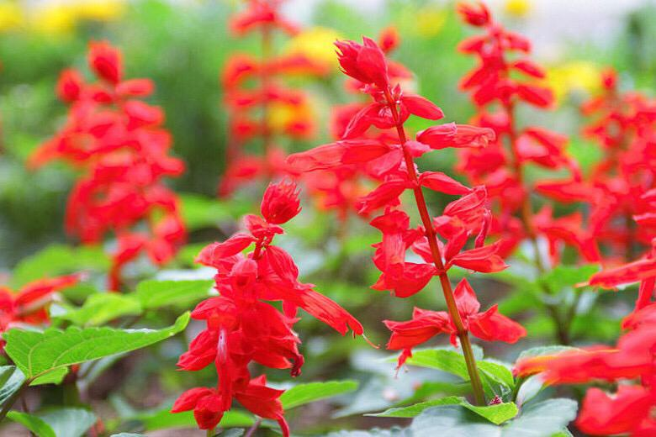
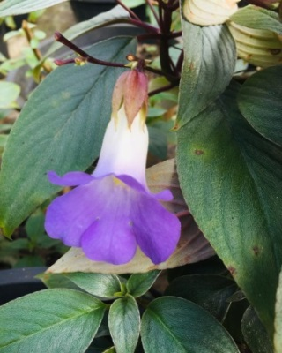
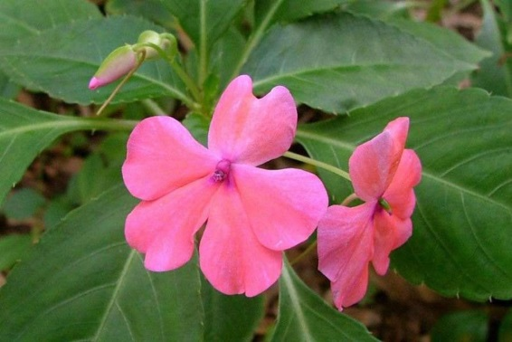
Effect of some selected plant extracts on rooting and early growth of Salvia (Salvia splendens), Henckelia and Impatiens (Impatiens walleriana) stem cuttings
DSH Jayasinghe : Department of Export Agriculture, Faculty of Agricultural Sciences, Sabaragamuwa
University of Sri Lanka
GDK Kumara : Department of Export Agriculture, Faculty of Agricultural Sciences, Sabaragamuwa
University of Sri Lanka
MMDJ Senaratne : Department of National Botanic Gardens, Royal Botanic Gardens, Peradeniya, Sri Lanka

Slide 2
Content
Introduction
Research problem
Objective
Methodology
Results and Discussion
Conclusions
References

Slide 3
Introduction
Vegetative propagation is important in horticulture for rapid multiplication of true to type plants.
Henckelia plant is an endemic wild flowering plant close to extinction due to indiscriminate collection from its natural habitats (Rubasinghe et al., 2009). Therefore, reliable rapid multiplication techniques are important to make it abundant.

Slide 4
Salvia is a perennial shrub, but difficult to find authentic seeds always. Therefore vegetative propagation would be more viable.
Impatiens, can be propagated using both seeds and cuttings however vegetative propagation is important to obtain true to type plants.
Moringa leaf extract contains high amount of IAA and it is also rich with Zeatin (Rashedy, 2022).
Garlic extract contains Auxin hormone, and immersing the tips of olive cuttings in garlic extract, produced the longest roots and increased the number of shoots, leaf number, mean shoot length, and dry weight of shoots (Abbasifar et al., 2020).

Slide 5
Objective
To evaluate the effect of Moringa leaf and garlic clove extracts on rooting and early growth of Salvia (Salvia splendens) , Henckelia hybrid Ⅱ (Henckelia moonii Ⅹ Henckelia communis) and Impatiens (Impatiens walleriana) stem cuttings.

Slide 6
Materials and Method
Experimental Site
The experiment was conducted in a propagator at the Royal Botanic Gardens, Peradeniya.
Planting Materials (cuttings)
Salvia splendens - Semi hardwood cuttings
Henckelia - Shoot tip cuttings
Impatiens walleriana - Shoot tip cuttings

Slide 7
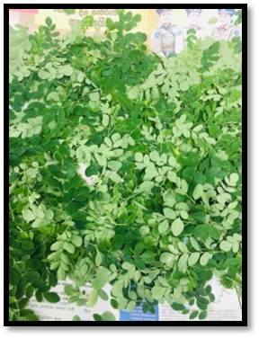
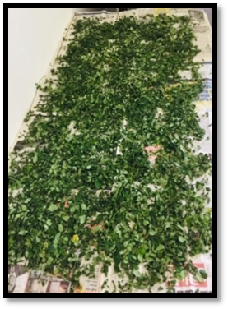
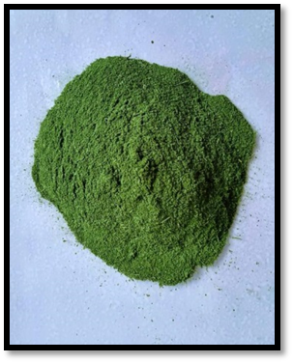
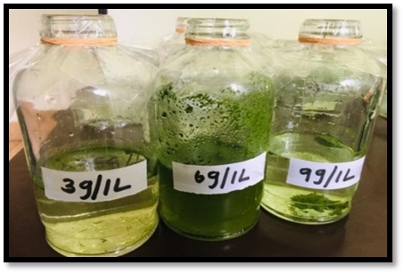
Preparation of Moringa leaf extract
Fresh Moringa leaves
Air-dried in a covered area
Preparation of Moringa leaf powder
Preparation of Moringa leaf extracts (3g, 6g, 9g/L)
Kept them for 24 hours and filtered before using

Slide 8
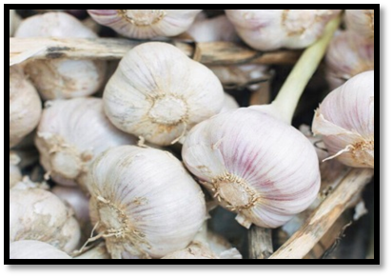
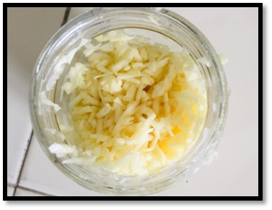
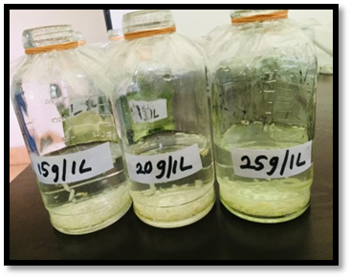
Preparation of garlic clove extract
8
Garlic cloves
Grated the garlic after peeling
Preparation of garlic clove extracts (15g, 20g, 25g/L)
Kept them for 24 hours and filtered before using

Slide 9
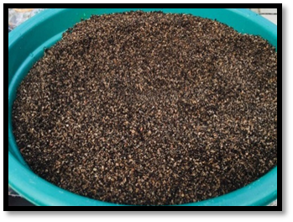
Preparation of planting trays
Two inch plug trays were used to plant cuttings.
Sterilized sand and coir dust were used as planting mixture.
Treating the cuttings
The basal end of the cuttings of the treatment 2 were dipped in the commercially available rooting hormone for 10 seconds while other cuttings of other treatments were dipped in the natural extracts and distilled water for half an hour. After that cuttings were planted in plug trays.
Planting mixture

Slide 10
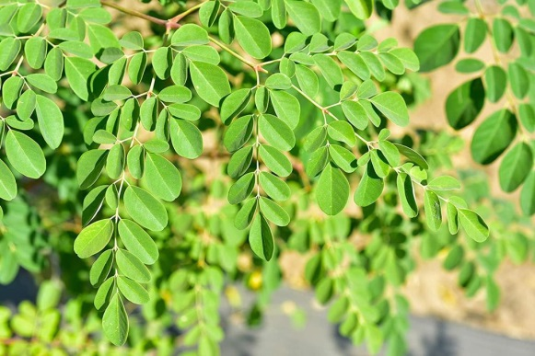
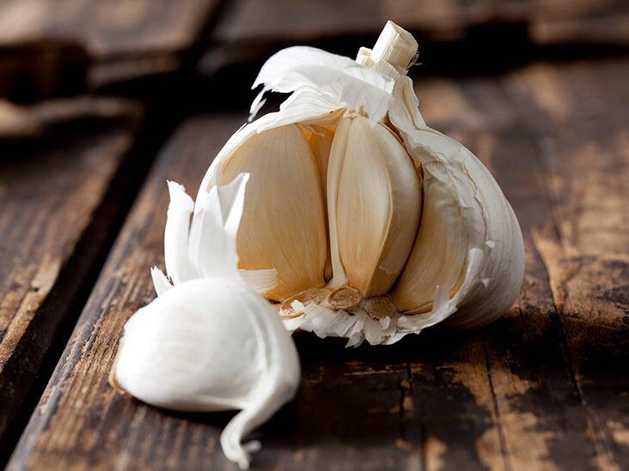
Treatments
Control (distilled water) - (T1)
Commercially available rooting hormone - (T2)
Moringa leaf extract 3 g/L (Dry weight) - (T3)
Moringa leaf extract 6 g/L (Dry weight) - (T4)
Moringa leaf extract 9 g/L (Dry weight) - (T5)
Garlic clove extract 15 g/L (Fresh weight) - (T6)
Garlic clove extract 20 g/L (Fresh weight) - (T7)
Garlic clove extract 25 g/L (Fresh weight) - (T8)
Each treatment was replicated three times.

Slide 11
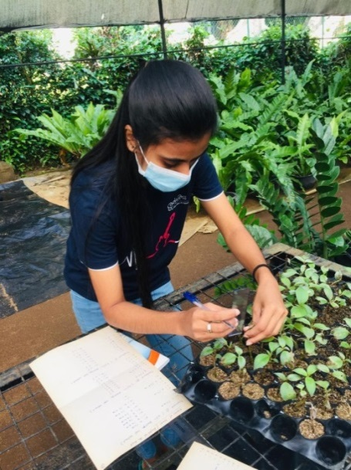
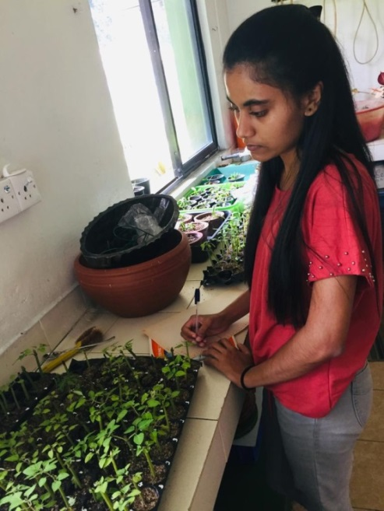
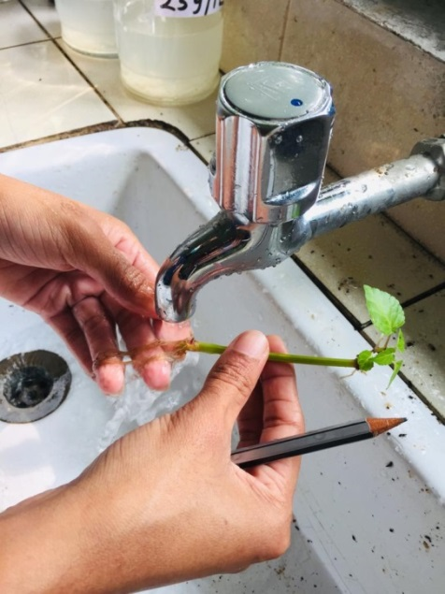
Growth Parameters
Following parameters were measured 3 weeks after planting (WAP).
Number of new leaves
Length of the shoot
Number of roots
Length of roots
Dry weight of the shoot
Dry weight of roots

Slide 12
Data Analysis
Data was analyzed using Statistical Analysis System (SAS) 9.0. Significance of treatment effects on rooting and early growth of cuttings was analyzed by using one way ANOVA (Analysis Of Variance).

Slide 13
Results and Discussion
1. Salvia splendens
MLE contains high amount of IAA and it is rich with Zeatin (Rashedy, 2022). Garlic extract contains Auxin hormone, and immersing the tips of olive cuttings in garlic extract, produced the longest roots (Abbasifar et al., 2020).
Highest shoot length was given by 20 g/ L garlic clove extract treated cuttings.

Slide 14
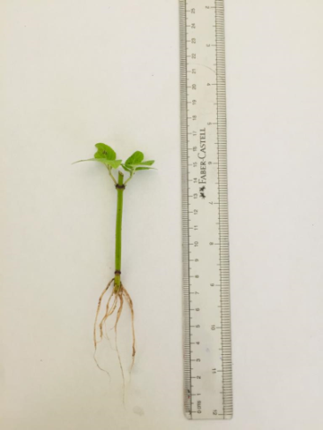
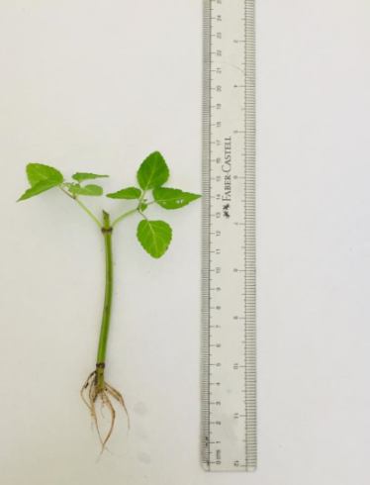
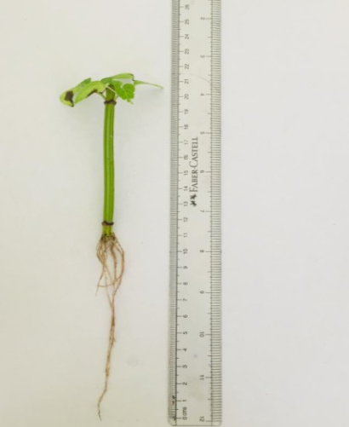
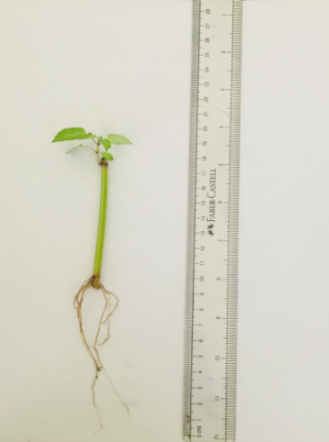
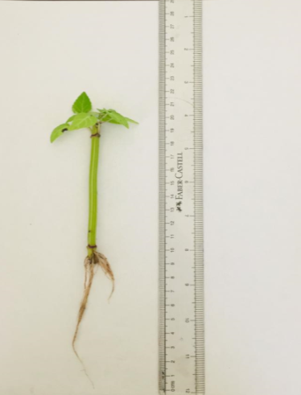
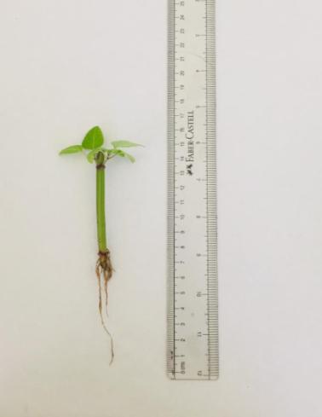
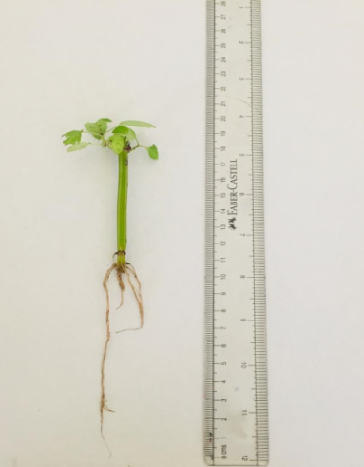
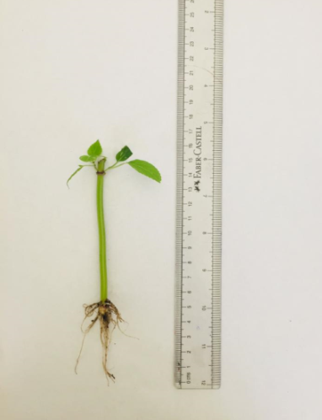
Salvia cuttings (length of roots)
14
Treatment 1
Treatment 2
Treatment 3
Treatment 4
Treatment 5
Treatment 6
Treatment 7
Treatment 8

Slide 15
2. Henckelia hybrid Ⅱ
6 g/ L Moringa leaf extract treated cuttings were given the highest root length.
Zeatin is a source of Cytokinin. It stimulates the cell division, regulate shoot meristem size and leaf and shoot growth of the cuttings.

Slide 16
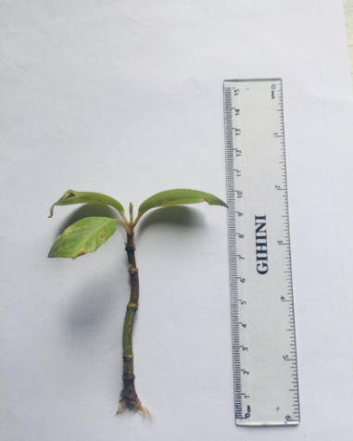
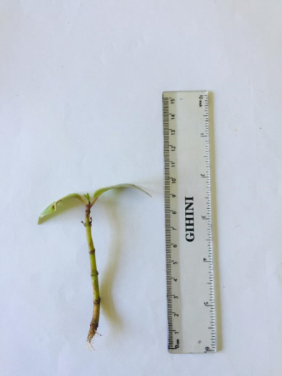
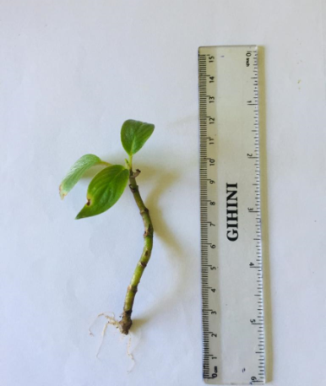
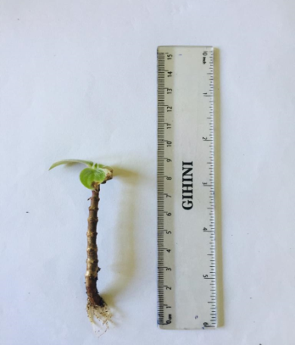
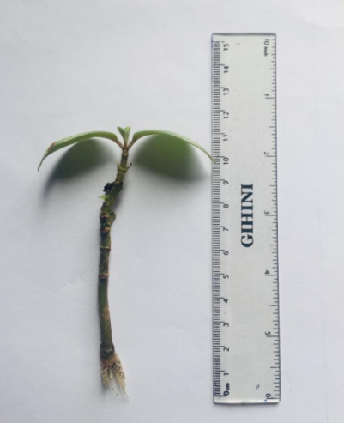
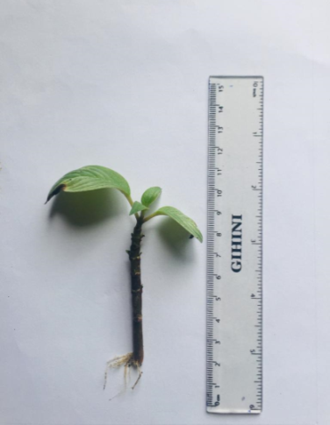
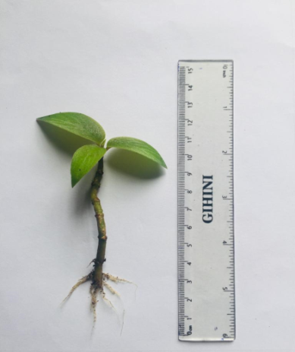
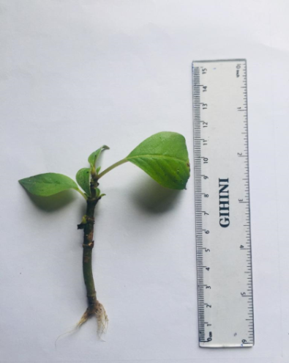
Henckelia cuttings (length of roots)
16
Treatment 1
Treatment 2
Treatment 3
Treatment 4
Treatment 6
Treatment 7
Treatment 8
Treatment 5

Slide 17
The highest number of roots observed in Moringa Leaf Extract treated cuttings due to the presence of Zeatin which is a component of Auxin found in the extract from Moringa leaf that aid root elongation (Emmanuel, 2016).
6 g/ L Moringa leaf extract treated cuttings have given the highest dry weight of the roots of Henckelia cuttings.

Slide 18
3. Impatiens walleriana
9 g/ L Moringa leaf extract was given the highest mean root length in Impatiens cuttings.
6 g/ L Moringa leaf extract has shown the highest value of mean shoot length.

Slide 19
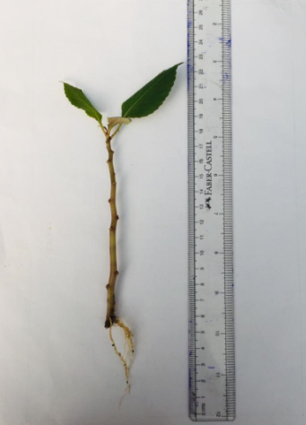
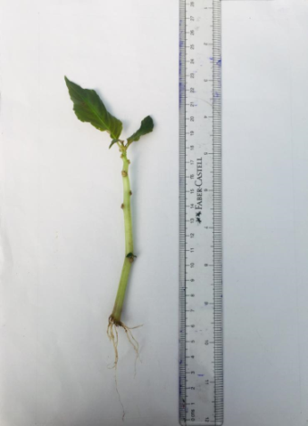
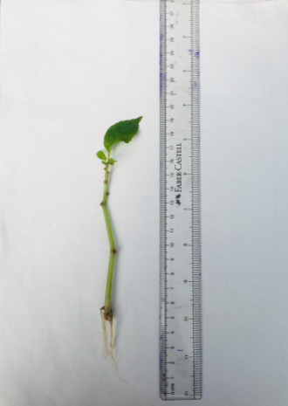
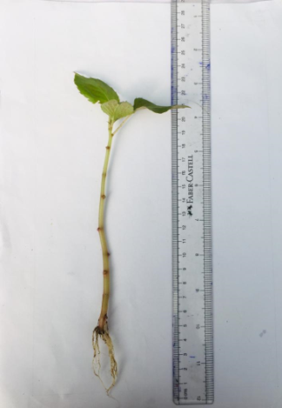
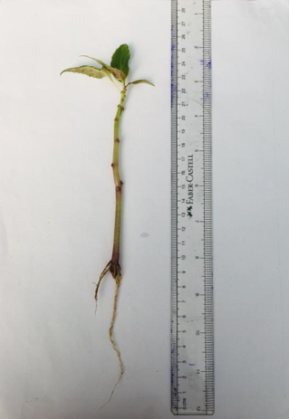
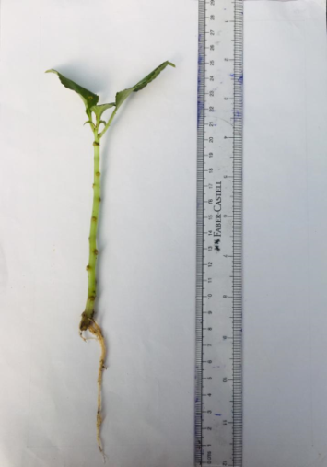
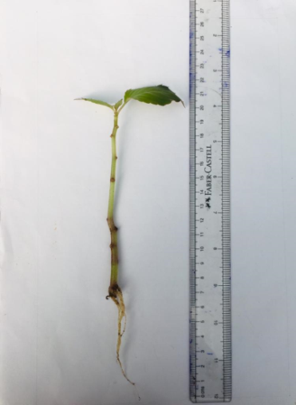
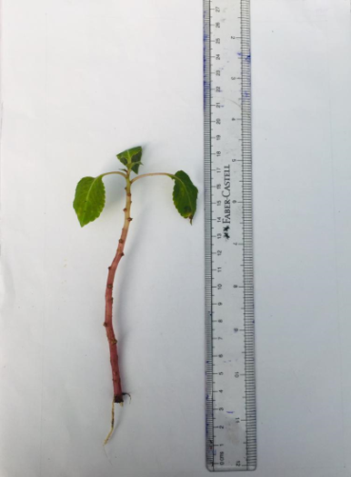
Impatiens cuttings (length of roots)
19
Treatment 1
Treatment 2
Treatment 3
Treatment 4
Treatment 5
Treatment 6
Treatment 7
Treatment 8

Slide 20
Conclusion and Recommendations
Moringa leaf extract is better than rooting hormone to increase root characteristics such as root length, number of roots and dry weight of roots of Salvia, Henckelia and Impatiens cuttings. Both Moringa leaf and garlic clove extracts are better than rooting hormone to increase shoot characteristics such as length of the shoot of Salvia, Henckelia and Impatiens cuttings. So the present study revealed that Moringa leaf extract (MLE) and garlic clove extract (GCE) can substitute commercially available rooting hormone in propagation of Salvia, Henckelia and Impatiens stem cuttings.

Slide 21
References
Abdel-Rahman, S., Abdul-Hafeez, E. and Saleh, A. (2020) ‘Improving Rooting and Growth of Conocarpus Erectus Stem Cuttings Using Indole-3-Butyric Acid (Iba) and Some Biostimulants’, Scientific Journal of Flowers and Ornamental Plants, 7(2), pp. 109–129. Available at: https://doi.org/10.21608/sjfop.2020.96213.
Eid, A.-A., Nomier, S., Ibrahim, M., & Gad, M. (2018). Effect of Some Natural Extracts, Indolbutiric Acid and Naphthalene Acetic Acid on Rooting of Picual Olive Cuttings. Zagazig Journal of Agricultural Research, 45(1), 119–136.
Hayat, S., Ahmad, H., Ali, M., Hayat, K., Khan, M. A., & Cheng, Z. (2018). Aqueous garlic extract as a plant biostimulant enhances physiology, improves crop quality and metabolite abundance, and primes the defense responses of receiver plants. Applied Sciences (Switzerland), 8(9).

Slide 22
Emmanuel, I.B. (2016) ‘Scientia Agriculturae Food demand forecast for Food demand forecast for Nigeria ( 2016-2028 )’, Scientia Agriculturae, 13(1), pp. 10–13.
Rubasinghe, M., Amarasinghe, K., & Krishnarajha, S. (2009). Effect of Rooting Media, Nephtheline Acetic Acid and Gibberelic Acid (GA₃) on Growth Performances of Chirita moonii. Ceylon Journal of Science (Biological Sciences), 38(1), 17.
Lanka, S. (2016). Synthetic Seed Production in. 1–7.

Slide 23
Thank you…

