Slide 1
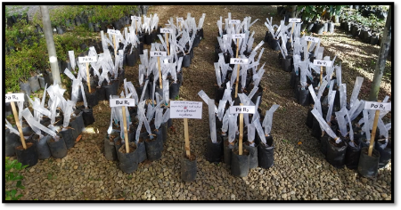
Effect of Different Wrapping Material on Grafting of ‘Ber’(Masan) (Ziziphus jujuba Mill.)
GMMD Muhandiram: Department of Export Agriculture, Faculty of Agricultural Sciences, Sabaragamuwa University of Sri Lanka.
PK Dissanayaka : Department of Export Agriculture, Faculty of Agricultural Sciences, Sabaragamuwa University of Sri Lanka.
DGPS Delpitiya : Fruit crop Research and Development station, Gannoruwa, Peradeniya, Sri Lanka.

Slide 2
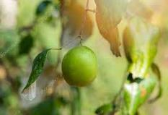
Content
Introduction
Problem statement
Objectives
Methodology
Results and discussion
Conclusion
Suggestions
Acknowledgment
References

Slide 3
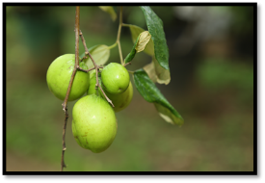
Introduction
Ber - Ziziphus jujuba Mill.
Family - Rhamnaceae
Ber is believed to have originated in Indo – Malaysian region of South – East Asia.
Ber is considered an underutilized fruit crop in Sri Lanka.
In Sri Lanka Ber is widely spread in Kurunegala, Puttlam, Hambanthota, Mathale, Polonnaruwa, and Trincomalee districts.
It is a nutritious fruit, rich in the vitamins B, C, and beta-carotene.

Slide 4
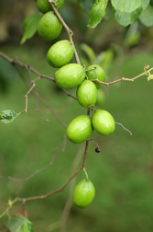
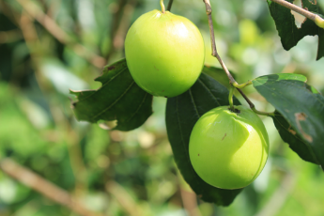
Problem Justification
Ziziphus mauritiana
Ziziphus jujuba
Ziziphus mauritiana Lam.(Masan) is a commonly found Species in Sri Lanka.
Department of Agriculture’s Recommended variety.
“Green big”
4

Slide 5
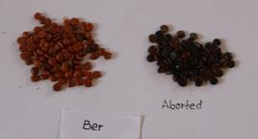
To get true-to-type plant
Vegetative Propagation
Ber is cross-pollinated plant.
Ber seeds are aborted when mature
Wedge grafting is the most common and easiest method.
Wrapping is one factor that affects the success of grafting. It is essential to combine the rootstock and scion.

Slide 6
Objective
To find the most effective wrapping material for the grafting of ber (Ziziphus jujuba Mill.) by comparing the successfulness of the grafting.

Slide 7
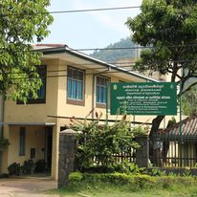
Methodology
1. Location
Fruit crop research and development station, Gannoruwa, Peradeniya.
It is located in Mid Country Wet Zone in Sri Lanka. (WM2b)
Reddish Brown Latosolic soil is the main soil type in the experimented area.
Fruit Crop Research and Development station

Slide 8
2. Experimental Details
The experimental design was,
Complete Randomize Design (CRD).
With four treatments and Four Replicates.
There are twenty plants per treatment.
Table 1 : Treatment of experiment
Treatment | Description of wrapping materials
Treatment 1 (T1) | Transparent Polythene Tape (Gauge 300)
Treatment 2 (T2) | Grafting Tape
Treatment 3 (T3) | Para film grafting Tape
Treatment 4 (T4) | Poly sac Tape

Slide 9
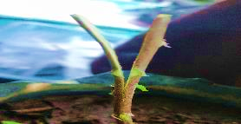
Method
Preparation of Rootstock
.
Six-month-old local varieties of Ziziphus mauritiana seedlings
Rootstock
Selected healthy and quality Ber seedlings as rootstocks.
Cut the tops of the rootstocks at a height of 15-20 cm.
The apical portion of the stems splited vertically into "V"-shaped sections about 4-5 cm in length

Slide 10
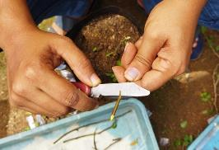
Preparation of scions
Scions
“Green Big” (Ziziphus jujuba Mill)
The scions were about 15 cm -18 cm long and pencil thickness. Scions were taken from the terminal, one–season–old scions with three to four healthy buds.
Selected healthy and quality scions for grafting.
Cut the basal ends into V –shaped wedge ( it’s about 4-5 cm).

Slide 11
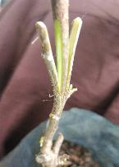
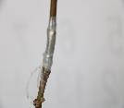
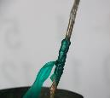
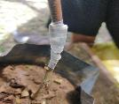
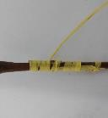
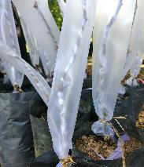
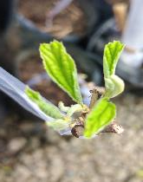
The Wedge – shape scion.
The graft was tightly wrapped by wrapping tapes.
Rootstock with V – shape slit.
Insert the scion into the rootstock
Polythene Tape
Grafting Tape
Para film grafting Tape
Poly-sac Tape
After three weeks, propagators were removed when new growth appears.
Covered the grafted plant with individual propagators.

Slide 12
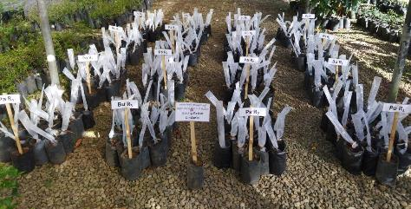
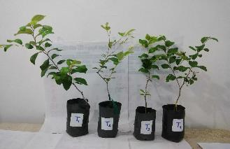
Data collection
The following parameters were checked,
Days taken to first sprouting
Shoot height per week
Shoot height (After 9 week of grafting)
Total number of shoots (After 9 weeks of grafting
Total number of leaves (After 9 weeks of grafting)
Percentage of bud emergence (%) (After two weeks of grafting)

Slide 13
Data Analysis
Data analysis was done at 5 % significant level with analysis of variance (ANOVA). Mean separation was done with the Least Significant Difference test(LSD).

Slide 14
Results and Discussion

Slide 15
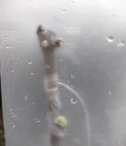
1.1 Percentage of bud emergence
a
a
b
b
Figure 1 : Variation of the bud emergence percentage among the treatments (After 2 weeks of grafting)
The wedge grafting reported a 72.5% success rate with semi-hardwood scion. (Jayawardene et al., 2013)

Slide 16
P < 0.05
Significant
1.2 Bud emergence with time
Figure 2 : Variation of bud emergence with time

Slide 17
P (0.0093) < 0.05
Significant
1.3 Total Number of Shoots
a
a
b
b
Figure 3 : Variation of total number of shoots among the treatments (After 9 weeks of grafting)

Slide 18
1.5 Total Number of Leaves
P < 0.05
Significant

Slide 19
1.5 Average shoot growth with time
Figure 5 : Variation of average shoot growth among the time (2nd week to 9th week after grafting)

Slide 20
1.6 Average shoot Height
P < 0.05
Significant
Figure 6 : Variation of average shoot height among the treatments (9th week after grafting)

Slide 21
Conclusion
The percentage of bud emergence, The total number of shoots, and the Total Number of leaves in Polythene Tape and poly-sac Tape were significantly better than the others.
The average shoot growth was not significantly different among all the treatments.
At the 9 weeks after grafting, Polythene tape and poly sac tapes showed good performance. Compared to the cost and performance, the use of poly sac tape is recommended for the farmer level.

Slide 22
Suggestions
Extend the study
Experimental Area
Doing the Experiment under the control environment instead of a Net house.
Various sizes of individual propagators are used with the same wrapping tapes.
Check the performance of semi-hardwood and hardwood scions of Ber.

Slide 23
References
Anonymous (1981) Project Report 1976-1980. All India Coordinated Fruit Improvement Project, Coordination Cell III, ICAR, India. Technical Document No. 1: 6-8, 35
Azam-Ali, S.(2006) Ber and other jujubes, Southampton Centre for Underutilised Crops. Southampton.
Jayawardena,A.A.M., Ketipearachchi,K.W. and Devasinghe,D.A.U.D .,(2013). Evaluation of promising vegetative propagation techniques of ‘Ber’ , pp.6-13.
Liu, M. (2010) Chinese Jujube: Botany and Horticulture, Horticultural Reviews.
Pareek, S. (2013) ‘Nutritional composition of jujube fruit’, Emirates Journal of Food and Agriculture, 25(6), pp. 463–470.
Sapkota and Sundar (2020) ‘Prospects and Significance of Chinese Jujube ( Ziziphus jujuba ) in New Mexico : A Review’, 54(1), pp. 21–35
Sherani, J. (2021) ‘Local Rootstock of Ber (Ziziphus mauritiana L) Grafted with Advanced Scion Cultivars Improved Fruit Yield and Quality under Arid Conditions’, Sarhad Journal of Agriculture, 37(2), pp. 492–499.

Slide 24
Acknowledgment
Internal supervisor Prof. P.K.Dissanayaka, Senior Lecturer, Department of Export Agriculture, Faculty of Agricultural Sciences.
External supervisor Mrs. G.D.P.S.Delpitiya, Assistant Director (Research), Fruit crop Research and Development Station, Gannoruwa, Peradeniya.
Dr. Aruna Kumara, Head, Department of Export Agriculture, Faculty of Agricultural Sciences.
Miss .D.D.M.O.Dissanayake , Lecturer (Prob.), Department of Export Agriculture, Faculty of Agricultural Sciences.
Everybody who helped me.

Slide 25
Thank you..

