Slide 1
Effect of Different Potting Mixtures on Growth of Cinnamon (Cinnamomum zeylanicum Blume) Seedlings
M.P.S.Rumeshika
16AGA1294
Module Agri Environmental Resource Management
Department of Export Agriculture
Faculty of Agricultural Science
Sabaragamuwa university of Sri Lanka
Internal Supervisor:
Prof. P.I.Yapa Department of Export Agriculture
Faculty of Agricultural Sciences
Sabaragamuwa University of Sri Lanka
External Supervisor:
K.H.G.M.Tharanga
Deputy Director (Research) Soil and Plant Nutrition Division National Cinnamon Research and Training Centre

Slide 2
Content for the presentation
Introduction
Research problem
Objectives
Material and Methods
Results and Discussion
Conclusions
Suggestion
References

Slide 3
Introduction
Cinnamon- Cinnamomum zelanicum Blume
Family- Lauraceae
Most economically important, perennial, spice crop

Slide 4
Research Problem
The use of the correct potting mixture is fundamental to produce a healthy plant.
DEA recommended potting media of the nursery for cinnamon:
Top soil: cow dung: coir dust: sand (1:1:1:1)
Unavailability of adequate amounts of major potting mixture components in study area, especially quality top soil.
Therefore farmers use the subsoil instead of the top soil, however it is lacking with nutrients.
Sub soil was used with different organic materials half burnt paddy husk, concentrated microbial solution (CMS),and cow dung solution

Slide 5
Objectives
To evaluate the effect of different type of organic potting mixtures on growth of cinnamon seedlings.

Slide 6
Material and Methods
Location
Experimental design
3.Preparation of pots
4.Preparation of Concentrated Microbial Solution (CMS) and application
5.Preparation of cow dung solution and application
6.Preparation of Microorganism culture
7.Data collection
8.Data analysis

Slide 7
1.Location
National Cinnamon Research and Training Centre of the Department of Export Agriculture, Palolpitiya, Thihagoda, Matara.
During the period: August –December in year 2022
Annual rainfall- about 2147mm
Average temperature-26.8℃.

Slide 8
2.Experimental design
Experimental design was Randomized Complete Block Design (RCBD) with 6 treatments and four replicate.

Slide 9
Treatments | Description of treatment
T1 T2 | Top soil: Coir dust: Cow dung: Sand (1:1:1:1) (Department Recommendation) Sub soil :Half burnt paddy husk (6:1):Concentrated Microbial Solution (CMS) (20%): Cow dung 30%
T3 | Sub soil :Half burnt paddy husk (9:1):Concentrated Microbial Solution (CMS) (20%): Cow dung 30%
T4 | Sub soil :Half burnt paddy husk (6:1): Concentrated Microbial Solution (CMS)(30%): Cow dung 30%
T5 | Sub soil :Half burnt paddy husk (9:1): Concentrated Microbial Solution (CMS)(30%): Cow dung 30%
T6 | Sub soil: Cow dung 30%

Slide 10
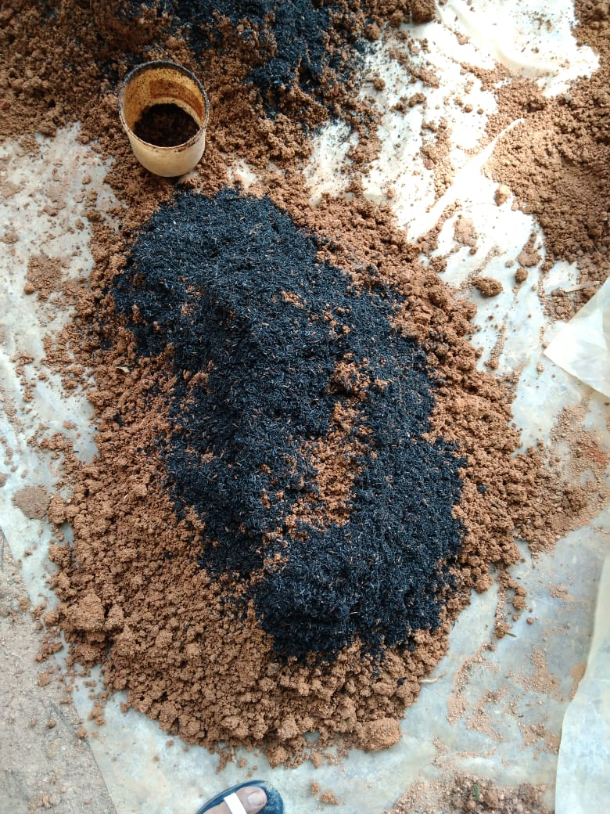
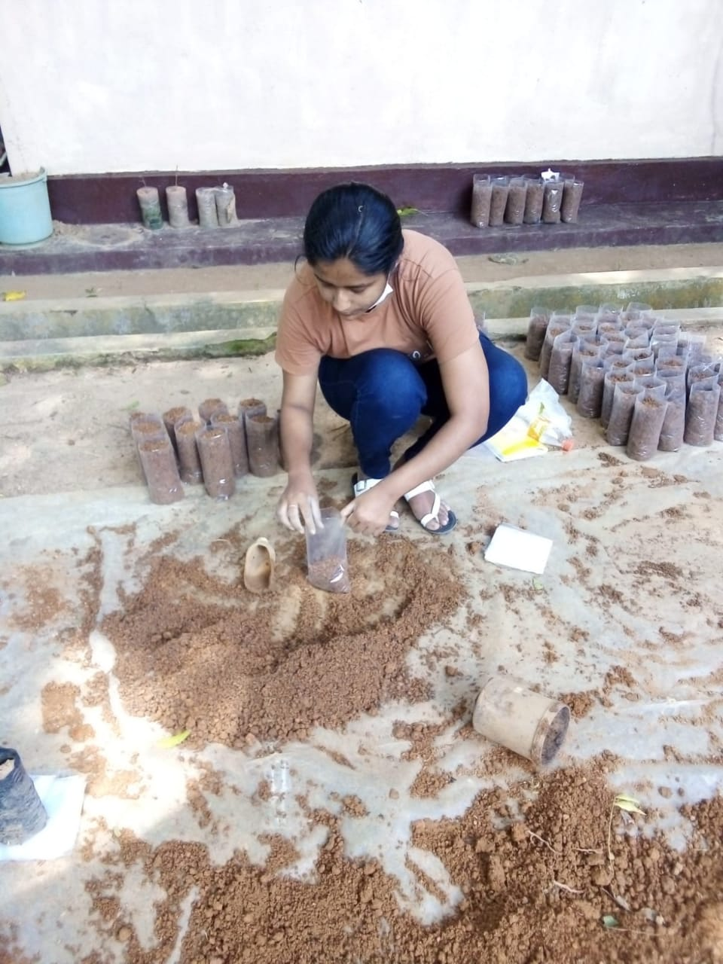
3.Preparation of pots
Nursery pots were filled with potting mixtures Seeds were planted

Slide 11
4.Preparation of Concentrated Microbial Solution (CMS) and application
Ingredients
4 kg of gliricidia leaves
4 kg of brown sugar
1kg of cow dung
Hand full of topsoil from the natural forest cover, with 200L of water(Pathiranage et al., 2022)

Slide 12
5.Preparation of cow dung solution and application
Cow dung (30%) solution was prepared by using cow dung with water. 1.7kg of fresh cow dung was mixed with 5.4L of water to make a cow dung solution.
30ml of solution was added to each nursery pot of T2, T3, T4, T5,
T6 treatments.

Slide 13
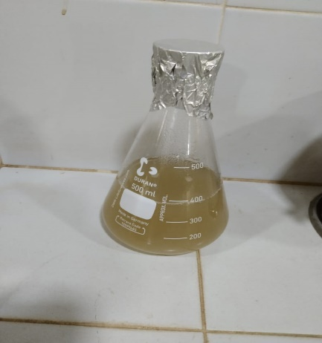
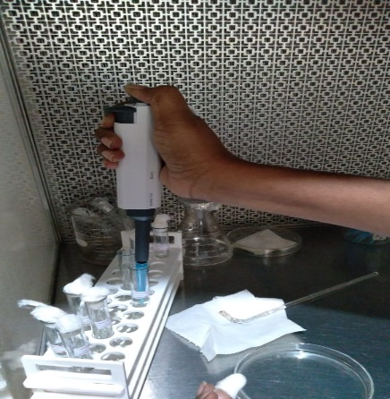
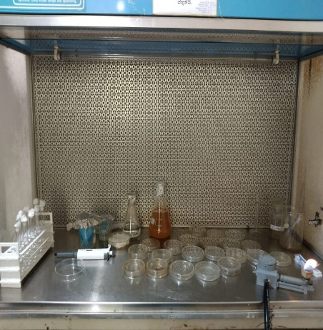
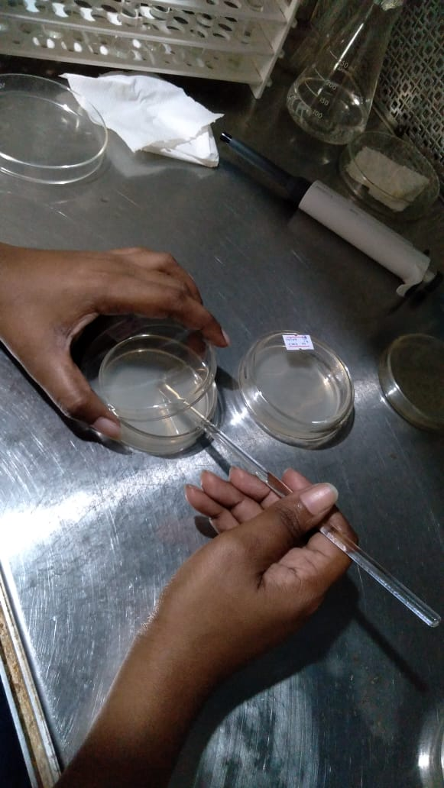
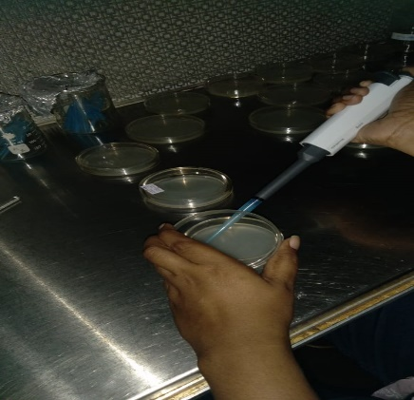
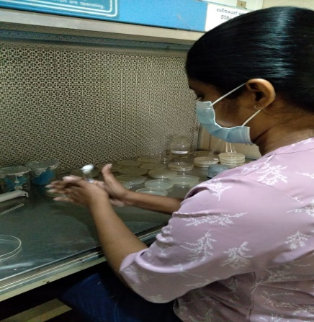
6.Preparation of Microorganism culture
Preparation of media Materials required to culture Serial dilution
Sample was spread by using spreader 0.5ml of aliquot transferred into petri plates
Preparation of Serial dilution

Slide 14
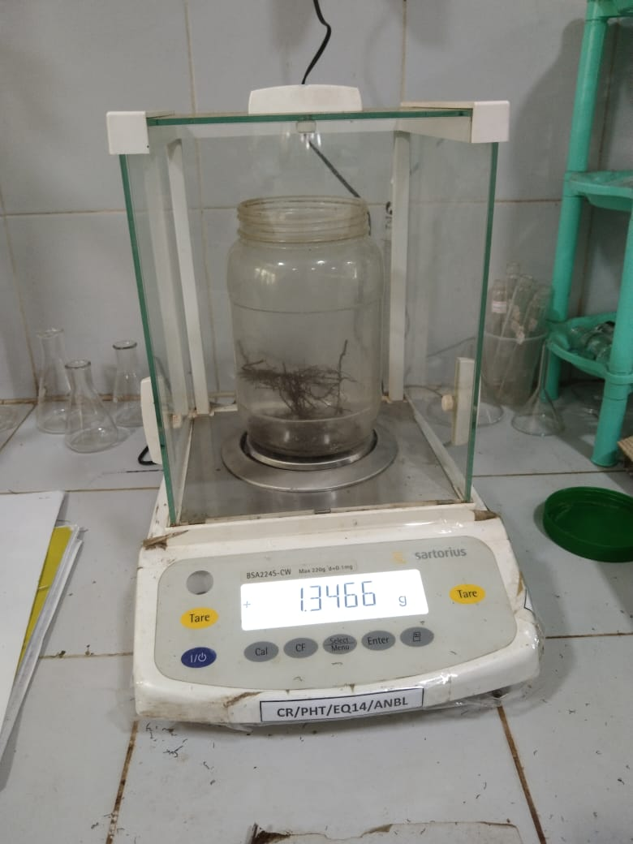
7.Data collection
Seed germination percentage(%)
Growth parameters
Plant height (cm)
Leaf area (cm2)
Tap root length (cm)
Dry weight of above ground biomass (g)
Dry weight of below ground biomass (g)
Pest and diseases
Dry weight of below ground biomass was measured

Slide 15
7.Data collection
Soil parameters
pH
EC
Total Nitrogen (N)
Available Phosphorus (P)
Exchangeable Potassium (K)
pH ,EC and nutrient content (N,P,K) were measured in 30% Cow dungs solution and CMS at the time of application at once.

Slide 16
8.Data Analysis
Data analysis – 5% significant level with analysis of variance (ANOVA) (Statistical Analysis Software (SAS) version 9.0)
Mean separation –DUNCAN test
Microsoft Excel (2013) -Present data

Slide 17
Result and Discussion

Slide 18
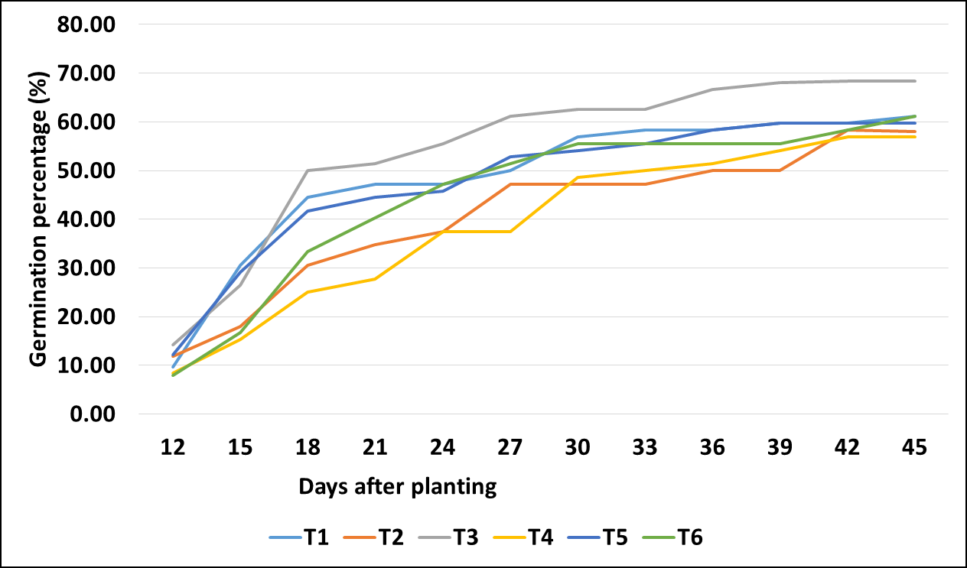
Seed germination percentage (%)
Figure 1 : variation of germination percentage with days after planting

Slide 19
Plant Height (12 week after planting -12WAP)
Significant=P<0.05
Figure 2: variation of mean plant height with treatments

Slide 20
Leaf area (12WAP)
Significant=P<0.05
Figure 3: variation of mean leaf area with treatments

Slide 21
Dry weight of below ground biomass (12WAP)
Significant=P<0.05
Figure 4: variation of mean dry weight of below ground biomass with treatments

Slide 22
Dry weight of above ground biomass (12WAP)
Significant=P<0.05
Figure 5: variation of mean dry weight of above ground biomass with treatments

Slide 23
Tap root length (12WAP)
Significant=NS
Figure 6: variation of mean tap root length with treatments

Slide 24
Pest and Disease
Figure 7: variation of pest and disease (%) with treatments

Slide 25
Analysis of soil chemical properties in final potting mixture
Available phosphorus in final potting mixture(mg/kg)
Exchangeable potassium in final potting mixture (mg/kg)
Figure 9: variation of exchangeable potassium with treatments
Figure 8: variation of available P with treatments

Slide 26
Analysis of soil chemical properties in final potting mixture cont..
pH in final potting mixture
Electrical conductivity in Final potting mixture (dc/cm)
Figure 10: variation of soil pH with treatments
Figure 11: variation of EC with treatments

Slide 27
Analysis of soil chemical properties in final potting mixture cont..
Total nitrogen (%) in final potting mixture
Figure 12 : variation total nitrogen (%) with treatments

Slide 28
Daily variation of the Bacteria colony count were recorded in CMS from first day of CMS preparation up to 14 days
Figure 13: Daily variation of CFU in CMS

Slide 29
Analysis of CMS and Cow dung solution
 | Nitrogen (%) | Phosphorus (ppm ) | Potassium (ppm ) | pH | EC (µs/cm)
CMS | 0.0308 | 1 | 19.36624 | 2.99 | 1544
Cow dung | 0.2184 | 1.5 | 27.83897 | 6.74 | 1983

Slide 30
Conclusions
Department of Export Agriculture (DEA) recommended potting mixture was the best for the considered growth parameters.
Department of Export Agriculture recommended potting mixture could not be substituted by tested nursery media.
However treatment sub soil: half burnt paddy husk (6:1): 20% CMS: 30% cow dung solution(T2) showed highest data on plant height, leaf area and dry weight of below ground biomass out of the considered potting mixtures except DEA mixture.

Slide 31
Conclusions cont…
The amount of nutrient applied to the pots would be the reasons for poor growth of cinnamon seedlings.
There by T2 has the potential to be developed as an alternative potting mixture instead department recommendation.
The best time for application of CMS is 11 to 14 days after preparation.

Slide 32
Suggestion
Further study are needed to enhance the Nutrient amount of the potting media for healthy cinnamon seedlings.

Slide 33
Reference
Agarwal, P., Saha, S. and Hariprasad, P., 2021. Agro-industrial-residues as potting media: physicochemical and biological characters and their influence on plant growth. Biomass conversion and biorefinery, pp.1-24.
Bilderback, T.E., Riley, E.D., Jackson, B.E., Kraus, H.T., Fonteno, W.C., Owen Jr, J.S., Altland, J. and Fain, G.B., 2013. Strategies for developing sustainable substrates in nursery crop production. Acta Hortic, 1013, pp.43-56.
Pathiranage, S.S.S., Tharanga, K.H.G.M. and Ampitiyawatta, A.D., 2022. Evaluation of Organic Inputs in Cinnamon (Cinnamomum zeylanicum Blume) Nursery Media along with Subsoil as Alternative Potting Mixture.

Slide 34
Acknowledgement
Internal supervisor-Prof. P.I.Yapa ,Department of Export Agriculture, Faculty of Agricultural Science, Sabaragamuwa University of Sri Lanka
External supervisor- Mrs.K.H.G.M.Tharanga,Deputy Director(Research), Soil and Plant Nutrition Division, National Cinnamon Research and Training Center.
Miss. D.D.M.O.Dissanayake, Lecture, Department of Export Agriculture, Sabaragamuwa University of Sri Lanka.
Dr. G.E.M Wimalasiri, Module coordinator, Department of Export Agriculture, Faculty of Agricultural Sciences, Sabaragamuwa University of Sri Lanka
Dr. J.B.D.A.P Kumara, Head, Department of Export Agriculture, Faculty of Agricultural Sciences, Sabaragamuwa University of Sri Lanka
Prof. P.M.A.S Karunaratne, Dean, Faculty of Agricultural Sciences, Sabaragamuwa University of Sri Lanka
Family, teachers, friends, batch mates and for all those who supported me.

Slide 35
Thank You

